Slide 1
Hierarchical Methods For Multi Partially Overlapped Social Network De-anonymization
张宇澄 517021910431
2020.6.3

Slide 2
目录 Contents
1
Introduction
2
Node-feature-aware Graph Matching
3
Hierarchical Multi Network De-anonymization
4
Experiments
5
Conclusion and Future Work

Slide 3
目录 Contents
1
Introduction
2
Node-feature-aware Graph Matching
3
Hierarchical Multi Network De-anonymization
4
Experiments
5
Conclusion and Future Work

Slide 4
Motivation
In real social network platforms, there may not exist one platform that can cover all the users.
Two social network may only partially overlap.
A large number of social networks.
Social network is not only about the connections between users. Each user has its own inherent characteristics (e.g. preference for a certain topic; behavioral habits).

Slide 5
Introduction
Each node has a d-dimension feature vector.

Slide 6
目录 Contents
1
Introduction
2
Node-feature-aware Graph Matching
3
Hierarchical Multi Network De-anonymization
4
Experiments
5
Conclusion and Future Work

Slide 7
Feature-aware graph matching
Each node has a d-dimension feature vector.

Slide 8
Feature-aware two-graph matching
the i-th node in A has a feature vector f_{i}^{A}
the j-th node in B has a feature vector f_{j}^{B}
Distance matrix D
If (i, j) is a correct match, $D_{ij }$is small with a high probability
If (i, j) is a wrong match, $D_{ij }$is large with a high probability

Slide 9
Feature-aware graph matching
Matching matrix P
Ground Truth P*

Slide 10
Feature-aware graph matching
Step 1
Step 2 Filter out the wrongly match pairs

Slide 11
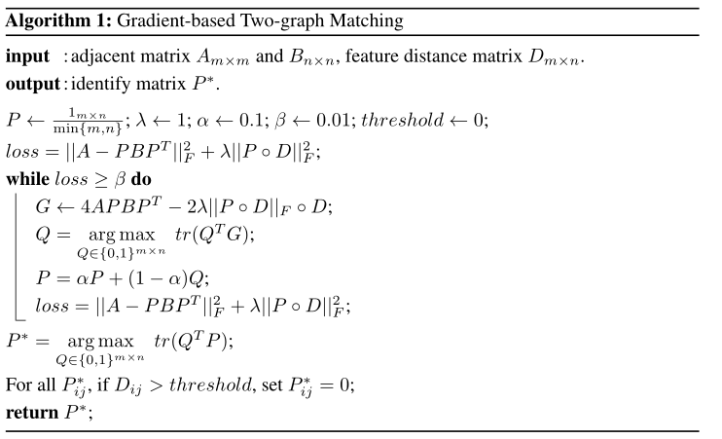
Gradient Descent Based Algorithm

Slide 12
Conditions for correct matching

Slide 13
Conditions for correct matching
If d is O($n^{α}$), we can even match just use node features.
However, this is not practical. We suppose that d is a constant.

Slide 14
目录 Contents
1
Introduction
2
Node-feature-aware Graph Matching
3
Hierarchical Multi Network De-anonymization
4
Experiments
5
Conclusion and Future Work

Slide 15
Center-Peripheral Structure
Central Graphs
This part contains two or three graphs which has the most
nodes.
We hope the union of nodes in central graphs will cover as
more nodes as possible while using the minimum number
of graphs.
Peripheral Graphs
The rest of graphs will be put into peripheral part.
They have less nodes than central graphs.

Slide 16
Peripheral Graphs
G5
Central Graphs
G2
G6
G1
G3
G4

Slide 17
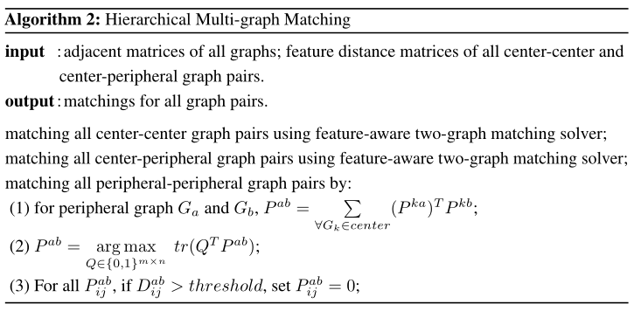
Matching Algorithm

Slide 18
Intuition and Advantages
Intuitions
In multi-graph matching, consistency means correctness.
Matching with graphs with more nodes will make the matching more accurate.
Advantages
More accurate than directly matching two peripheral graphs.
Our method is faster. If there are 2 central and (n-2) peripheral graphs, we only need to match 2n times rather than n(n-1)/2.
Scalability for online matching. If there comes a new small graph, just add it to peripheral part.

Slide 19
目录 Contents
1
Introduction
2
Node-feature-aware Graph Matching
3
Hierarchical Multi Network De-anonymization
4
Experiments
5
Conclusion and Future Work

Slide 20
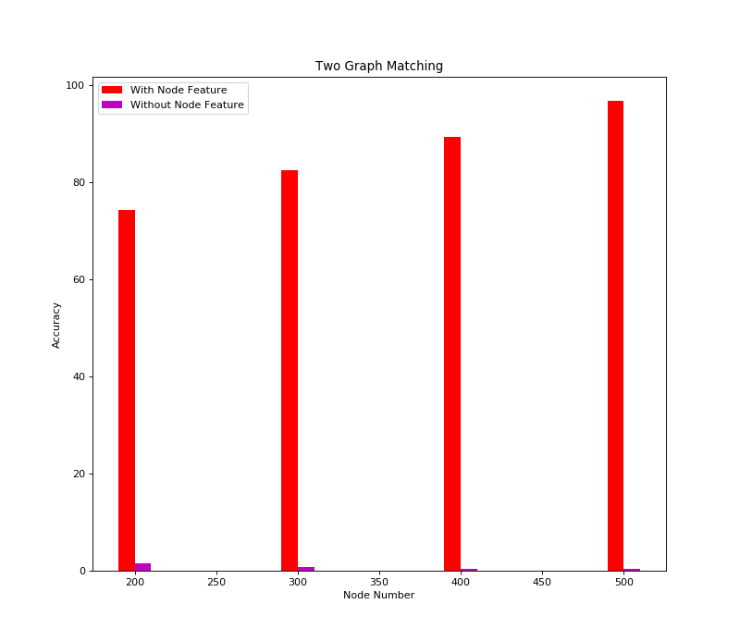
With Feature VS Without Feature
We do experiments on synthetic data
s = 1.0
p = 0.05
λ = 1.0
d = 5
$t_{1}$=0.9
$t_{2}$=0.2

Slide 21
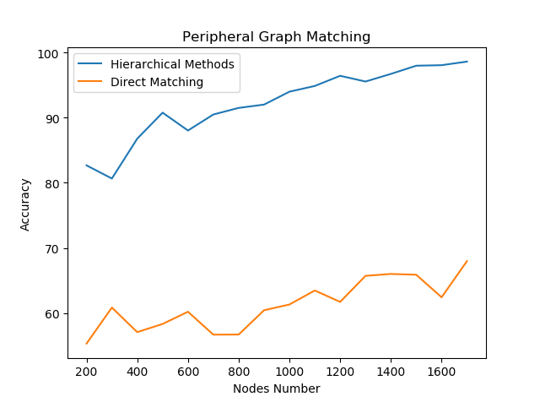
Hierarchical Methods VS Direct Matching
s = 1.0
p = 0.05
λ = 1.0
d = 5
Central Graphs
$t_{1}$=0.9
$t_{2}$=0.9
Peripheral Graphs
$t_{3}$=0.2
$t_{4}$=0.2

Slide 22
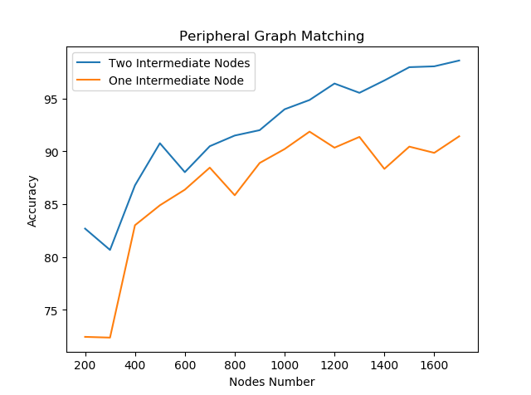
Two Intermediate VS One Intermediate
s = 1.0
p = 0.05
λ = 1.0
d = 5
Central Graphs
$t_{1}$=0.9
$t_{2}$=0.9
Peripheral Graphs
$t_{3}$=0.2
$t_{4}$=0.2

Slide 23
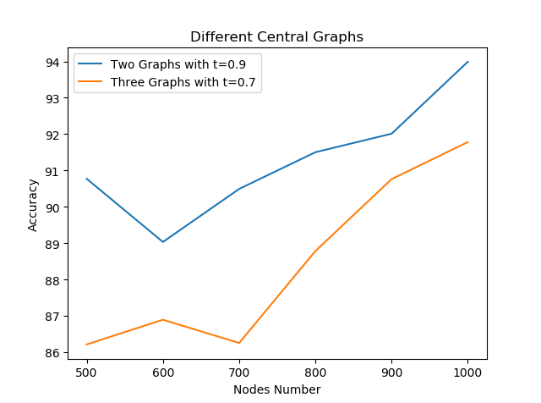
2 Graphs with t=0.9 VS 3 Graphs with t=0.7
s = 1.0
p = 0.05
λ = 1.0
d = 5
Central Graphs
$t_{1}$=0.9
$t_{2}$=0.7
Peripheral Graphs
$t_{3}$=0.2
$t_{4}$=0.2

Slide 24
目录 Contents
1
Introduction
2
Node-feature-aware Graph Matching
3
Hierarchical Multi Network De-anonymization
4
Experiments
5
Conclusion and Future Work

Slide 25
Conclusion
When matching two partially overlapped graphs, taking nodes’ features into consideration is a better method.
We come up with a hierarchical structure for multi social network de-anonymization.
Experiments show our proposed method performs very well on generated data.

Slide 26
Differences with Prior Work
Ehsan Kazemi, Lyudmila Yartseva, and Matthias Grossglauser. 2015.
When Can Two Unlabeled Networks Be Aligned Under Partial
Overlap? .In Allerton Conference on Communication.

Slide 27
Future Work
Online Matching
Future work may take the change of each platform’s user number
into consideration.
There may be new users for social networks.
Small platforms may grow larger while large platform may decline.
All platforms are too small
In this work, we have an assumption that the top 2 or 3 platforms
will cover most of the latent nodes. But what if the biggest
platform only contains less than 50% of total nodes?

Slide 28
Thanks！

