Slide 1
Robust Seed Selection for Influence Maximization Problem
517021910416 丁雨成
2020/06/01

Slide 2
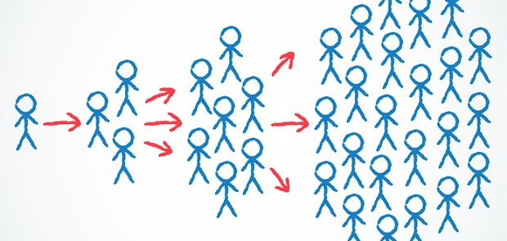
Background
Influence spread over social networks
Word-of-mouth effect
seed
Select k initial nodes to maximize the final influenced size

Slide 3
Introduction
Some of the initial nodes are not successfully activated. (e.g., refuse to spread the information)
As the information diffusion progresses, the diffusion efficiency decreases.

Slide 4
Problem Formulation
Notations
Social influence graph G(V, E)
Influence function $F$
Initial seed size $k$
Inactivated seed size $m (m≤k−1)$
Dynamic independent cascade model
Edge (u, v) has an original propagation probability p(u, v)
A discrete time model
Attenuation coefficient $δ<1$
At the $r$-th round, each newly activated node u independently activates its out-neighbor v with probability p(u, v) * $δ^{r−1}$

Slide 5
Problem Formulation
Objective
Robust seed selection → max-min problem

Slide 6
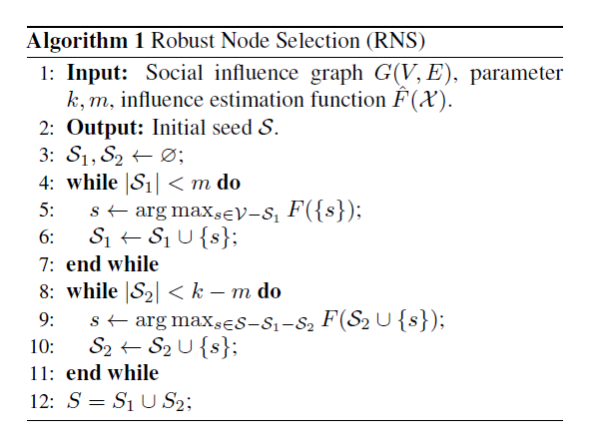
Algorithm Design
Find $m$ nodes with maximum influence
Aims to increase robustness
Find $k−m$ nodes with marginal maximum influence
Greedy algorithm, simulate the “max” process

Slide 7
Influence Estimation
For each node $v$, estimate the probability of $u$ being activated
Probability of $v$ being activated at the $r$-th round: $I_{v}^{r}$
First part: $v$ was not activated at the first $r−1$ rounds
Second part: $v$ was activated at the $r$-th round by its neighbour, who were activated at the $(r−1)$-th round

Slide 8
Influence Estimation
The efficiency of information diffusion decreases with time
$r$ → $+∞$, $I_{v}^{r}$ → 0
Only calculate $I_{v}^{r}$ in the first $t$ rounds
Bounded error
Estimated influence function, denoted as $\hat{F}$

Slide 9
Approximation Ratio
Lemma 1: The influence estimation function $\hat{F}$ is submodular
Lemma 2:
Lemma 3:
Lemma 4:
Theorem:

Slide 10
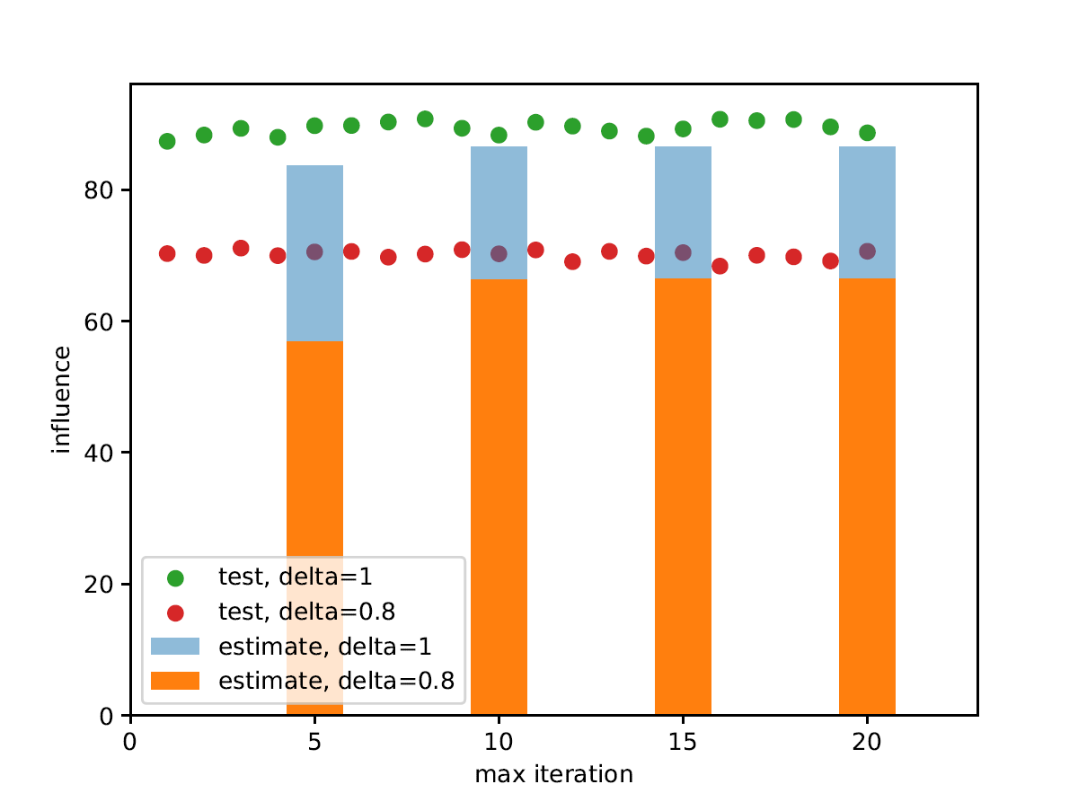
Evaluation
Influence estimation test

Slide 11
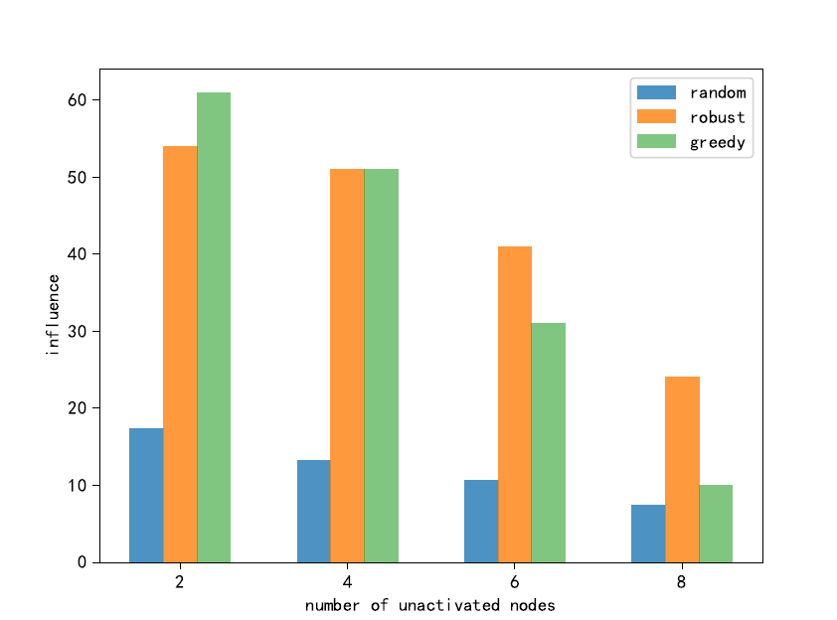
Evaluation
Robust seed vs Random seed vs Greedy Alg.
original seed → delete some nodes to minimize the influence

Slide 12
Future Work
Some of the initial nodes spread negative information?
New activation rules
At the $r$-th round, node u activates its out-neighbor v with probability p(u, v) *$f(r)$?
Based on the real situation

Slide 13
Thanks

