Slide 1
Context-Aware Citation Recommendation
Junjie Wang

Slide 2
Directory
Introduction
  Task Analysis
  Background
Baseline
Contributions
  Proposed Network
  Proposed Inference Pipeline
Experiments
Difficulties and Future Work

Slide 3
Introduction
Task Analysis:
  Different from recommender systems such are movie recommender system where we often use techniques like collaborative filtering, dealing with user matrix and item matrix, here we focus on citation recommendation given a specific context. And based on such citation recommendation, we consider to recommend potential cooperators with similar interests.
Background
  Vast plethora of scientific literature makes searching for relevant work time consuming and highly keyword dependent(i.e. word usage between citation context and cited document may be quite different, leading to a mismatch between predefined keywords).
  Following the proceedings of well-known conferences restricts the scope of related work.
  The meaning of words may vary through time(e.g. deep learning), important to consider semantic information when performing citation recommendation.

Slide 4
Introduction
Context: “find a distribution over the latent variables that is close
to the posterior of interest. Variational methods provide effective
approximation in topic models and nonparametric Bayesian models. “
Recommendations:
1. Graphical models, exponential families, and variational inference
2. An introduction to variational methods for graphical models

Slide 5
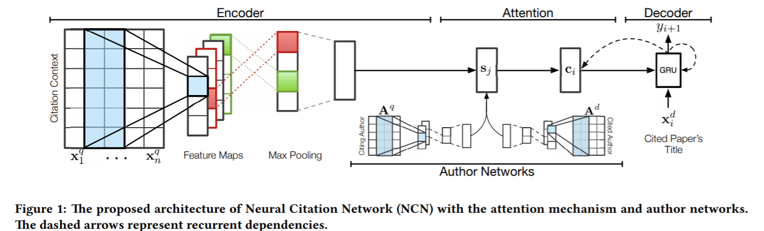
Baseline
Each column is a single
word embedding
Use max-pooling,
yield a scalar for
one region size in context
Similar encoder-decoder
structured network,
but different weights
Use one-dimension
convolution

Slide 6
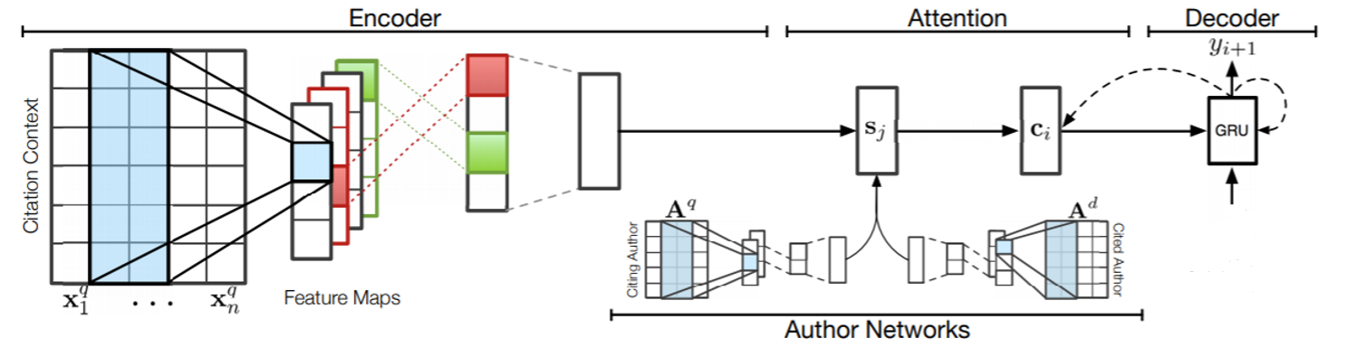
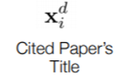
Proposed Network
projection
avg pooling
one-dim conv
Why average pooling: information from all windows are useful
Why projection before fusing the outputs of context encoder and decoder: features from two spaces may be quite different
Why one-dimensional convolution instead of recurrent neural networks?
1. Many papers have pointed out that convolution can obtain similar performance with less computation
2. Explicit model spatial relationships with multiple strides

Slide 7
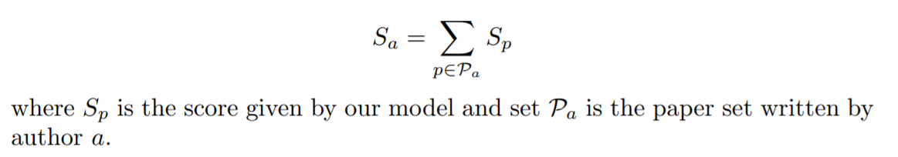
Proposed Inference Pipeline
Select the candidates based on information retrieval methods
Motivation:
1. Extremely slow inference speed when the database is large, since we need to compose incoming context query
with each existing title and perform a forward pass through the network
2. IR methods are also widely used baselines
Author recommendation:
It does not make sense to use neural networks to recommend authors
Recommend the author directly based on paper recommendation results, define the score of the author

Slide 8
Proposed Inference Pipeline
Incoming context
Our Model
Paper Scores
Citation Recommendation
Paper Pool
IR (e.g. bm25)
Candidates
Author Scores
Collaborator Recommendation

Slide 9
Experiments
Refseer Dataset
http://refseer.ist.psu.edu/data/
4,549,267 context pairs with 855,735 papers in a citation-cited relation. In this paper, they divide the data by year, before, after and equal to 2013, yielding 4,258,383 training; 148,927 testing; and 141,957 validation citation contexts respectively

Slide 10
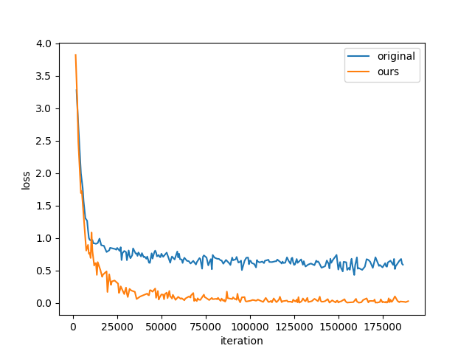
Experiments
Training loss curve
Results Released In Baseline Paper
 | MAP | MRR
CTM | 0.0726 | 0.0777
Baseline(NCN) | 0.2418 | 0.2667
Large Gap
Results in my implementation
 | MAP | MRR
Baseline | 0.0172 | 0.0224
- | - | -

Slide 11
Difficulties And Future Work
Many details in the baseline method and preprocessed dataset are lost(e.g. the mapping between words and one-hot vocabulary) -> take a long time to reproduce the baseline results
Future:
  Find the mapping between the words and one-hot vocabulary and implement the proposed pipeline.
  May ensemble the model into a web application and provide an interface.
  May construct graphs and use graphs to learn more appropriate embeddings( previously considered but cost much more computation and no good idea)

Slide 12
That’s all! Thank you!

