Slide 1
Final Project Display
By 曹昕哲 Xinzhe Cao 517030910283
周 凡 Fan Zhou 517030910305
刘瀚文 Hanwen Liu 517030910294
花泽宇 Zeyu Hua 517030910277
Notes:
Good afternoon everyone. I’d like to introduce our team members: Caoxinzhe, Zhoufan, Liuhanwen and myself.

Slide 2
Contents
01
02
03
04
Xinzhe Cao
Fan Zhou
Zeyu Hua
Hanwen Liu
Introduction
Main website
D3.js
Force-Directed Graph
Recommendation
Acceleration
UI Design
Elasticsearch
Notes:
Our division of work has been listed on the screen.
First, let’s extend our warm welcome to Caoxinzhe, who will give us a general idea of our project.
[!Turn the page!]

Slide 3
01
Xinzhe Cao

Slide 4
02
Fan Zhou

Slide 5
D3.js
D3
Data-Driven Documents
D3.js
JavaScript Library
Produces dynamic interactive data visualization in web browsers
Function
Can be used to create many examples based on the data we want to exhibit in our website

Slide 6
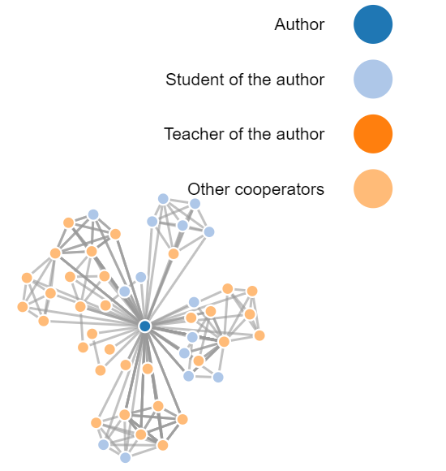
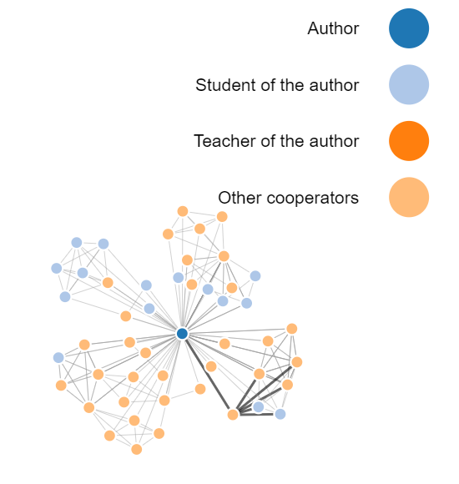
Force-Directed Graph
Be used to show the cooperation relationship between authors of the papers
An algorithm, which draws nodes in 2D or 3D space and maintains stability using forces through lines
Nodes are linked with lines and forces calculated by the relative position of the nodes. It can show the many-to-many relationship between different nodes.

Slide 7
Force-Directed Graph
3-step Process:
Data:
Usually some arrays about statistics of nodes and edges
Layout
In d3, use d3 function: d3.layout.force() to define the canvas.
Draw
Include lines and nodes
You can add text and set colors to describe the node or the relationship.

Slide 8
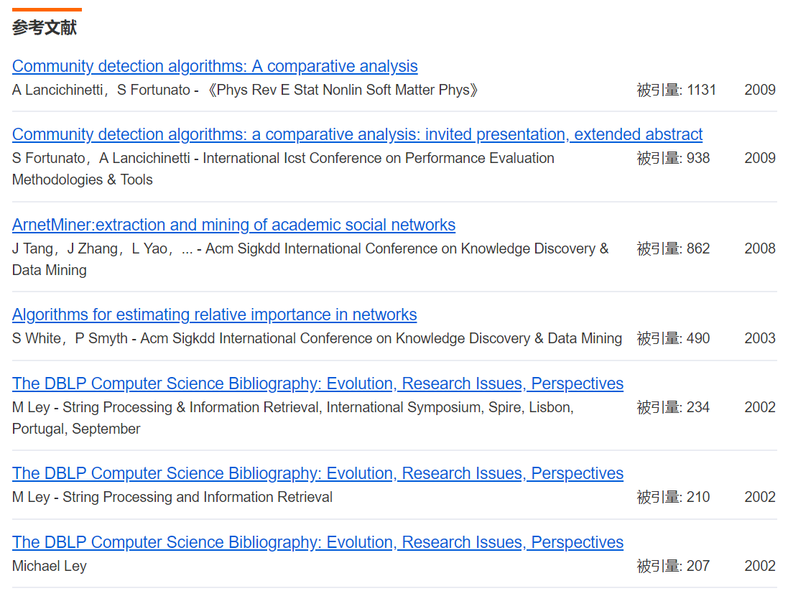
Recommendation
Google scholar
Shows the related papers and cited time
Baidu scholar
Shows referred papers, and related papers
The author’s other papers (most cited)
Other papers citing the current paper
Other papers with similar names

Slide 9
03
Zeyu Hua
Notes:
Thanks for Zhoufan’s wonderful introduction.
And I’m going to illustrate what I’ve done in the final project.

Slide 10
The Acceleration Of Site Performance
Rebuild tables
Reduce queries
Speed up
Reduce queries
Original：
Query papers
-> Search for their authors
After revision：
One single table for each page
Reduce the number of queries to the minimum.
Notes:
My first job is to speed up the website.
Then I thought about rebuilding the tables in MySQL.
In the original code, the page first queried the papers.
Then for each paper, it searched for its authors.
Undoubtedly, it would cost a lot of time.
So in the revision, I set one single table for each page with all the information needed.
It greatly reduced the number of queries.

Slide 11
Comparison
Take title.php as an example:
Notes:
We tested the time consumption with original database, new database and Elasticsearch separately.
And result is shown in the chart.
The new database takes less than 15% of the original one.
And it should be noted that Elasticsearch takes even less.
The details about it will be discussed by Liuhanwen later on.

Slide 12
UI Design
Background picture
Brief introduction
Dynamic effects
Footer
Compact & Easy To Use
Notes:
Another job for me is to improve UI, that is, the user interface.
Caoxinzhe has introduced specific details before, so I’ll emit them.
All I want to say is, whatever changes, we just want to keep the page compact and easy to use.
After all, practicality is of the top priority.
Finally, let’s welcome Liuhanwen to introduce Elasticsearch.
[!Turn the page!]

Slide 13
04
Hanwen Liu
Notes:
Hello Everyone. Next I’ll introduce my part: Elasticsearch.

Slide 14
Elasticsearch
Installation:
Java
Elasticsearch 6.2.4
Composer
Curl/Curl
Notes:
I first installed the following tools to build the environment:
Java, Elasticsearch, Composer and curl

Slide 15
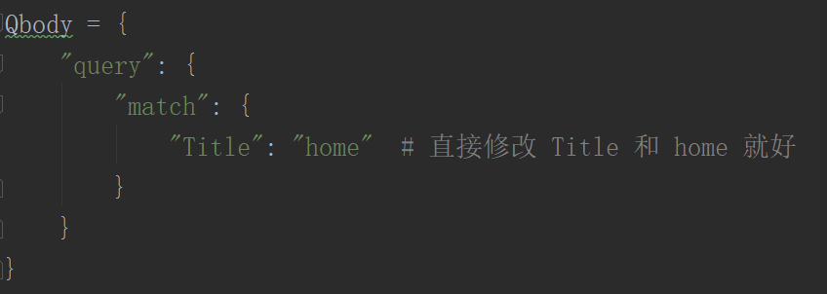
Elasticsearch
Searching:
REST request body:
Query DSL
Elasticsearch provides a JSON-style domain-specific language that you can use to execute queries.
REST request URI:
Curl
Notes:
Then we can go and search.
Elasticsearch provides us with two kinds of formulas.
The first one is the request body, which is JSON-STYLE.
The other one is called the request URI.
It is brief and suitable for our needs.

Slide 16
Elasticsearch
Space => %20
Notes:
One thing haunted me for several days.
That is, how to search with a space.
Fortunately, when I was surfing the internet, Zhihu inspired me.
You can see the ‘%20’ in the picture.
Not only Zhihu, I found that many other websites like Baidu &Wekipedia also use Elasticsearch.

Slide 17
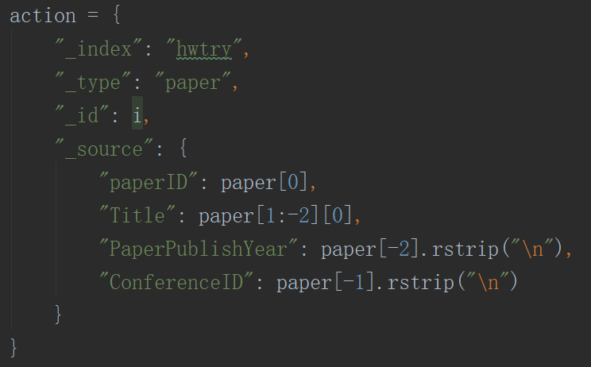
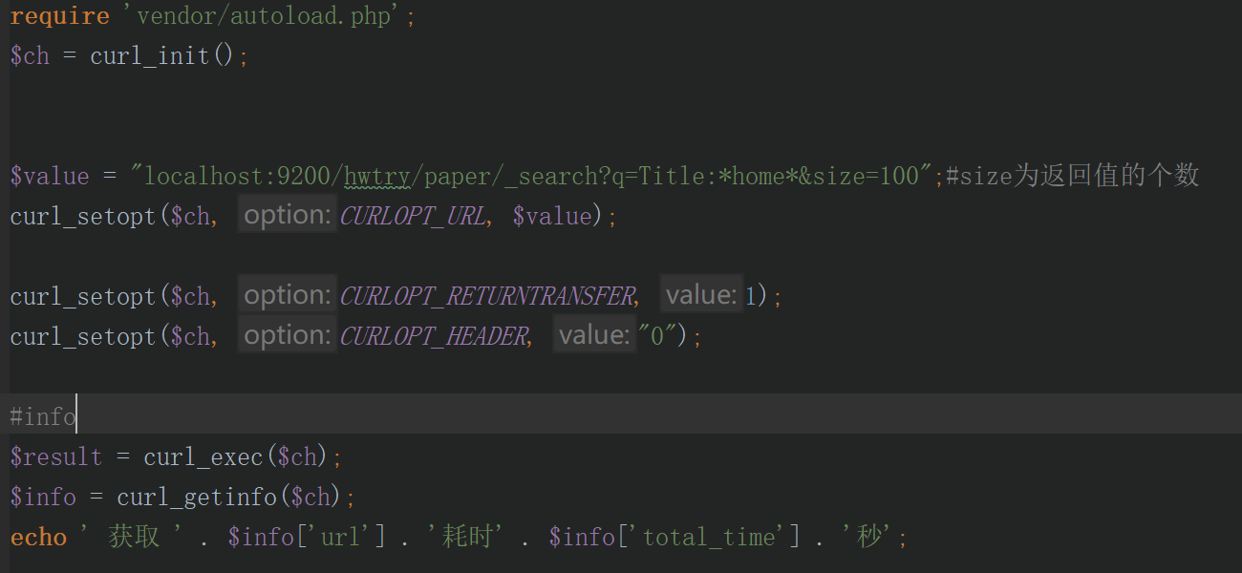
Elasticsearch
Code & Comparison:
Python
Database
# took
# timed_out
# _shards
# hits.total
# hits.max_score
PHP
Search
Notes:
Then I’ll talk about my codes.
I used python to create the database and PHP to fetch the result.
Besides the basic data we need, it can also give us many other details like those ones.
The shards, which I want to emphasize to you, is the greatest thing of Elasticsearch.

Slide 18
Comparison
Take title.php as an example:
Notes:
As you can see, the original database needs 3.8 second while with the new one, we cut down the time to 0.56 seconds.
With Elasticsearch, however, it only takes 0.08 seconds, about 2 percents of the original one.

Slide 19
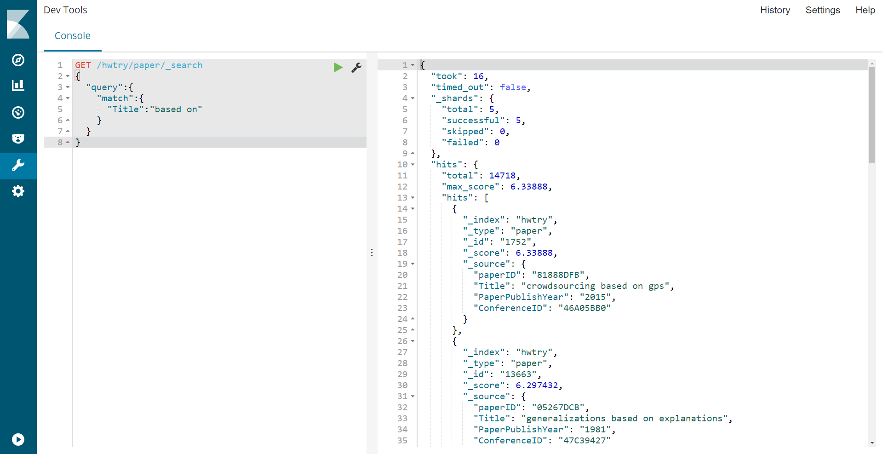
Elasticsearch
Kibana:
Notes:
Finally, I’d like to mention Kibana, which enhanced our interaction with Elasticsearch.

Slide 20
Thanks for
listening
Notes:
Thank you all.
That’s the end of our exhibition.
Do you have any questions?

