Slide 1
Academic & More
Group 4
谢知晖
王逸雄
郭嘉宋
程若愚

Slide 2
ABOUT US
Our icon
Academic and More
延时符
Notes:
First, please let me introduce our group’s project: Academic and More, which is done by my partners Wang, Guo, Cheng and me. We did our utmost to optimal the performance and beautify our website, making it both clean and informative.

Slide 3
Basic Structure
Beautification
Data search & MVC
Visualization
延时符
Notes:
The basic structure is separated into three parts: Data search & MVC, Beautification and Visualization.

Slide 4
01
Data search & MVC
Notes:
I’m in charge of integrating these components into the codeigniter MVC framework and setting up the elasticsearch engine. Now please let me introduce the basic framework of our project.

Slide 5
Data search & MVC
Elasticsearch & MVC
Lucene-based
Inverted index
Highlight
RESTful API
Notes:
As many other groups have mentioned, MVC framework provides us a simple logic to separate and integrate our tasks. And elasticsearch is another powerful tool. Although we were not able to realize its full potential such as its distributed structure and high availability, we still benefited a lot from this lucene-based search engine. The highly efficient inverted index makes the search really fast. The page load time including graphs is less than 2s for every page. Besides, we can easily highlight the keyword of the search results thanks to Elasticsearch.
With its RESTful APIs and JSON, we can easily transfer our data from mysql database to elasticsearch engine with python, and get the results in json form with php.

Slide 6
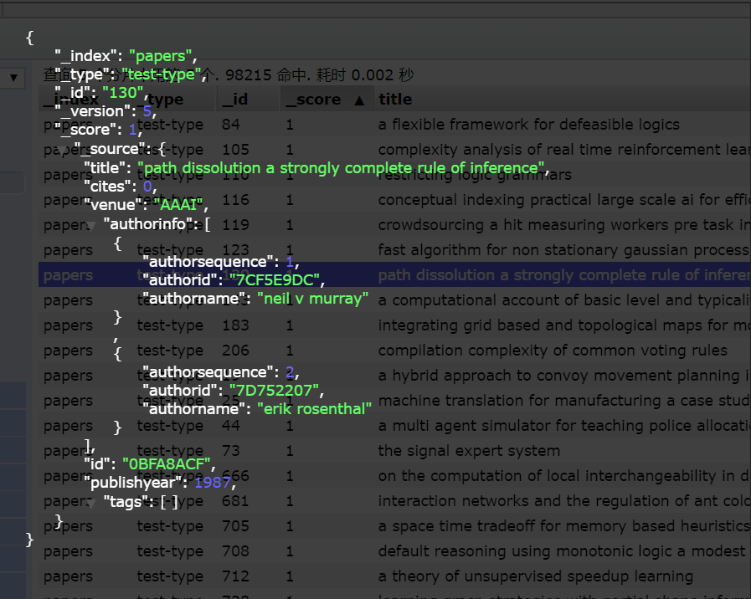
Data search & MVC
Relational DB ⇒ Databases ⇒ Tables ⇒ Rows ⇒ Columns
Elasticsearch ⇒ Indices ⇒ Types ⇒ Documents ⇒ Fields
Index Configuration
延时符
Notes:
For each index such as paper, we use 5 shards and 1 replica to implement the Search Engine.
The data are stored in Elasticsearch’s document-oriented database in the form like this:
This allows us to use simple query dsl to get the data we want. But limited by time, we were not able to model our data in a more efficient structure such as Parent-child relationship. Maybe we can improve the performance in this aspect.

Slide 7
Data search & MVC
Tagging System
Visualization
Track topics
Classify papers
Data analyze
A lot of function can be realized easily thanks to Elasticsearch
延时符
Notes:
The best part is that we can fulfill plenty of functions. For paper information, we implement the tagging system. Papers whose title includes the hot words in computer science will be added with tags. And for each tag, the user can check the development of the related field in the tag page. Besides, we fullfill a lot of visualization with the help of elasticsearch.
And now, please welcome my partners to show the website in practice.

Slide 8
02
Beautification

Slide 9
BEAUTIFICATION
Framework
01
CSS work
Static pages
02
03
延时符

Slide 10
STRUCTURE
Author general view
01
Conferences
03
02
Author specific view
HOME
04
05
Paper general view
Paper specific view
延时符

Slide 11
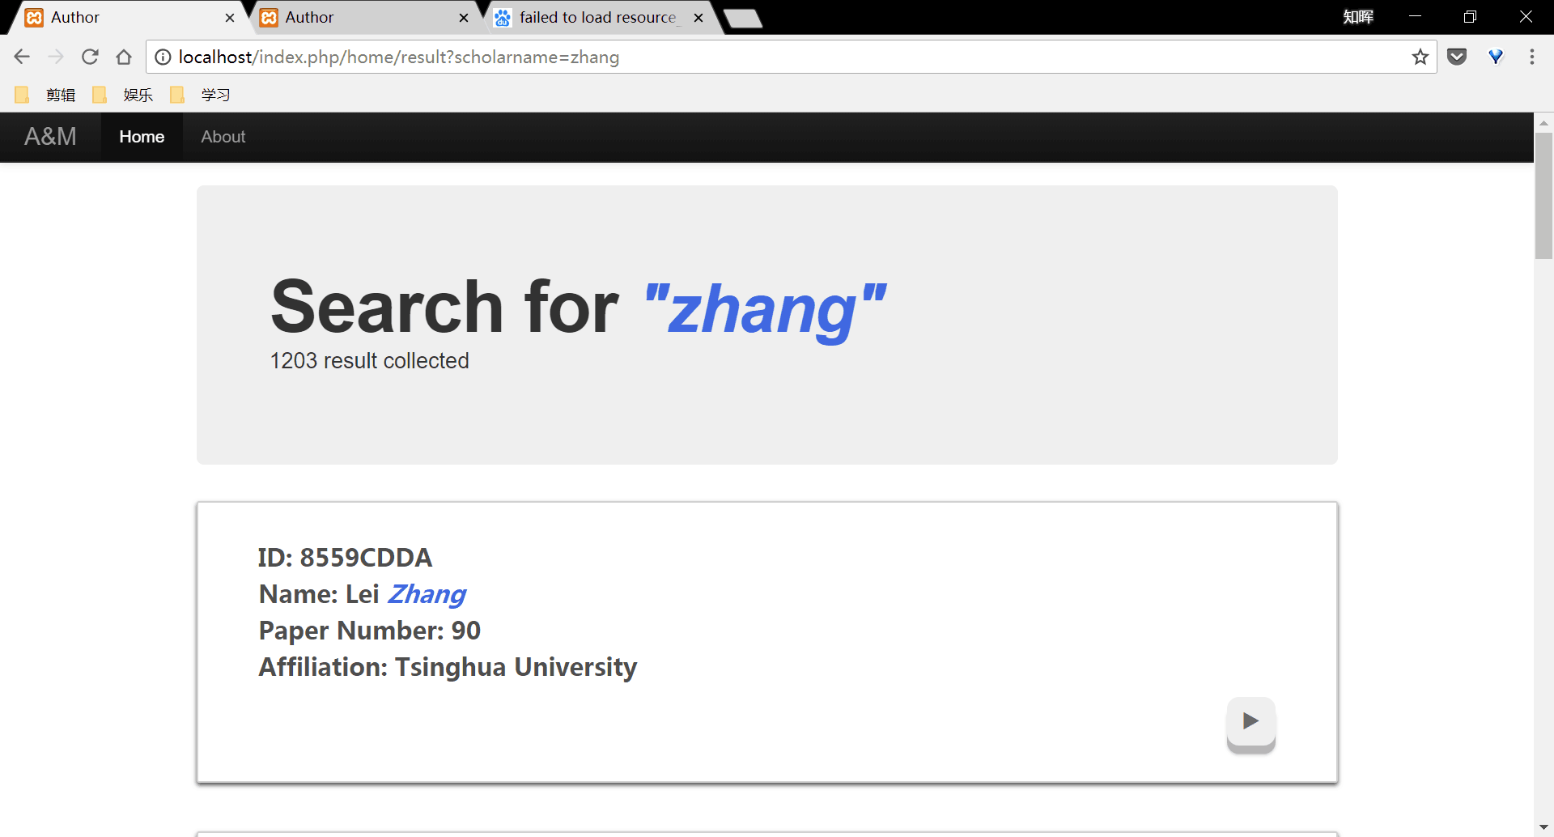
AUTHOR GENERAL VIEW
延时符

Slide 12
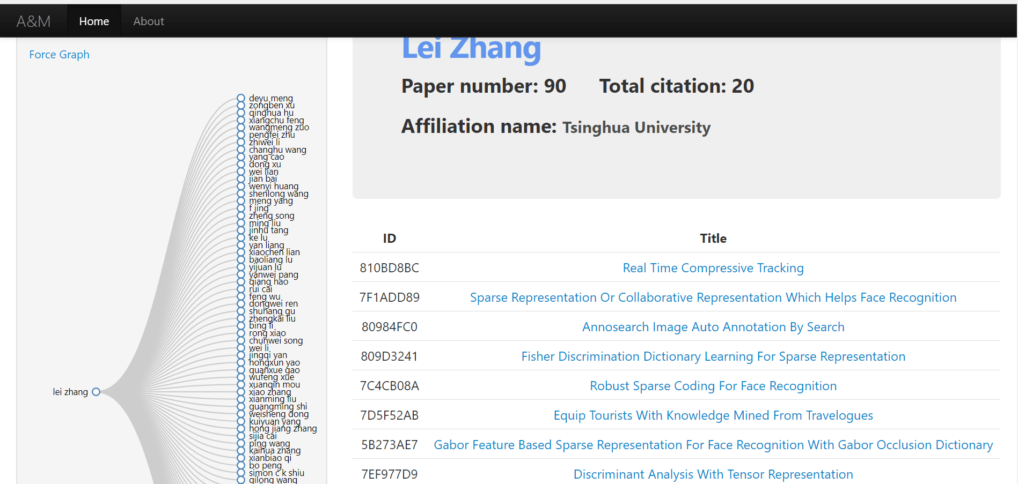
SPECIFIC AUTHOR VIEW
延时符

Slide 13
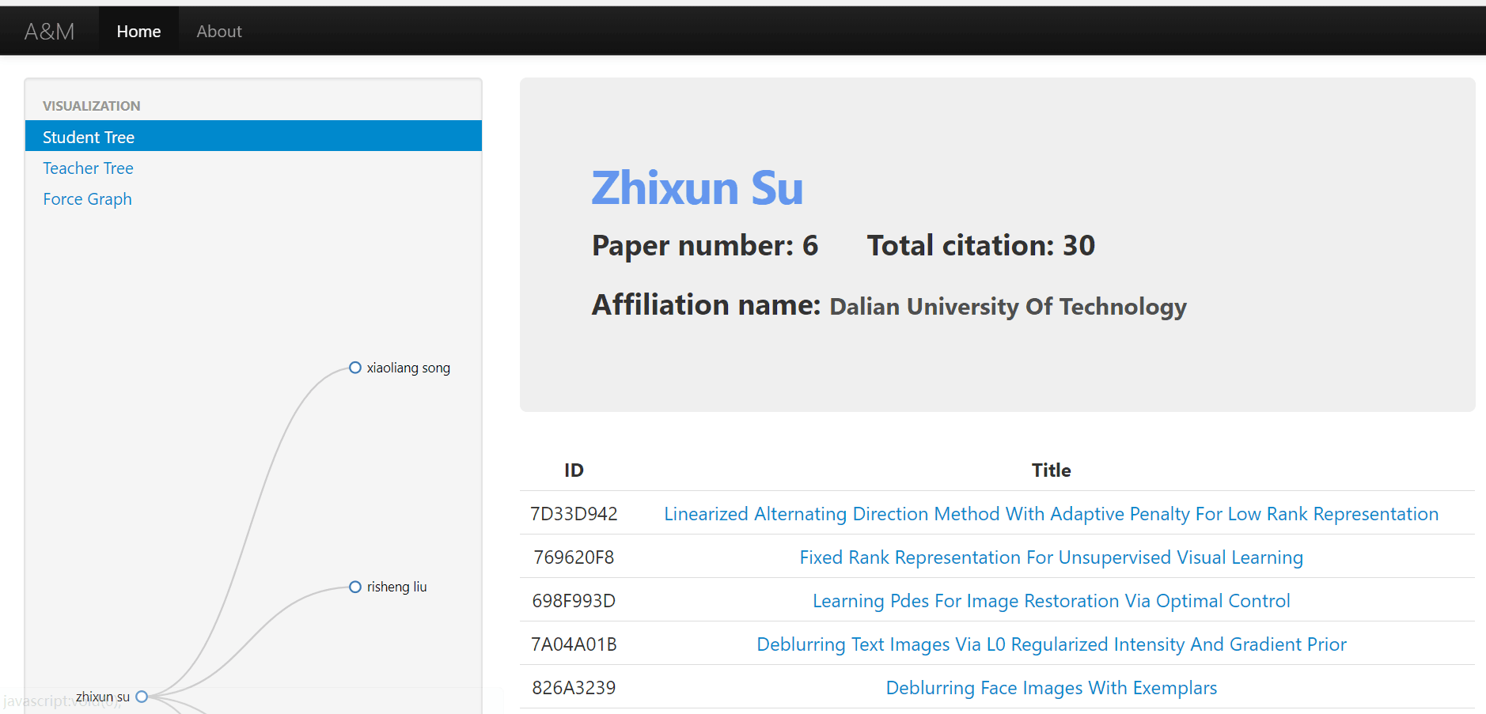
SPECIFIC AUTHOR VIEW
延时符

Slide 14
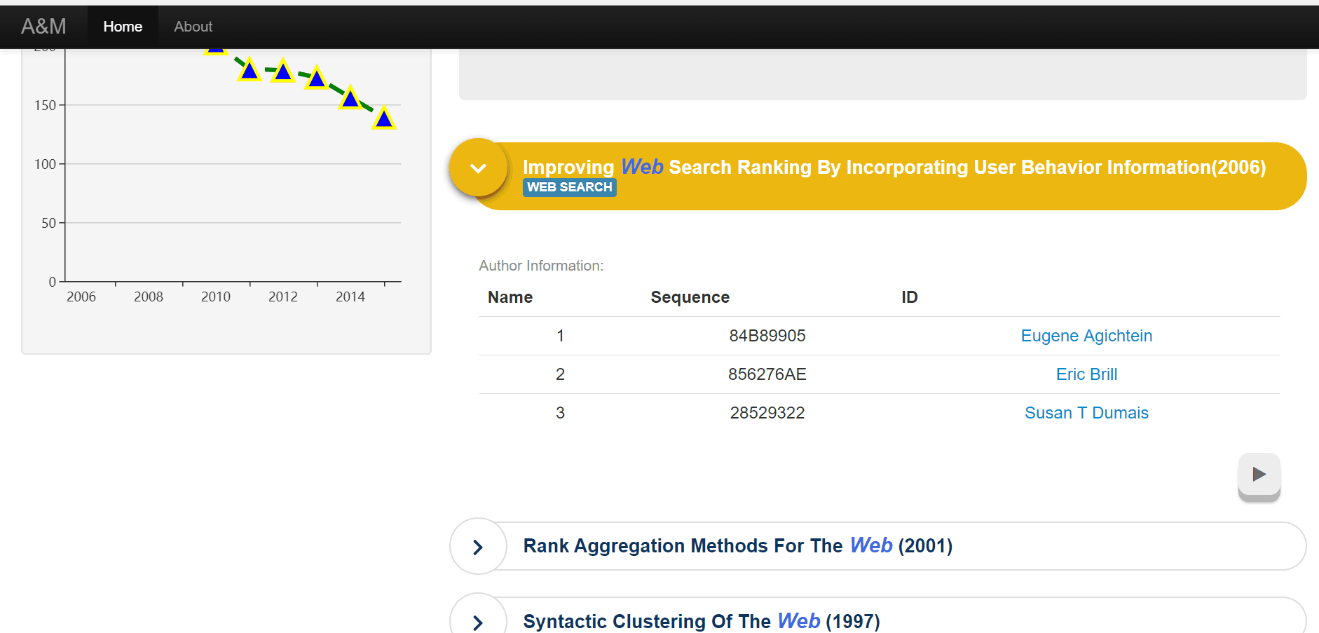
PAPER GENERAL VIEW
延时符

Slide 15
SPECIFIC PAPER VIEW
延时符

Slide 16
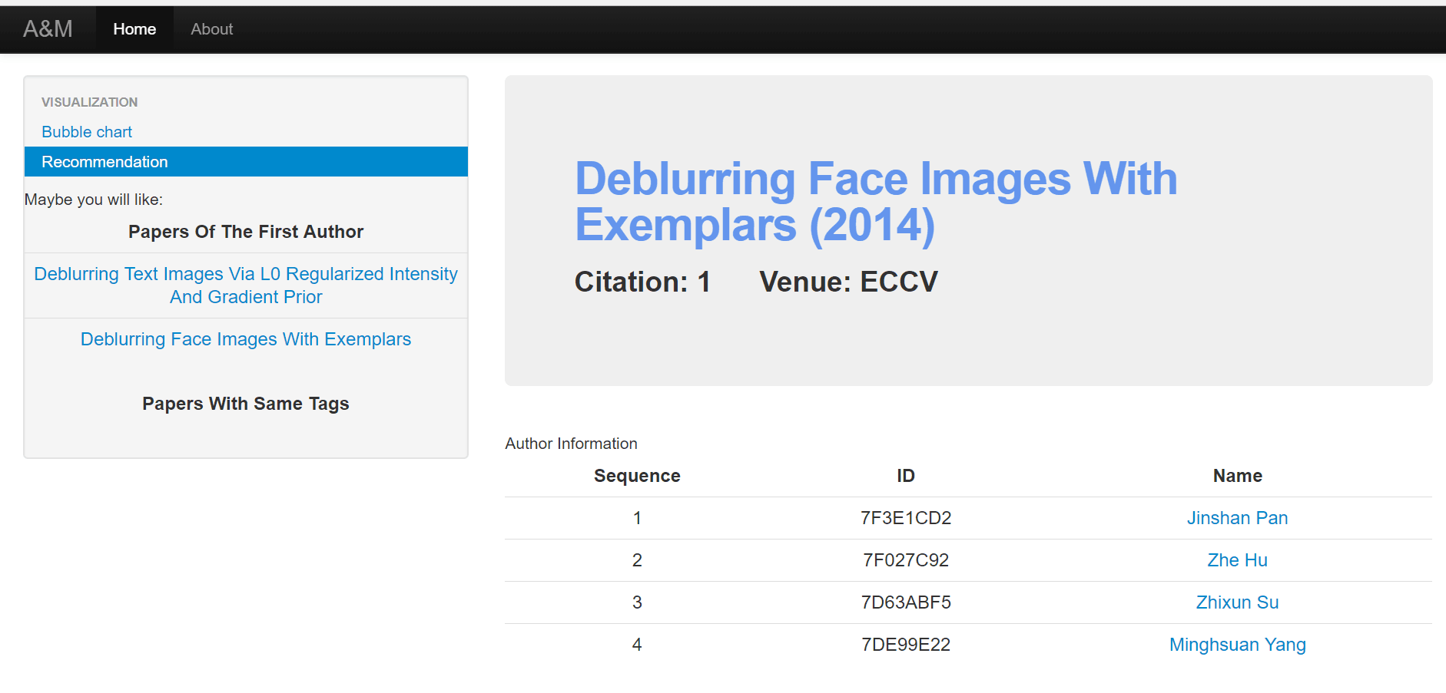
SPECIFIC PAPER VIEW
延时符

Slide 17
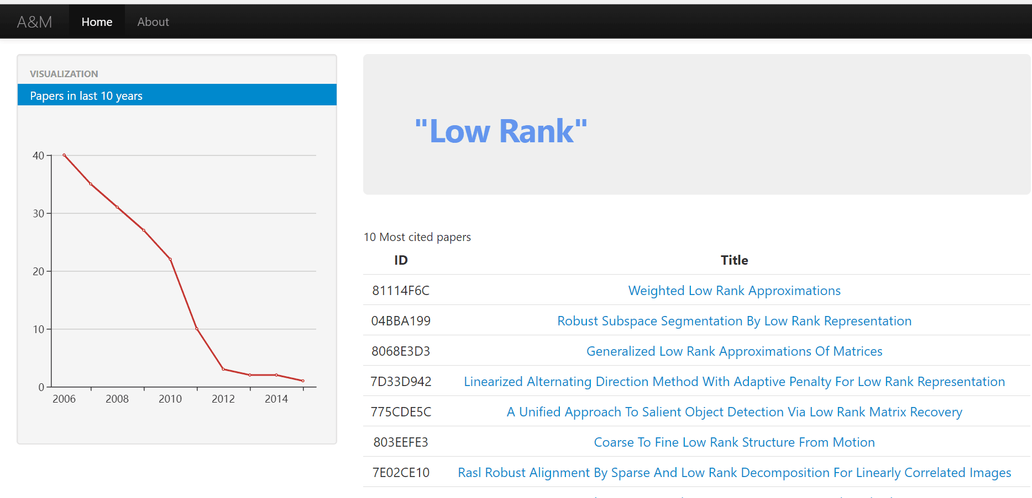
TAG
延时符

Slide 18
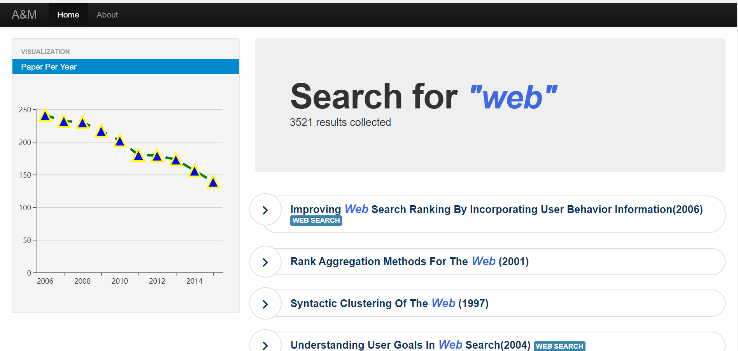
TAG
延时符

Slide 19
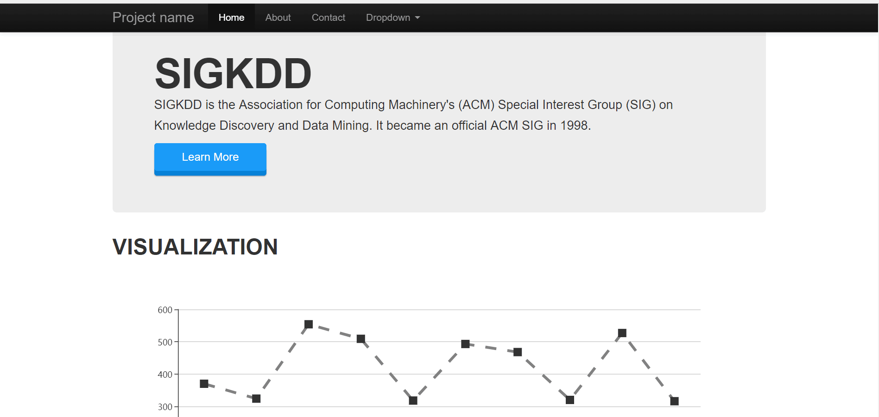
CONFERENCE VIEW
延时符

Slide 20
CSS WORK
BOOTSTRAP
CAROUSEL
Framework
Dynamic font
1
2
3
4
BUTTON
FLATNAV
Button styles
Navigator
延时符

Slide 21
STATIC PAGES
CONFERENCE
01
13 pages in total
02
ABOUT
Our information and general introduction

Slide 22
03
Visualization

Slide 23
visualization
01
Bar chart & pie chart & line chart & bubble chart
Map
02
03
Force-Directed Graph & Tree
延时符

Slide 24
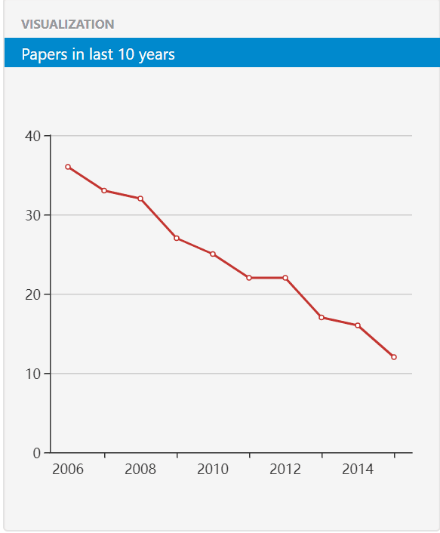
paper general => line chart
延时符

Slide 25
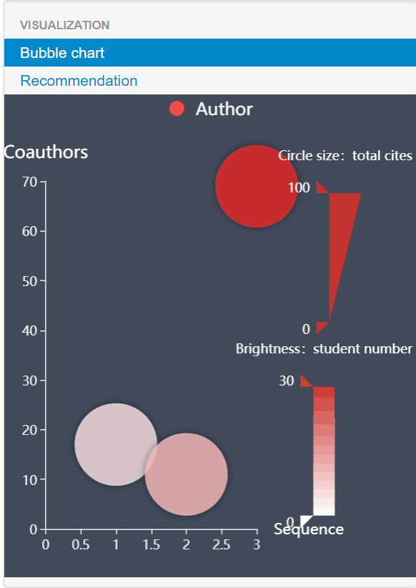
paper specific => bubble chart
延时符

Slide 26
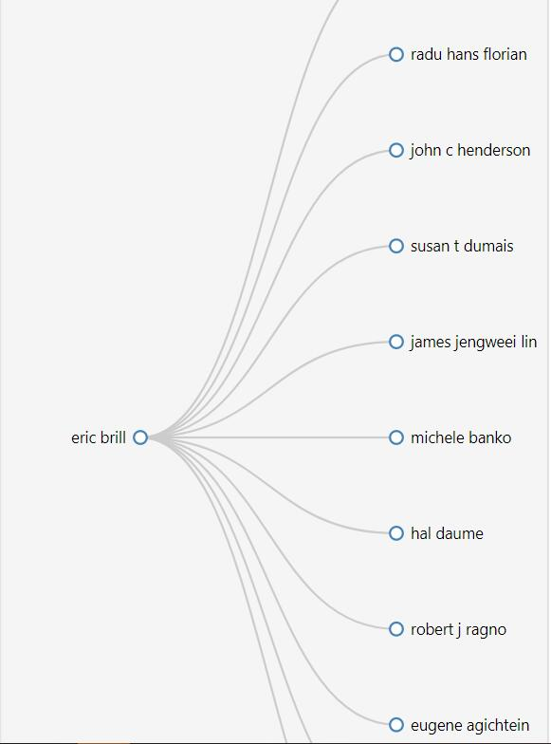
Author specific => tree
延时符

Slide 27
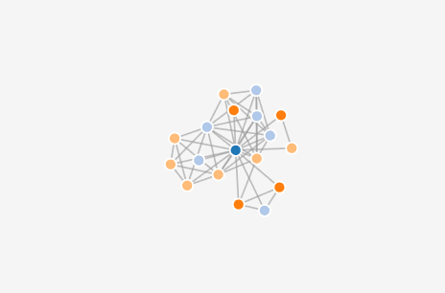
Author specific => Force-Directed Graph
延时符

Slide 28
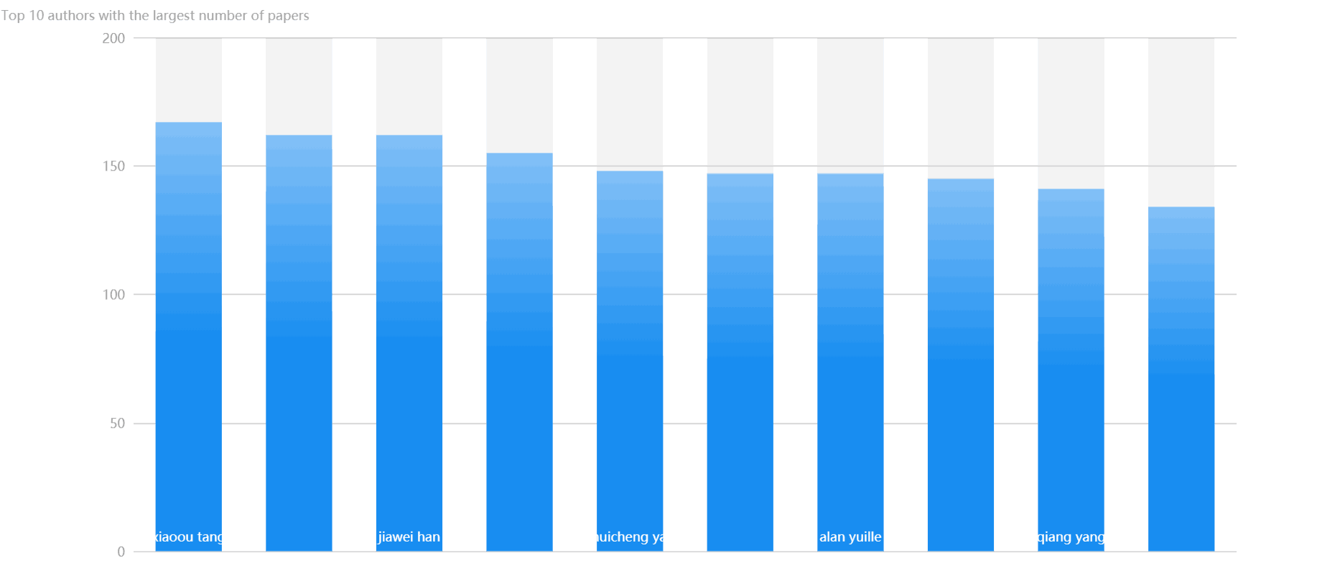
General graph => bar chart
延时符

Slide 29
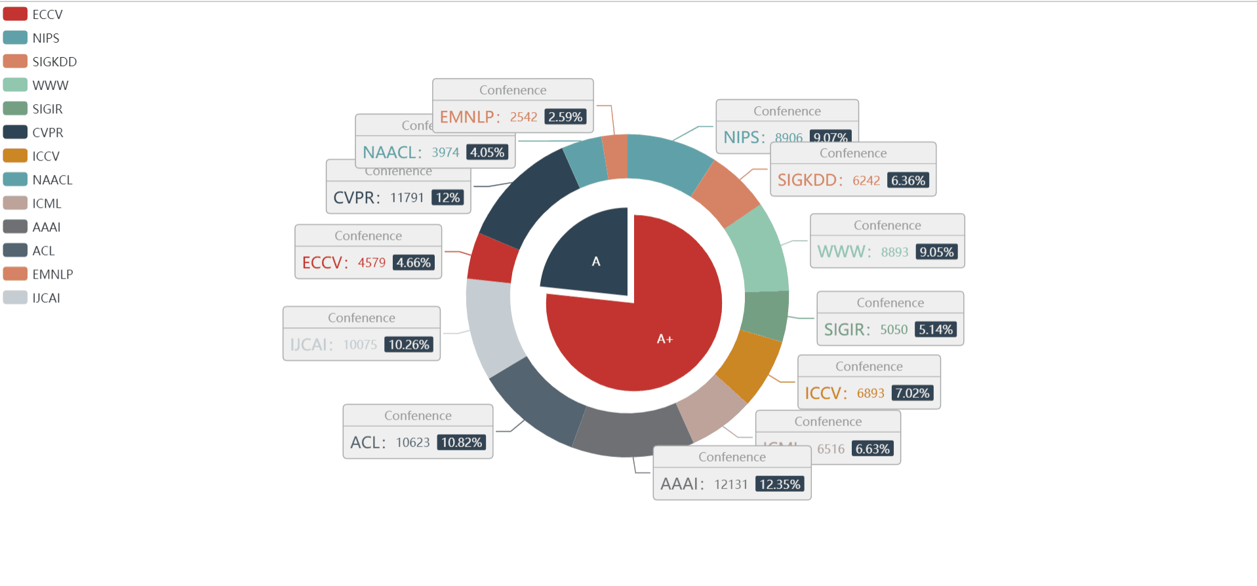
General graph => pie chart
延时符

Slide 30
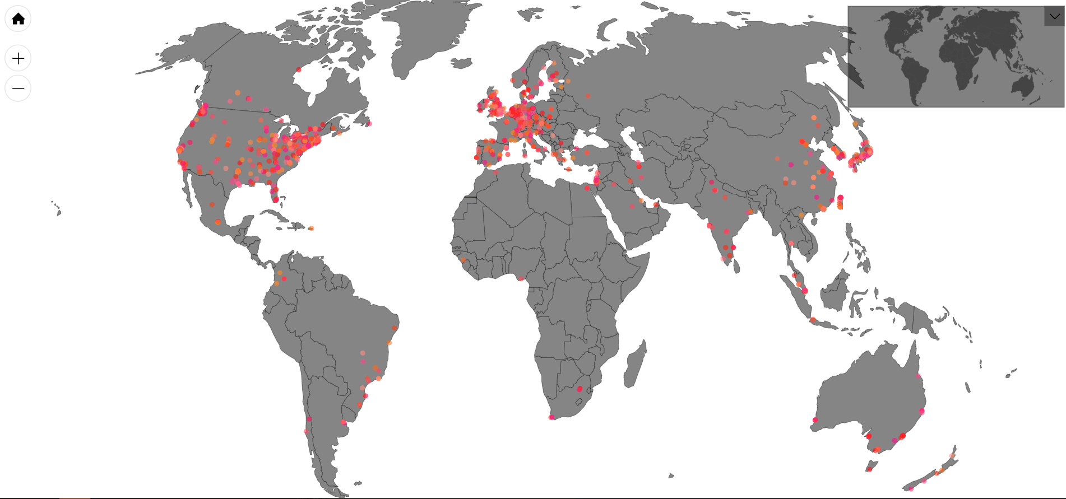
General graph => map
延时符

Slide 31
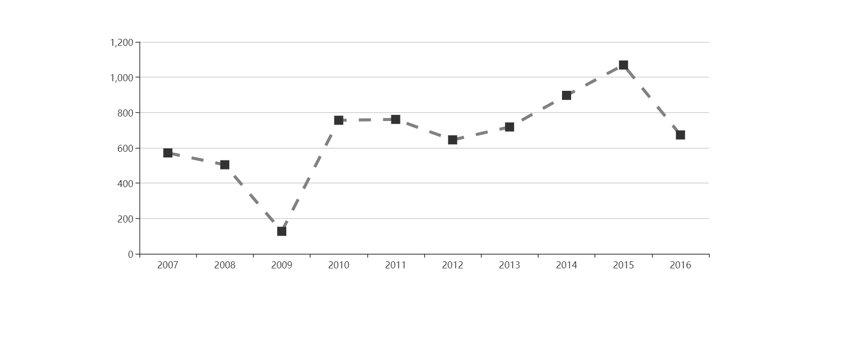
Conference => line chart
延时符

Slide 32
ECharts
A open-source visualization library implemented by JavaScript
Rich visualization types
Big data
01
02
03
04
Multiple data formats
In-depth data exploration
延时符

Slide 33
Acemap
inspiration
extract data from
our database
延时符

Slide 34
D3.js
A useful JavaScript library for visualization
Selections
01
Dynamic properties
02
03
Transformation
延时符

Slide 35
Thanks for watching
延时符

