Slide 1
Academic search
——final project presentation
TEAM 28
李竞宇
贺文迪
张宇恒
杜鹏翔

Slide 2
Concepts and Methods
Basic function
New feature
Possible improvements

Slide 3
Concepts and methods
01
02
Develop Pattern
Embellishment
Model-View-Controller (MVC):
Codeigniter
CSS
Bootstrap

Slide 4
Our Layout
Model
View
graph
Ace_model
header
author
Result_page
New_author_page
Acemap
home
Result_page_page
recommendation
paper
New_paper_page
menu
Controller
Result_conf_page
conf
footer
New_result_page

Slide 5
Basic function
(next display the website)

Slide 6
Home page

Slide 7
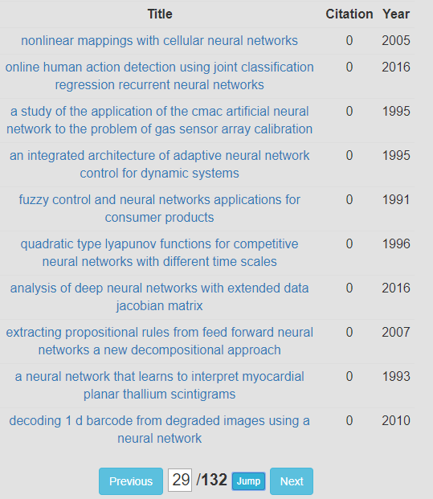
Result page

Slide 8
author

Slide 9
paper

Slide 10
conference

Slide 11
New feature
History Record
Paper Recommendation

Slide 12
History record

Slide 13
Paper recommendation

Slide 14
Possible improvements
Login-in mechanism
Smarter recommendation

Slide 15
Thank you
分工：
李竞宇：MVC，浏览历史记录，论文推荐
张宇恒：美化
贺文迪：搜索，会议页面

