Slide 1
Academic Map
Report And Exhibition
Group24

Slide 2
Work Assignment
XuShangning:
Elasticsearch, UI Design(Bootstrap, Unified Search Bar, Navigation Bar, Card-like Style),Force directed graph
KuangYi:
CodeIgniter, Thesis Recommends, Hint(authorname, papertitle), Possible results(author, conference)
CaoJianzhen:
authors, single author, papers, single paper, Data Visualization(Tree)
WuHao:
conferences, single conference, machine learning(teacher student relationship)

Slide 3
Catalogue
1
General Appearance
2
Data Visualization
3
UI Design
4
Backend

Slide 4
1
General Appearance

Slide 5
hint
home
conferences
hint1
authors
papers
Force directed graph
author
paper
conference
Student tree

Slide 6
2
Data Visualization

Slide 7
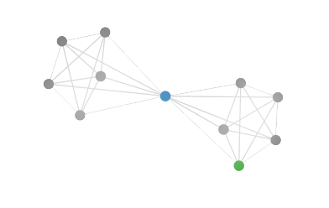
Force Directed graph
Tree

Slide 8
3
UI Design

Slide 9
Bootstrap
Unified Search Bar
Navigation Bar
Card-like Style
UI

Slide 10
4
Backend

Slide 11
1)
CodeIgniter

Slide 12
A PHP or HTML file
Views
Controller
Model
Return search results
Load view
Ask information
New page(url)
Elasticsearch

Slide 13
2)
Elasticsearch

Slide 14
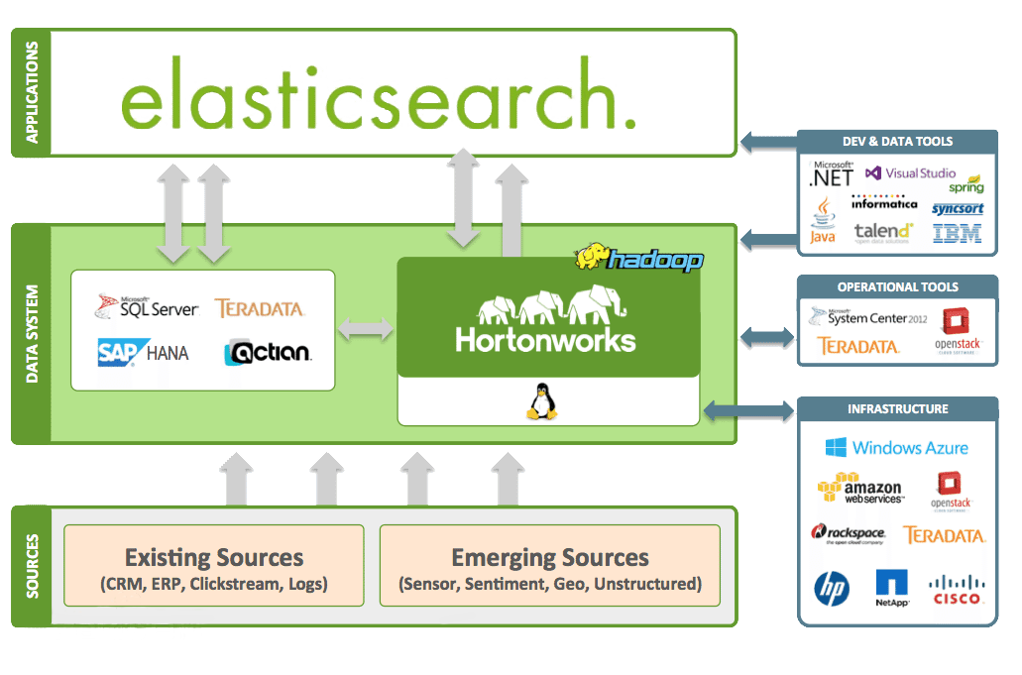
Why we choose elasticsearch
It provides a distributed multi-user capable full-text search engine based on a RESTful web interface. Elasticsearch was developed in Java and released as an open source under the Apache license terms, and is currently the popular enterprise search engine. Designed for cloud computing, it can achieve real-time search, stable, reliable, fast, easy to install and use.

Slide 15
Importing Data & Construct a Query

Slide 16
Machine Learning
3)

Slide 17
Improve accuracy rate
Add new features
Change function parameters
Choose the better algorithm

Slide 18
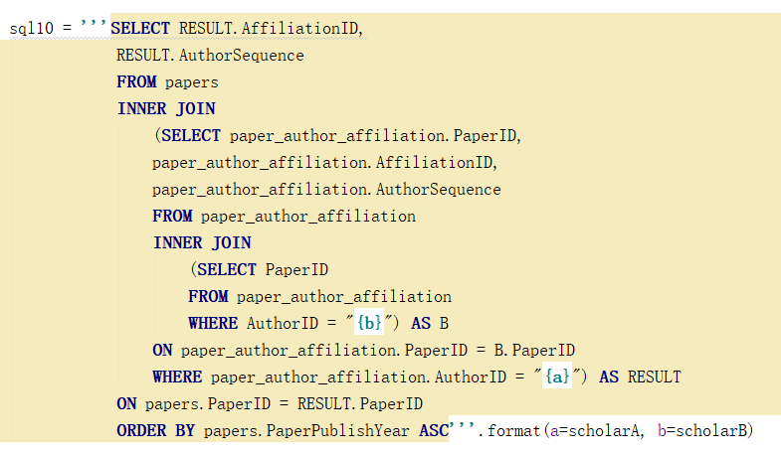
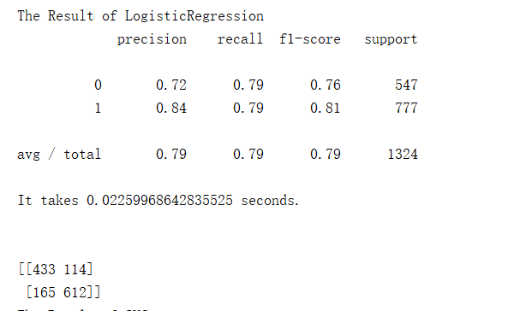

Slide 19
Thanks!

