Slide 1


Final Project Presentation

Slide 2
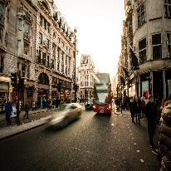
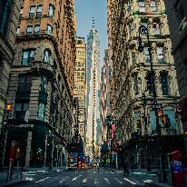

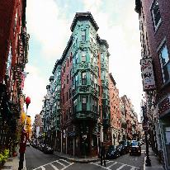
content
Huang Tianyi:
Tree and force-directed
graph
Title , conference page
Leng Mengchao:
Recommendation
Huang Yifan:
Beautification
Ding Zehua:
Website acceleration
Some additional
features

Slide 3
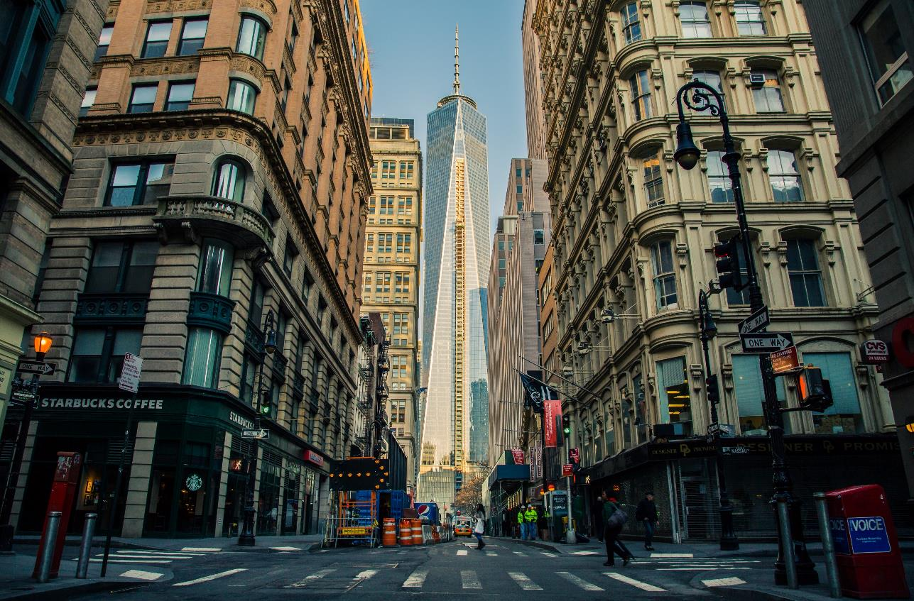
Huang Tianyi
Tree and force-directed graph
Title , conference page

Slide 4
Leng Mengchao
Paper Recommend

Slide 5
Huang Yifan
Beautification

Slide 6
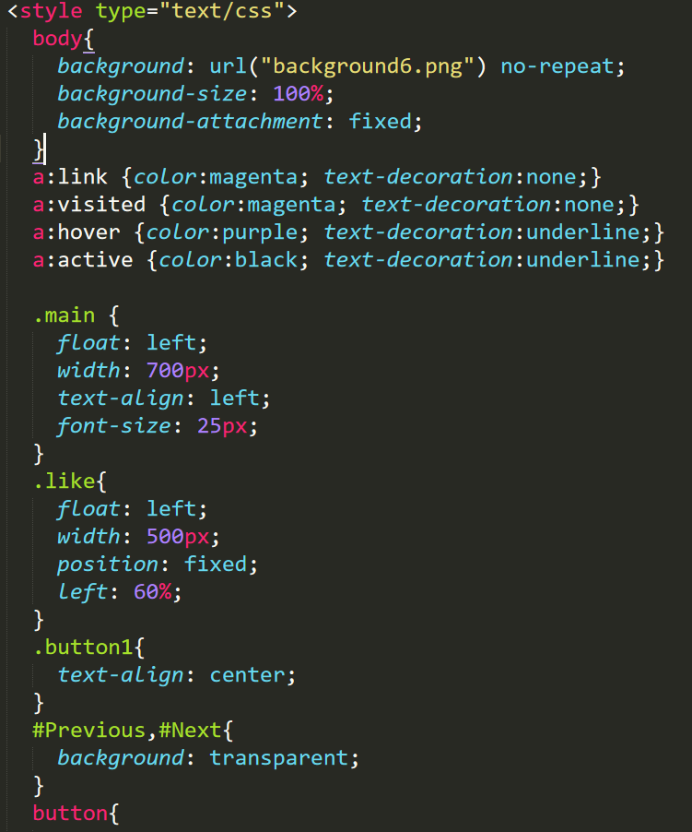

Slide 7
Ding Zehua
Website acceleration
Some additional features

Slide 8
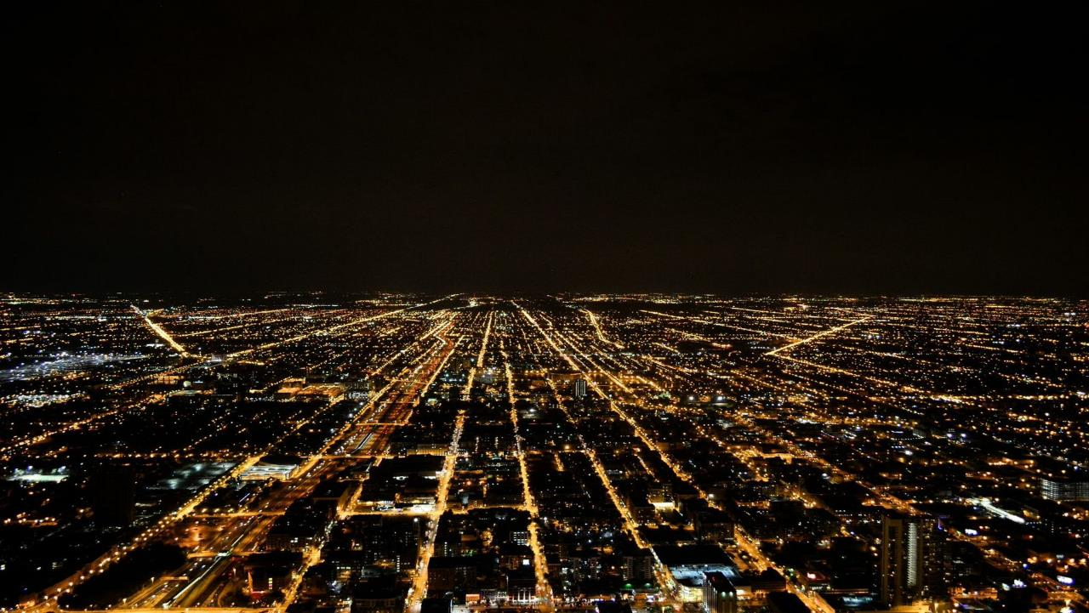
THANKS

