Slide 1
SJTU
IEEE Grade 1.
Laundry Assistant.
Useless, but enjoyable.
我们毕业啦
其实是答辩的标题地方
Presented by
周小舟，周澜轩，颜铭萱，瞿国一.

Slide 2
Abstract
瞿国一&周小舟
01
Physical model.
周澜轩
Codes and API.
User interface.
02
03
Division of work.
颜铭萱

Slide 3

Physical model.
---瞿国一 & 周小舟

Slide 4

Model.
Evaporation of water.
Knudsen layer.
Fick’s law.
Diffusion process.
The flow rate of the diffused material per unit cross-sectional area perpendicular to the diffusion direction per unit time is proportional to the concentration gradient at that section.

Slide 5

Evaporation
Atmosphere.
Your clothes.
Knudsen Layer
: Evaporation
: Diffusion

Slide 6

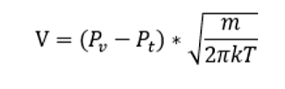

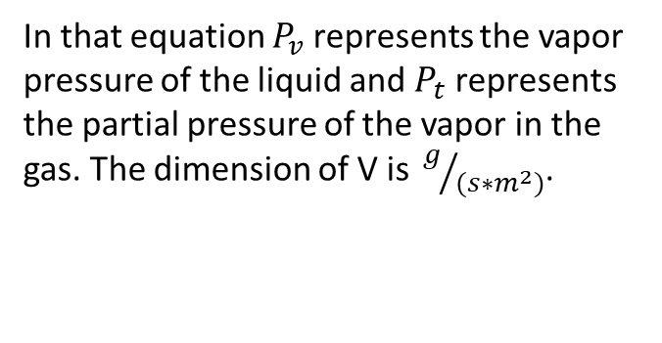
Evaporation
Langmuir’s Evaporation Equation
Knudsen layer.
The Knudsen layer is also called an evaporation layer and is a thin layer of vapor on the solid or liquid. On the surface of the porous medium, the thickness of the Knudsen layer can be approximated as , where l stands for the distance of adjacent pores.
In that equation $P_{v}$ represents the vapor pressure of the liquid and $P_{t}$ represents the partial pressure of the vapor in the gas. The dimension of V is ${ g}/{(s∗m^{2})}$.

Slide 7




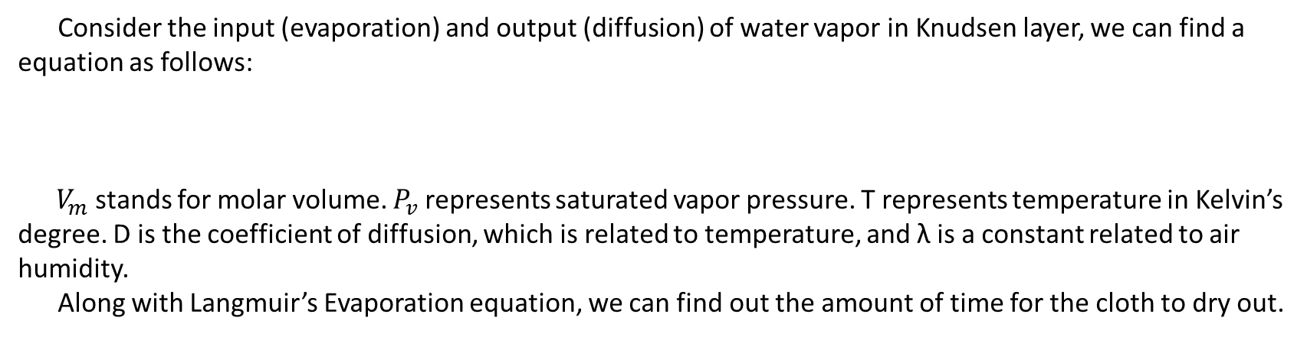
Diffusion
Fick's second law can help predict how diffusion will cause concentration to change over time: .
Solution: .
A、B are constants.
Let x=0 and .
Consider the input (evaporation) and output (diffusion) of water vapor in Knudsen layer, we can find a equation as follows:
$V_{m}$ stands for molar volume. $P_{v}$ represents saturated vapor pressure. T represents temperature in Kelvin’s
degree. D is the coefficient of diffusion, which is related to temperature, and λ is a constant related to air humidity.
Along with Langmuir’s Evaporation equation, we can find out the amount of time for the cloth to dry out.
Notes:
Thermal diffusion equation.

Slide 8

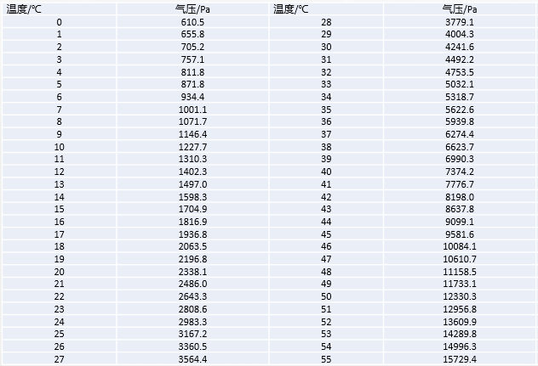
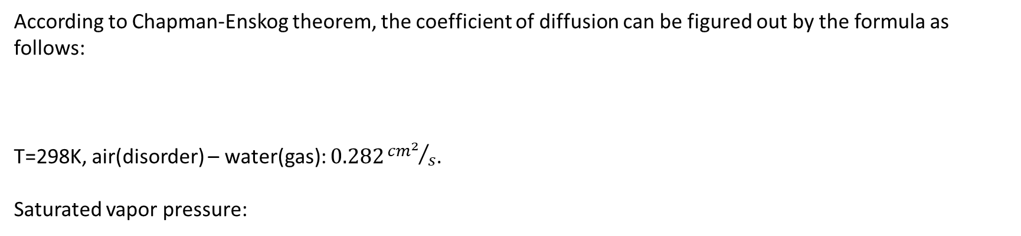
Diffusion
According to Chapman-Enskog theorem, the coefficient of diffusion can be figured out by the formula as follows:
T=298K, air(disorder) – water(gas): $0.282{{cm}^{2}}/s$.
Saturated vapor pressure:

Slide 9

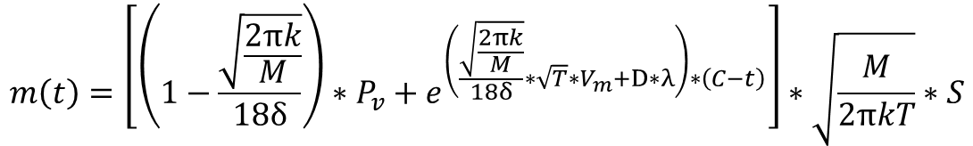

Final equation
$$\frac{D(T_{1})}{D(T_{2})}={(\frac{T_{1}}{T_{2}})}^{\frac{3}{2}}$$
$$m\left(t\right)=\left[\left(1−\frac{\sqrt{\frac{2πk}{M}}}{18δ}\right)∗P_{v}+e^{\left(\frac{\sqrt{\frac{2πk}{M}}}{18δ}∗\sqrt{T}∗V_{m}+D∗λ\right)∗\left(C−t\right)}\right]∗\sqrt{\frac{M}{2πkT}}∗S$$
$$D\left(T\right)=0.282∗{10}^{−4}∗{(\frac{T}{298})}^{\frac{3}{2}}$$

Slide 10
MainActivity.java
---周澜轩

Slide 11
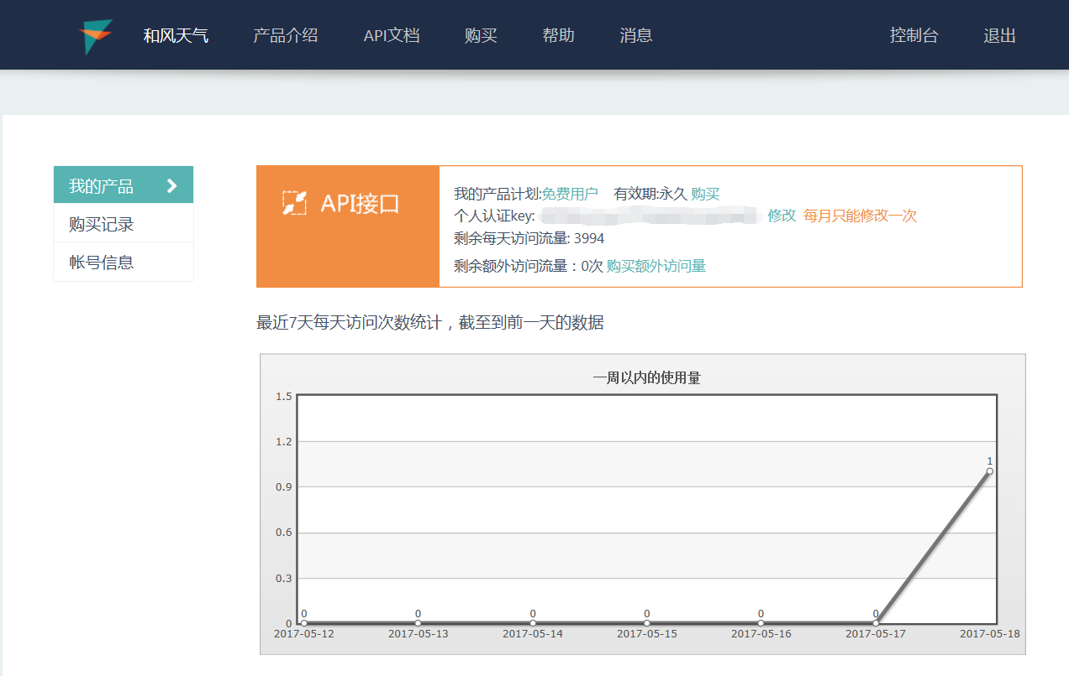
API source: HeWeather

Slide 12
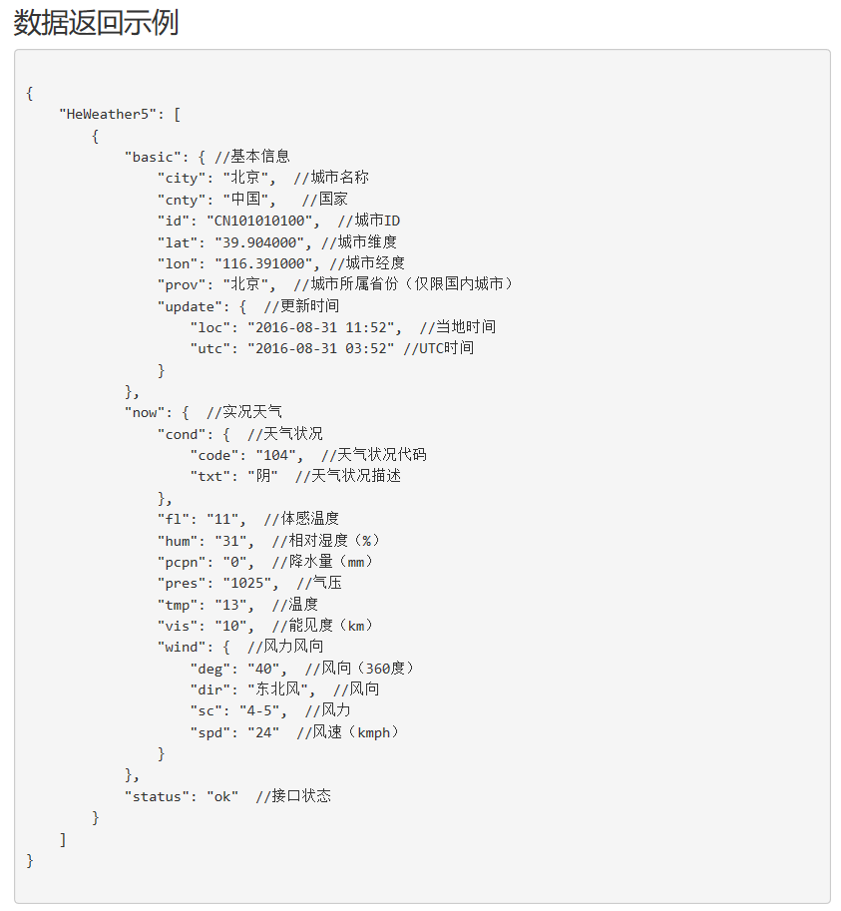


Slide 13
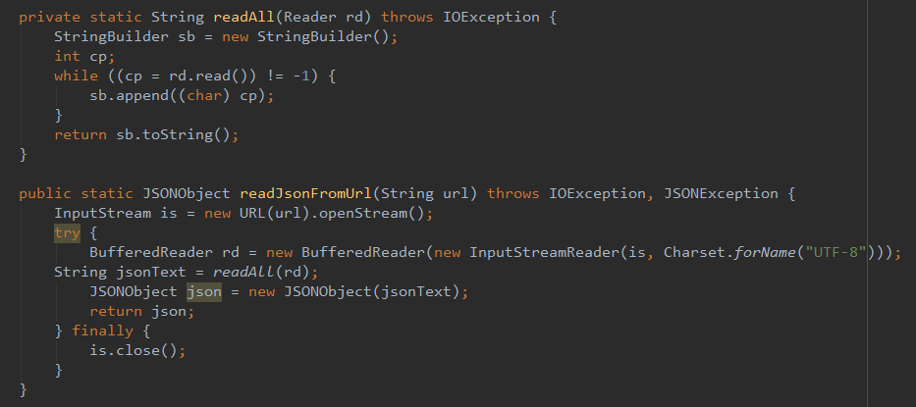
How to get JSONObject by URL

Slide 14
Multithread(多线程)
Why I have to use multithread?
Because getting JSONObject by URL will cost time but Android Studio forbid UI thread to do time-consuming operation.
How to use thread?
  thread
  runnable
  handler
UI thread
URL

Slide 15
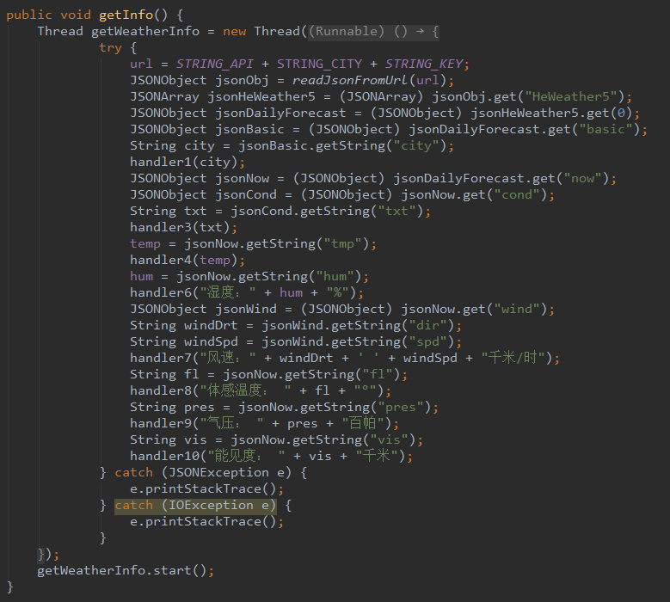
Analysis JSONObject in a new thread
Analysis Porcess

Slide 16
The framework of the JSONobject:
{
key: [
{
key: {
key-value;
key: {
key-value;
}
}
key: {
key: {
key-value;
}
key-value;
key: {
key-value;
}
}
key-value;
}
]
}

Slide 17
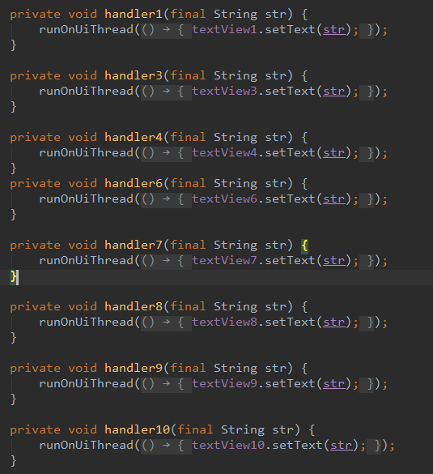
Android Studio forbid users to update UI in another thread. But by using handler, users can update UI(setText) outside the UI thread.
thread
handler
UI

Slide 18
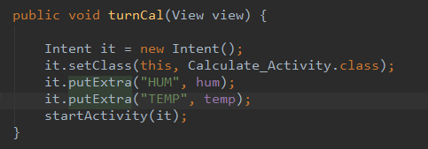
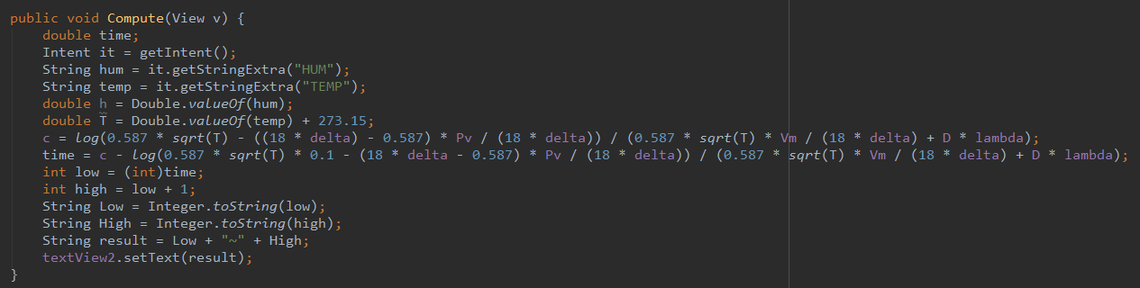
MainActivity.java
humidity
&
temperature
Calculate_Activity.java
Calculation Function

Slide 19
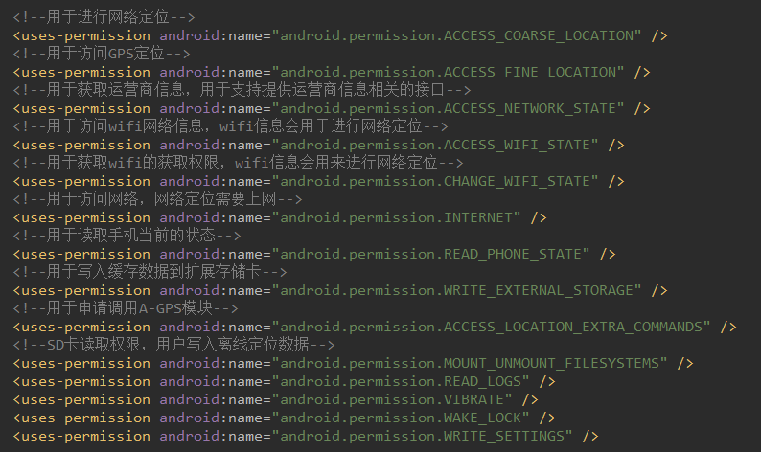

Slide 20
XXX.xml
---颜铭萱

Slide 21
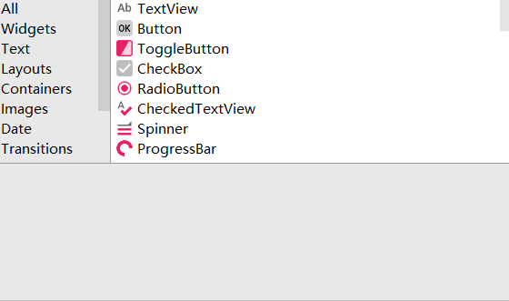
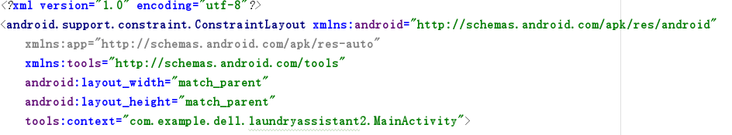
User Interface
The advantage of Externalization (将视觉设计与程序逻辑分开)：
The programmer may not expertise in visual design. Similarly, the visual designer may not be familiar with thee programmer's work. The seperation of visual design and program logic makes the cooperation more effective and effiient.
The seperaiton of visual design also allows the designer to adjust the layout both by dragging the widgets into the UI and writing the codes to revise the detailed properties .

Slide 22
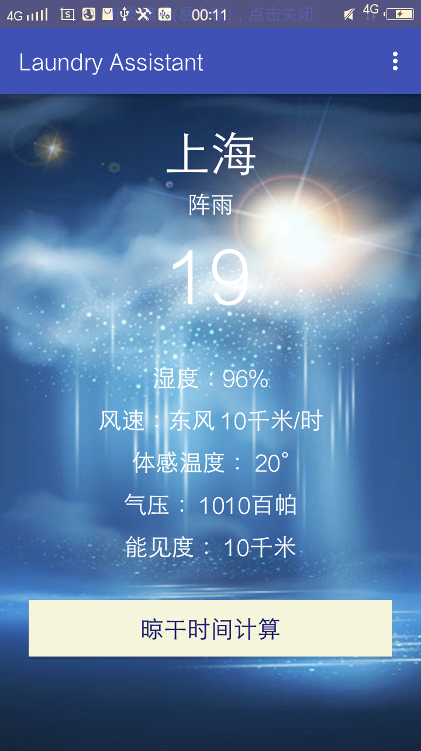
UI Structure
Main Page
Location Page
Calculation Page

Slide 23
Main Page
Linear Layout ( vertical )
TextView
Button
The main page is used to display the real-time weather report obtained from the Internet. The location page is acces-sed with it through the menu, and the calculation page is accessed by the button.

Slide 24
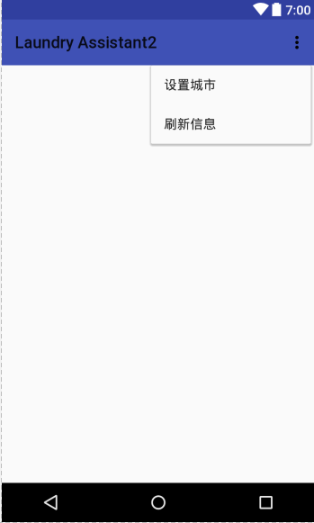

Location Page
The entrance of this page is set in this menu.
In this page two functions are designed.
(1) Positioning.
(2) Setting any city.
The menu also provides the users with manual refre-shing function.

Slide 25
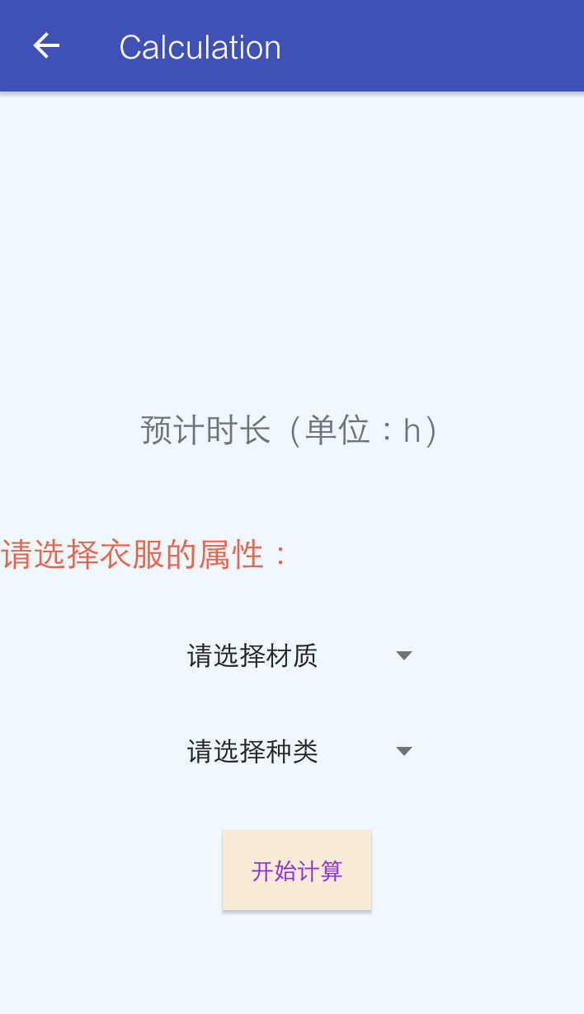
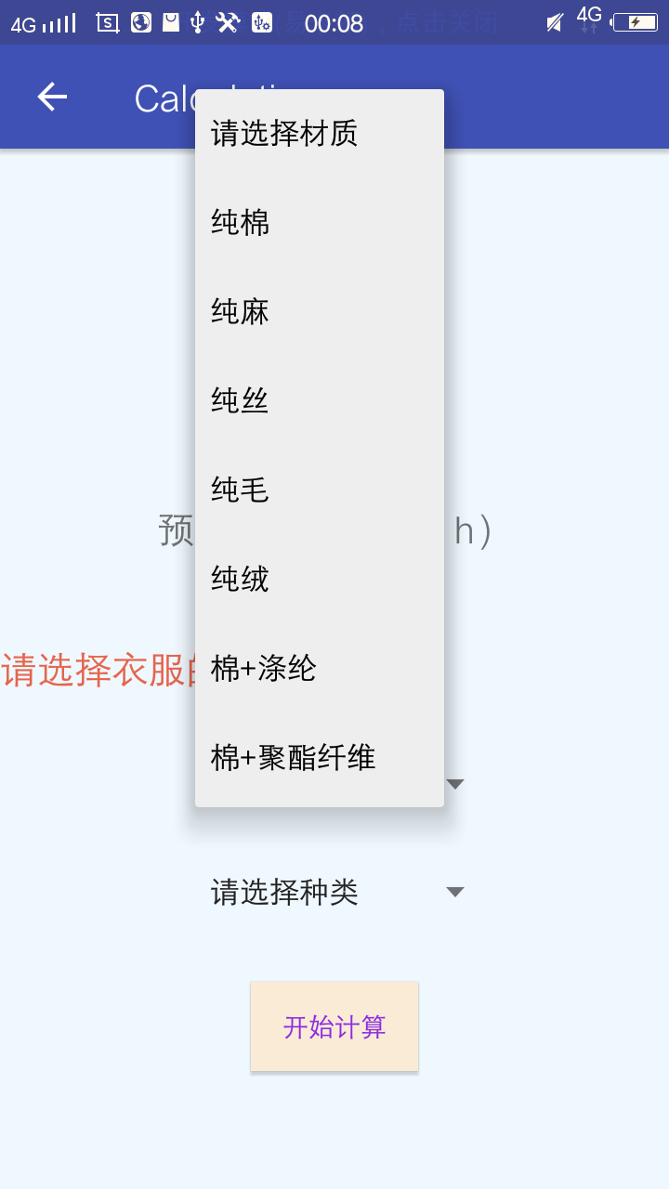
Calculation Page
This is most important part in the three UI, which is designed for our core algorithm.
Mainly consist of:
(1) TextView
(2) ListView
(3) Button
In the following two lists, the user can choose the further details of his clothes, and each choice contains different coefficient and will effect the final result of the calcualtion.

Slide 26
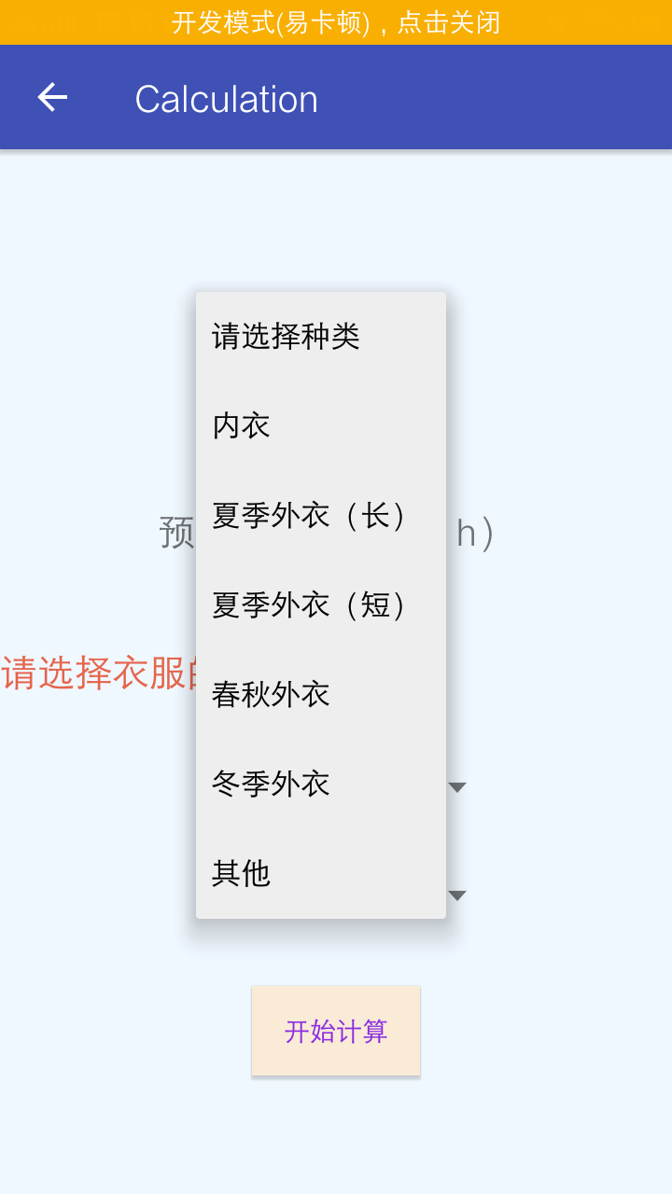
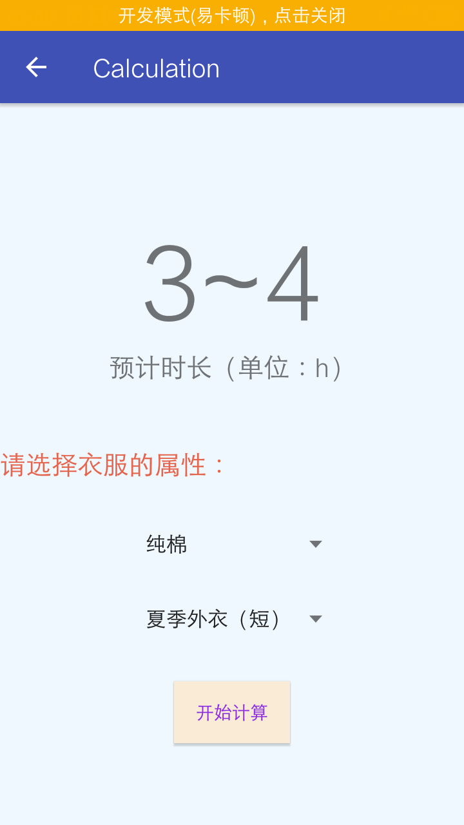
The detailed information includes the material and the type of clothes.
In the former introduction, according to our study, the material is the key factor of the result, and the type will influence the thickness of the clothes, which determines the evaporation rate.
The final result will be shown on the screen and the user can see it quite clearly.

Slide 27
THANKS

