Slide 1
上海交通大学
WordMap
电子信息与电气工程学院
Group 8
Group leader：
Hao Xia 夏昊

Slide 2
CONTENT
01
Project Background
02
App Structuring & Core Algorithm
03
UI Design
04
Maintenance & future plans
02

Slide 3
01
Project Background
PART ONE
How do we come up with this idea?
Speaker: Mengqi Cao
曹梦奇

Slide 4
Problems in my life
Have trouble remembering words
Know clearly where you encountered this word but just forget all the details
Why not try
Associative Mnemonic Approach 联想记忆法
03

Slide 5
Associative Mnemonic Approach
8:00
~
9:40
Solid
geometry
Parallelepiped
Professor
Li
Classroom
207
amazing
In psychology, associative memory is defined as the ability to learn and remember the relationship between unrelated items.
WordMap records locations to classify the words we have memorized.
04

Slide 6
Function implementation
Main function
Providing that you want to check the meaning of parallelepiped and recite it (when you are studying in the school library), you can use our WordMap to:
Check the meaning of the word.
Store such word (including meanings & your present position) in your vocabulary book.
Check the position where you recited the word on the map and display all the details about the word.
Auxiliary
function
Translate phrases and sentences.
(simply to perfect the functions of our app)
05

Slide 7
02
App Structuring &
Core Algorithm
PART TWO
How do we organise and implement our app?
Speaker: Haoxuan Wang, Hongying Ma
王皓轩，马鸿英

Slide 8
App Structuring
Speaker: Haoxuan Wang
Main Activity
Look up
words
(default)
Display
the map
Display your
vocabulary book
Translation
XML Parsing
Youdao API
Dynamic Array
(within Android)
Acquire map
Baidu Map API
Baidu Translation API
Return a string value
06

Slide 9
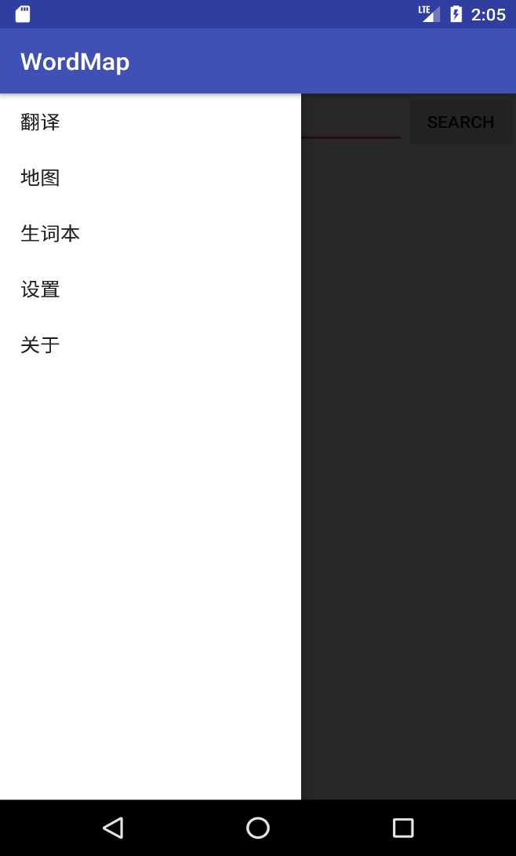
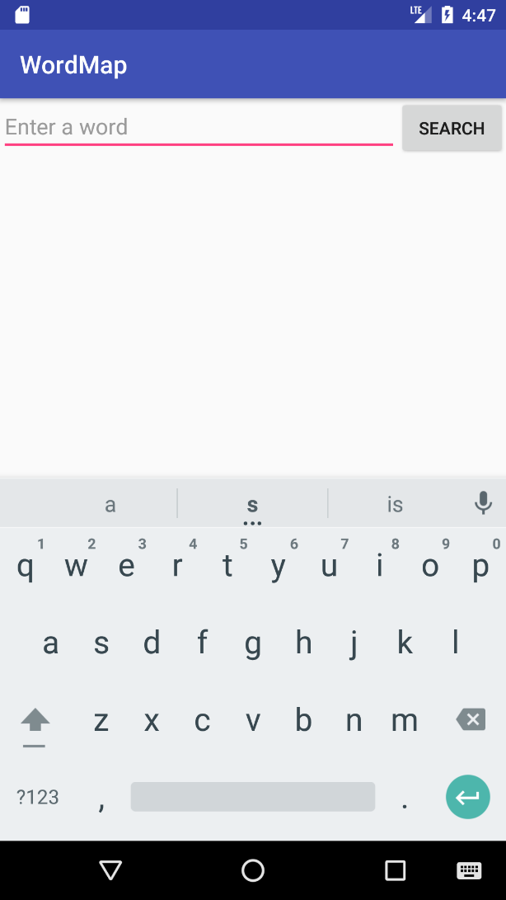
Splash，MainActivity， Youdao API
07

Slide 10
App Structure and connection
Speaker: Hongying Ma
translation
Vocabulary book（Glossary）
map
Method:
map:Baidu Map API
translation:Baidu translation API
connection with Vocabulary： Baidu map inner class :marker and
favorite.
08

Slide 11
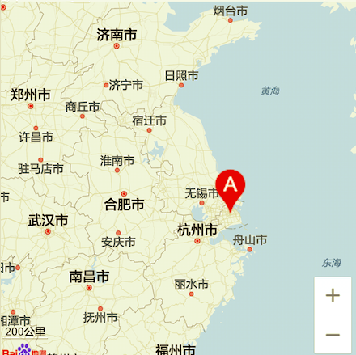
Map
Use Baidu map api to display map on the screen.
09

Slide 12
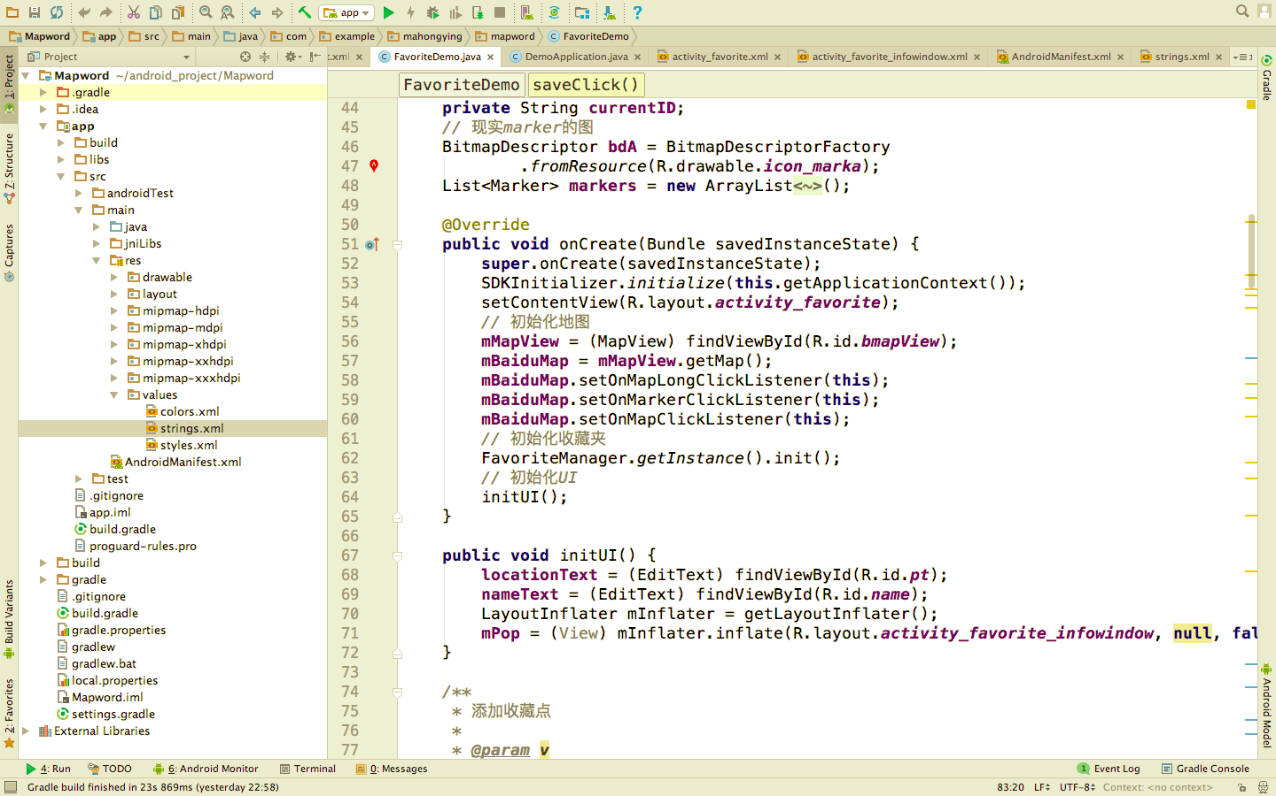
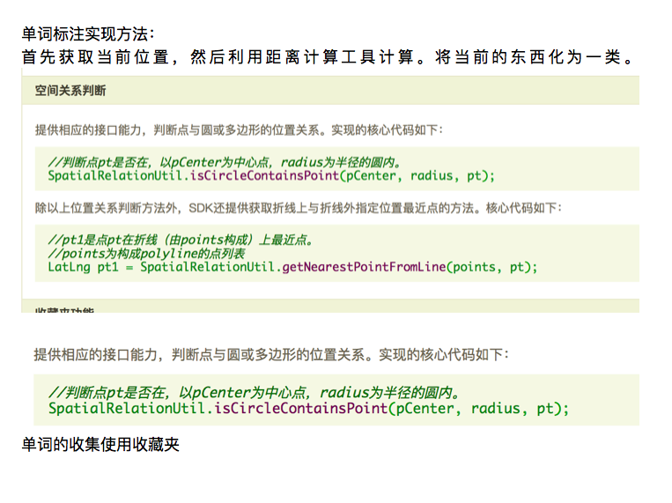
Position marker
Baidu Map inner class:marker and favorite.
10

Slide 13
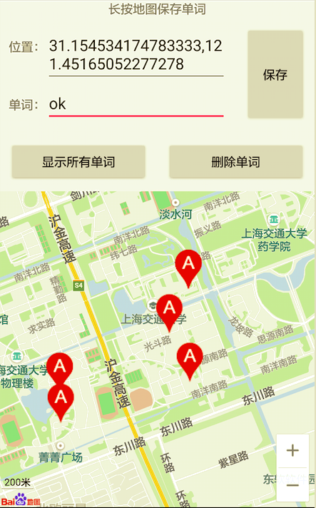
Get position
Using the function Getlatitude and Getlongitude to get the current position.
11

Slide 14
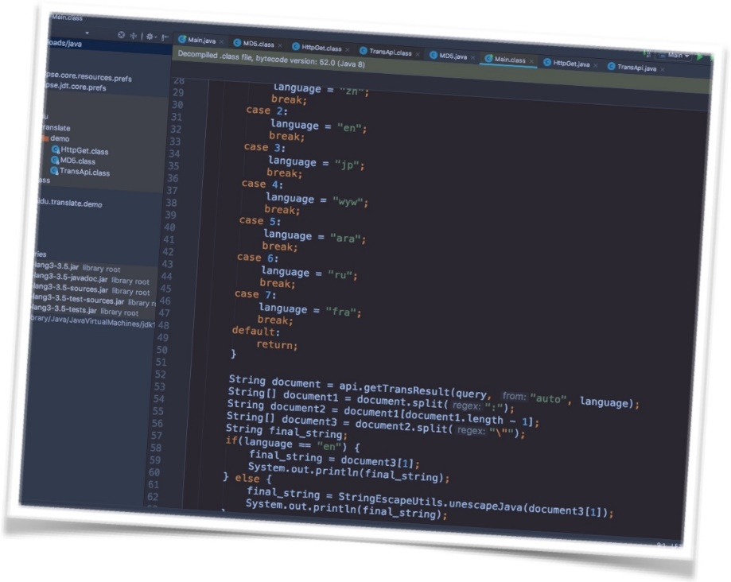
Translation
Use Baidu translation api to get the
Translation of the sentence, than Cooperate with Mengqi Cao’s interface to finish this part.
12

Slide 15
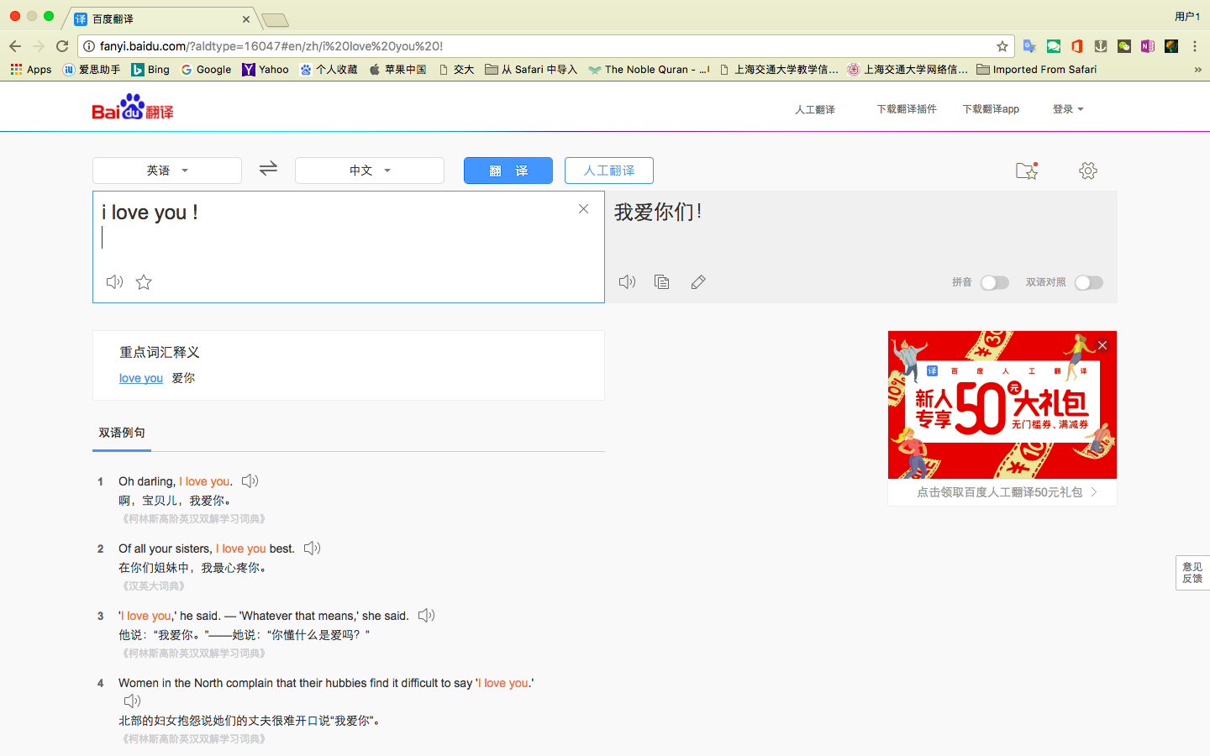
Original ideal: download the HTML page to split the string.
13

Slide 16
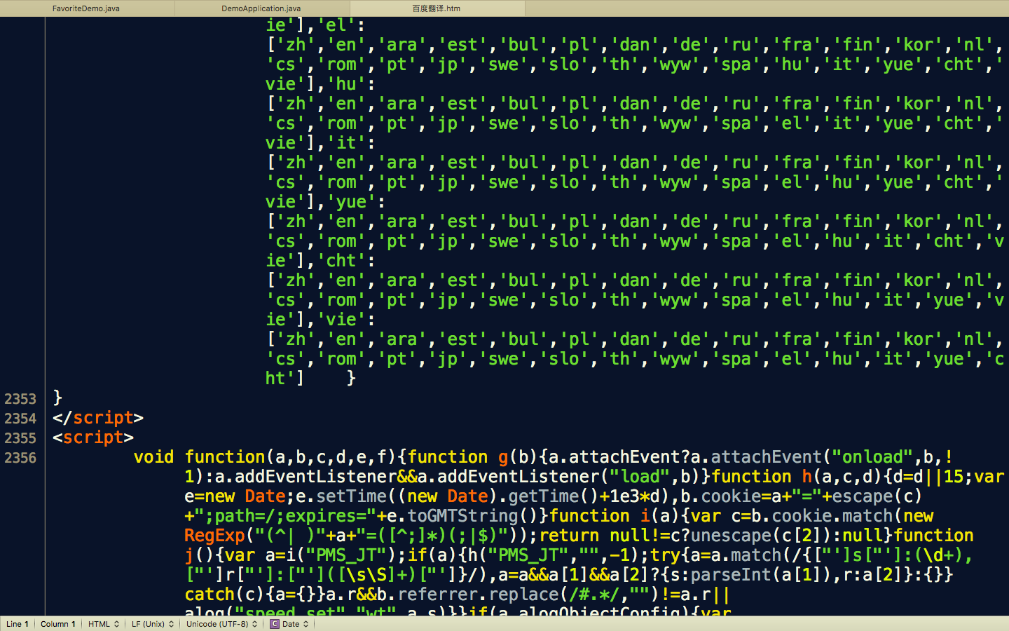
Result:failure!
HTML file: very complicated and can’t find the result.
Encryption algorithm (加密算法):MD5.
14

Slide 17
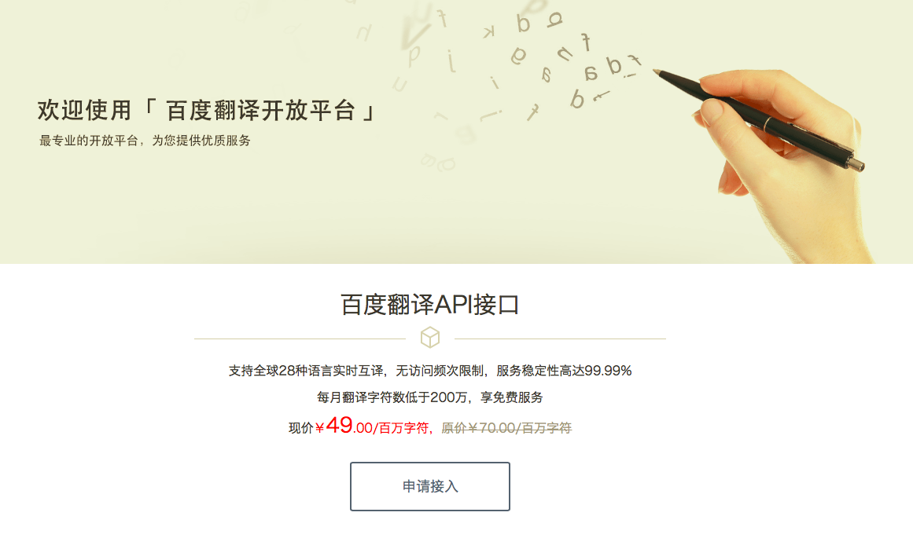
New method: API
The advantage of API:
Easy to use.
Plurilingual (多语种)
Information security:(MD5 algorithm)
15

Slide 18
03
UI Design
PART THREE
How do we build UIs?
Speaker: Hao Xia
夏昊

Slide 19
Layout
Activity
Widget
XML
16

Slide 20
TextView
Button
EditText
WebView
AlertDialog
…
17

Slide 21
LinearLayout
FrameLayout
RelativeLayout
ListView
18

Slide 22
04
Maintenance & Future plans
PART FOUR
Now it is not the end.

Slide 23
Maintenance & Future Plans
User
interface
optimization
Expansion of
the primary
vocabulary
book
APK Size &
Multi-
thread
19

Slide 24
Thanks for listening
上海交通大学
电子信息与电气工程学院
Group 6
Group leader：
Hao Xia 夏昊

