Slide 1
Family Tree
IEEE F16
Notes:
The User Interface is like this--

Slide 2
张寅青
Introduction

Slide 3
Remember HER? Who’s HIM?
Notes:
Hello everyone, we are group 12. You may wonder, what the hell our app is, is it about dementia or something? Imagine when spring festival, all your family members assembled together, and you noticed someone who’s familiar with you but you couldn’t recall who he or she is, unfortunately, he or she was walking to you and prepared to say hi. Well, it’s the time to open our app --

Slide 4
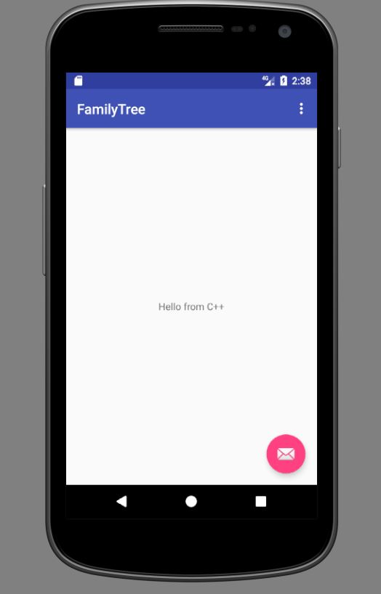
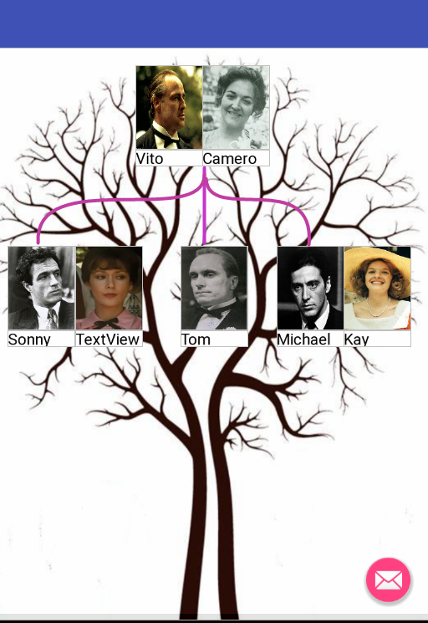
User Interface

Slide 5
Friend Circle?
Notes:
Nowadays, we are gradually used to maintaining our friend circle, which is connected by friendship. However, the family affection may be neglected as the same time. So we think about designing a family circle, which is based on blood connection.

Slide 6
How do you do!
Family meeting, Info Sharing… and more.
Notes:
In this app, it’s relatively easy to share family reunites and information with your family friend in this app.

Slide 7
Hey There!
Notes:
Another interesting function is to detect your family member, which makes it possible to connect to your long-time-no-see relative, and I will talk about how it walk latter. Now welcome our main user interface designer -- Qinyu

Slide 8
秦宇
Main User Interface

Slide 9
Main Interface
Linked picture represent a couple
Curve lines the parent and children
Each picture is a image button
Click it and show the profile

Slide 10
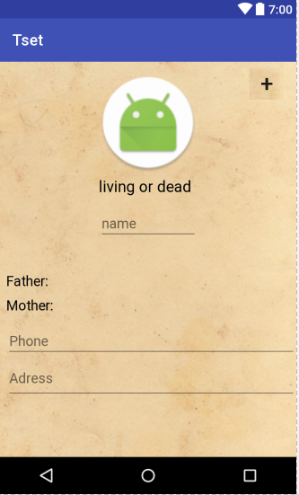
Personal Profile
Brief personal information
Dead or alive
The “+” means add sibling, child or parent

Slide 11
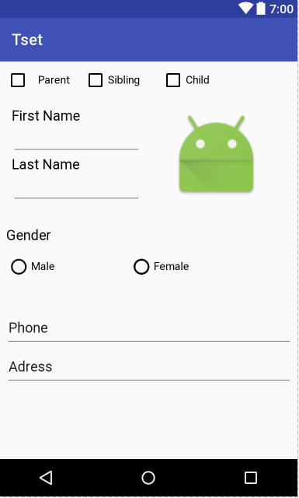
Add new people
Choose the relationship
Sibling or child or parent
Name and gender
Add photo

Slide 12
邱柏崴
Login Interface
Notes:
Welcome our designer of login interface – Qiu Bowei

Slide 13
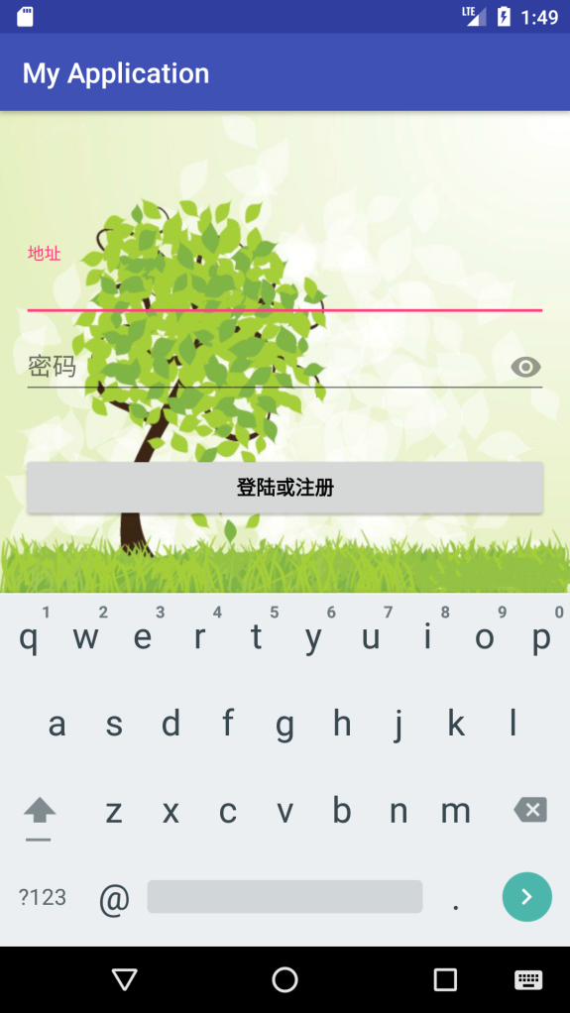
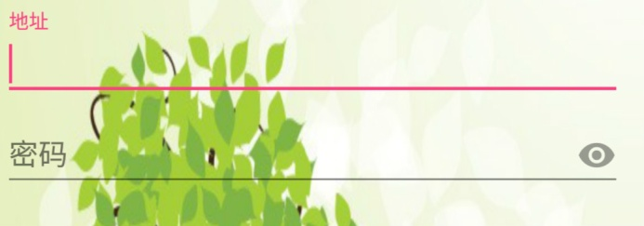
Login Interface
Address Bar
Password Bar
Login/Register Button
We set the word“地址、密码”as the hint type.

Slide 14
Success Interface
It will pop dialog according the process
Login success
Register success

Slide 15
Error
The username can’t be empty
The form of the username should be ****@***.com

Slide 16
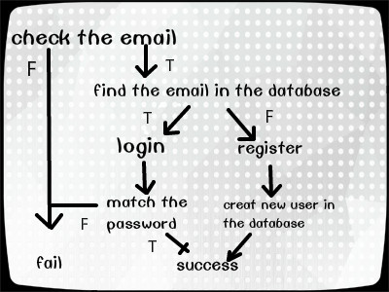
Notes:
Welcome our designer for sharing port – Zhang Yuhui

Slide 17
张煜辉
Sharing

Slide 18
We designed the screemshot function which saves the screemshot picture in the sdcard automatically.
We mainly use the “View.getDrawingCache()” method to get the screenshot.

Slide 19
We want to make our users look over their family tree or share their family tree with others conveniently. To bring users a better using experience.

Slide 20
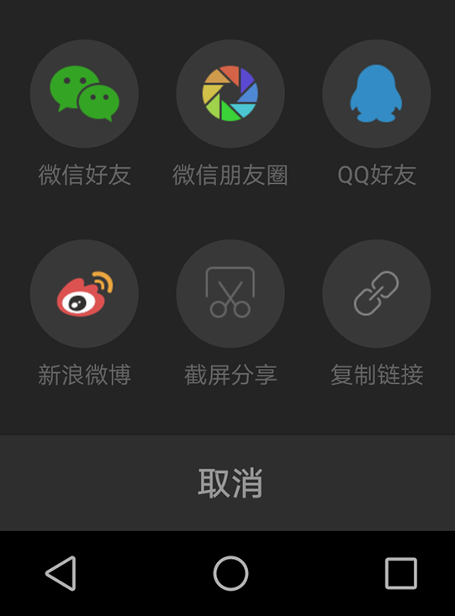
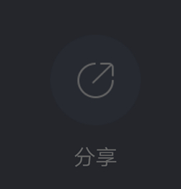
Share the pdf directly on social
media, such as Wechat, QQ
Click
Notes:
Finally, it’s the database and algorithm part.

Slide 21
张寅青
Database & Algorithms

Slide 22
HWR (Handwriting Recognition)
张二的儿子叫张三，手机号是18667131322，常住在上海。
----After Tesseract----
张二的儿子叫张三，手机号是18667131322，常住在上海。
Notes:
The first interesting feature is handwriting recognition, I used Tesseract to implement this function. The code is --

Slide 23
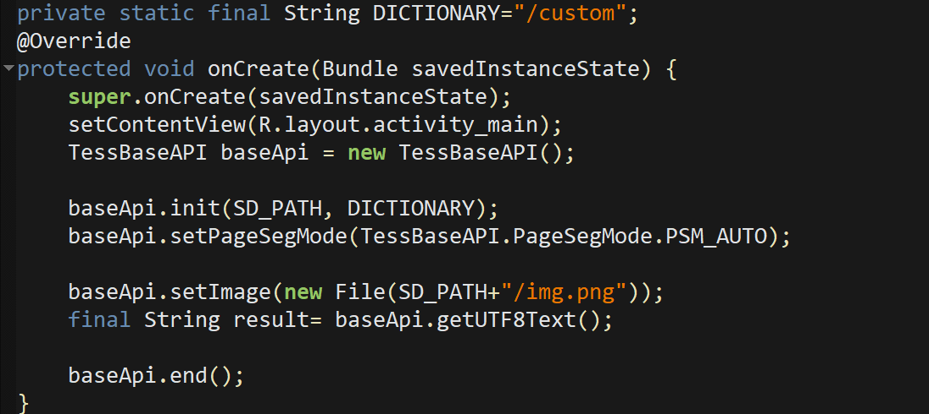

Slide 24
NLP(Natural language processing)
张二的儿子叫张三，手机号是18667131322，常住在上海。
----After NLP----
Gender：Male
Name：张三
Tel： 18667131322
Location：上海
Father：张二
Notes:
The second important feature is NLP, natural language processing. The former sentence is now processed to 5 pieces – Gender Name TelNum Location and immediate family member, well, here is his father.

Slide 25
张二
张三
张三
Gender：Male
Name：张三
Tel： 18667131322
Location：上海
Father：张二
Click
Notes:
The user interface is like this -- a bunch of the tree is established, and when you click the bottom button, his info will be show as the right column

Slide 26
Database
SQLiteDatabase
Structure
Adapter
SQLiteDatabase APIs
Notes:
The database part is kind of boring – I used SQLiteDatabase to store our user info. The following code is for storing user’s account --

Slide 29
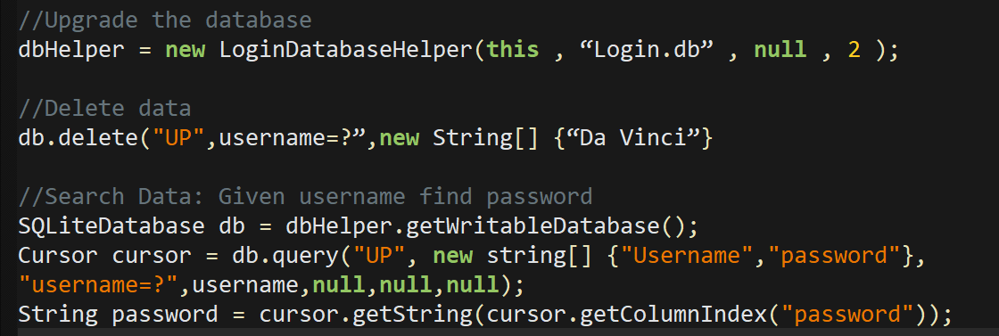

Slide 30
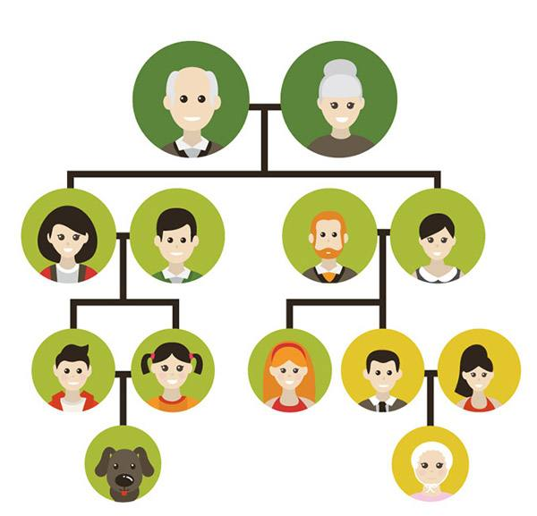
Build the Trees
Tree 1
Tree 2
Tree 3
Notes:
The last feature is connect several pieces, which I mentioned before. Here is 3 different trees, but they have some common parts.

Slide 31
Build the Trees
Tree 1
Tree 2
Tree 3

Slide 32
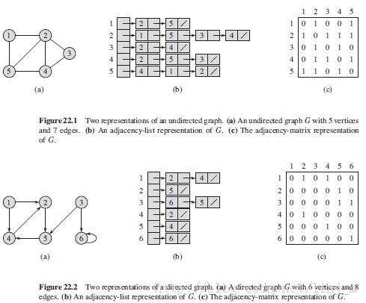
DPS
Notes:
After DPS and other necessary processing --

Slide 33
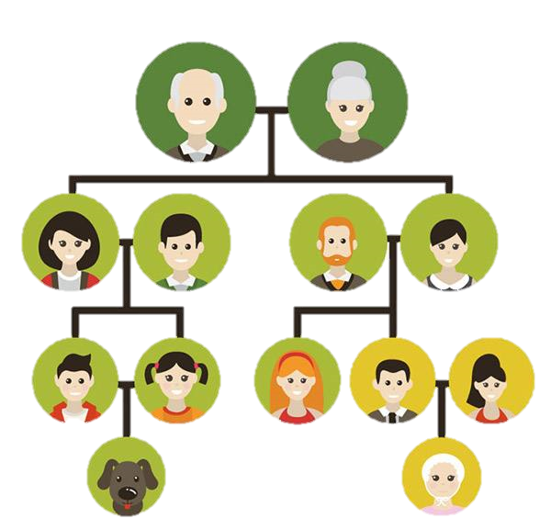
Finally
Whole Tree
Notes:
We got the whole tree – you may ask why there is a dog? Well, we all know the marriage of close relatives often leads something wrong -- This time it’s the poor dog by accident.

Slide 34
Thank You
Notes:
That’s all, thank you.

