Slide 1
Android Tex
Tex Editor on Android Platform
Haotian Tang Benjie Miao
Feixang Xu Hanbo Wen

Slide 2
Background
UI and StructTree
CONTENTS
Inner Structure and Widgets
To Improve

Slide 3
Background
Brief introduction
to
LaTeX
Why
on
Android?
Difficulties

Slide 4
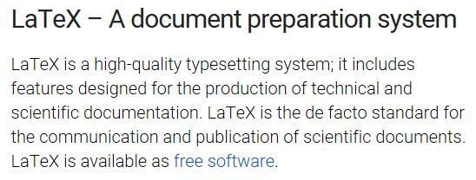

Slide 5
Background
Brief introduction
to
LaTeX
Why
on
Android?
Difficulties

Slide 6
Background
UI and StructTree
CONTENTS
Inner Structure and Widgets
To Improve

Slide 7
UI and StructTree
Decide the key function
Math
formula
Table
Picture
As to Table,
we try to enable
users to edit it like
Excels
For math formula, we want our user to insert and modify them in the most nature way to input a formula -- to write it. Fortunately, we find an API Myscript to implement this.
For picture, we decide
to provide the visualized interface

Slide 8
UI and StructTree
Decide the key function
And the primary target of the app is:
in the whole LaTeX project, the users are able to not contact with any coding. The app can deal with the coding process by itself.

Slide 9
UI and StructTree
Construct the data structure
Use a Tree Structure to represent the structure.
The different level of nodes represents the different level of sections.
Representation: Left Son Right Sibling.
class treeNode {
int index;
int parent;
int firstChild = -1; //-1 means no Child
int nextSibling = -1;//-1 means it is the last child of his parent(i.e. no next sibling)
boolean isDeleted = false; //is Deleted means the node is deleted( but is able to be recovered)
int height = 0;
//The height of the node

Slide 10
UI and StructTree
Construct the data structure
Thus, we can use a small amount of information to represent the whole structure tree. However, it is relatively difficult to edit, add or delete nodes or to modify the structure of the tree. Therefore, we design a series of Methods to construct the primitive operations:

Slide 11
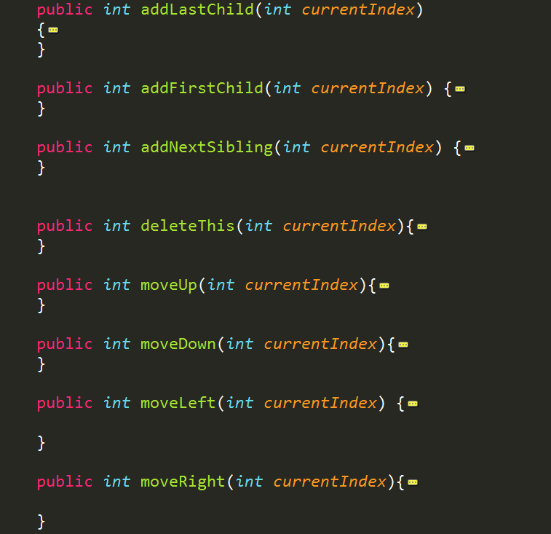

Slide 12
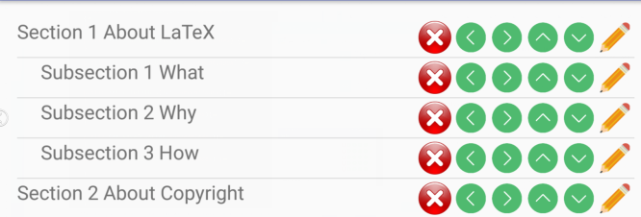
UI and StructTree
Construct the data structure
When dealing with the height of each node, we store it in every node but check and refresh it when the tree is modified.
When it comes to show the whole structure in a ListView like below:
A DFSTraversal is first done. And the sequence of each node indicates the order to be shown. And the height of node decides the indents before the item.

Slide 13
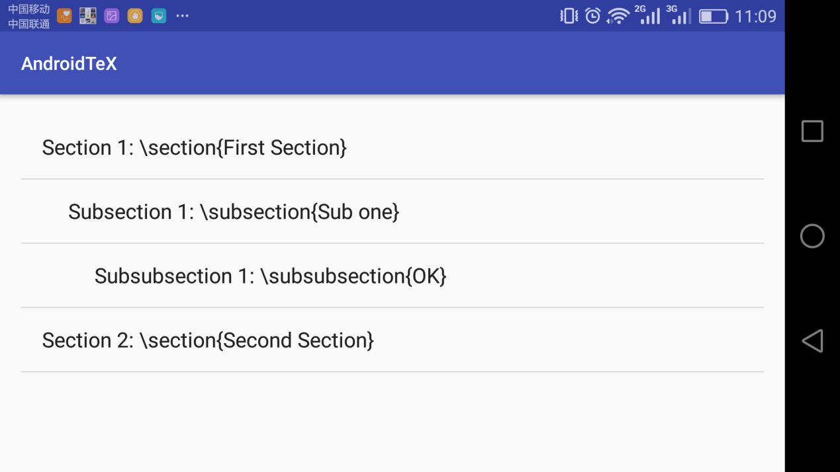
UI and StructTree
User interface
The main interface is the structure of the Essay.

Slide 14
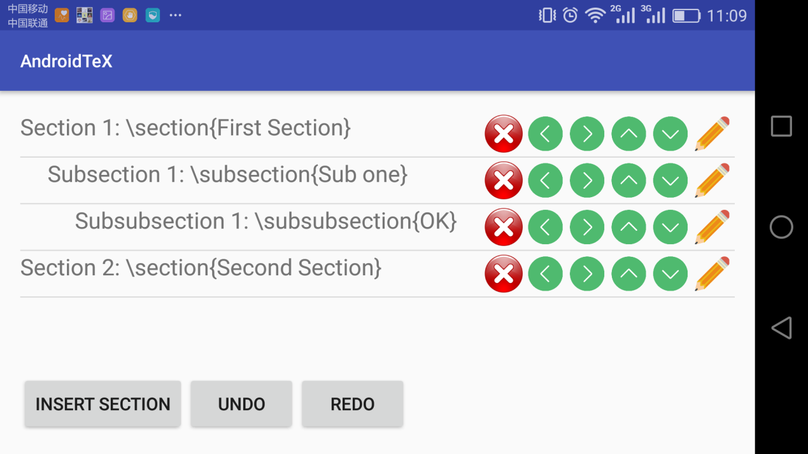
UI and StructTree
User interface
simply click the certain item: see and edit one section and the content of the section will appears.
long-click: the system enters the modifying mode.

Slide 15
Background
UI and StructTree
CONTENTS
Inner Structure and Widgets
To Improve

Slide 16
Inner Structure and Widgets
Syntax analysis
Adjacent sections can have only 3 relationships:
1. Father node and son node;
2. Siblings;
3. Different level but not father and son.
We can perform following operations when building the struct tree.
1.Add first child to the first node.
2.Add next sibling to the first node.
3.Find LCA(Least Common Ancestor) of the first node and the second node, and add the second node as a next sibling of LCA’s first son.

Slide 17
Inner Structure and Widgets
Syntax analysis
Use an Article class to store the information of the whole passage:
1.all the inner structures
2.some interfaces which can interact with inner structures
3.StructTree
A global class

Slide 18
Inner Structure and Widgets
Inner structure
A class ArticleComponent to store the inner information of each latex document.
Three simple elements:
1.table
2.mathematical formula
3.picture
Position vector

Slide 19
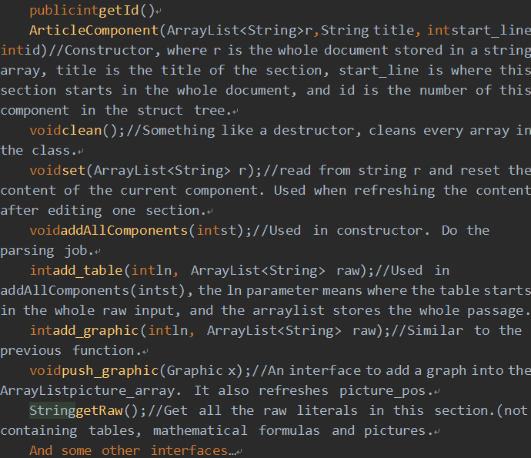
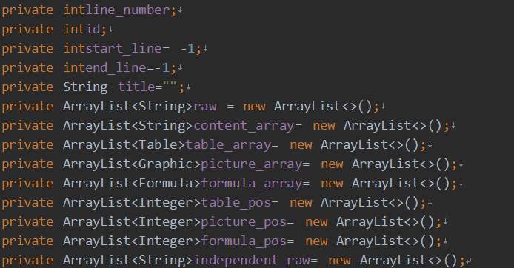
Inner Structure and Widgets
Inner structure
Structrue of ArticleComponent
Methods of ArticleComponent

Slide 20
Inner Structure and Widgets
Mathematical Formulas
Hand-writing coginition:
Using Myscript api.
What is supported:
Real time hand-writing cognition
and converting into latex strings.
Restore the content that is recognized
last time.
What to be supported:(We have been
working on this but due to the time
limit we haven’t succeeded):
Use this Api to modify existing
mathematical formulas in the document.

Slide 21
Inner Structure and Widgets
Rendering
Java API JLatexmath
Basically the API can only render single-line tex code.
After doing some modifications to the API, it can render the whole section now.
About What is Rendered

Slide 22
Background
UI and StructTree
CONTENTS
Inner Structure and Widgets
To Improve

Slide 23
To improve
Future works
1.Modify existing mathematical formulas in the document.
2.Not only simple m*n tables, support merging.
3.Able to generate the result .pdf file on the mobile.

Slide 24
THANKS

