Slide 1
Word2vec Tutorial
Zhe Ye
yezhejack@sjtu.edu.cn
2018.9.27

Slide 2
Outline
One-hot representation vs word vectors
Requirement
Virtual environment
Python
Corpus
Gensim
Training word vectors
Evaluation
Analogy
Word clustering

Slide 3
One-hot representation vs word vectors
One-hot representation
Sparse: using 3000K dimensions to represent vocabulary with 3000K word types
Not related
Word vectors
Model statistical information
Dense: using 300 (or less) to represent vocabulary with 3000K word types
related

Slide 4
Outline
One-hot representation vs word vectors
Requirement
Virtual environment
Python
Corpus
Gensim
Training word vectors
Evaluation
Analogy
Word clustering

Slide 5
Virtual environment
Features
Provide separate dependency libraries
Do not require admin or sudo to install package
Two popular tools which provide these features
Anaconda
It’s convenient in windows (scipy)
Virtualenv

Slide 6
Python
It’s very popular in NLP
It’s very simple and easy to understand
Version: Python 3.6

Slide 7
Corpus
Tokenized plain text
我们很高兴。 -> 我们 很 高兴 。
We are very happy. -> We are very happy .
Tokenized plain text resource
http://www.statmt.org/lm-benchmark/1-billion-word-language-modeling-benchmark-r13output.tar.gz
Tokenizer
LTP for Chinese (https://github.com/HIT-SCIR/ltp)
Stanford Tokenizer (https://nlp.stanford.edu/software/tokenizer.shtml)

Slide 8
Training data

Slide 9
Gensim
Implementing a wrapper for word2vec (https://code.google.com/archive/p/word2vec/)
It provides python API

Slide 10
Outline
One-hot representation vs word vectors
Requirement
Virtual environment
Python
Corpus
Gensim
Training word vectors
Evaluation
Analogy
Word clustering

Slide 11
Training word vectors
Linux+virtualenv+gensim (recommended)
Windows 10 (64bit) + anaconda+gensim

Slide 12
Training word vectors

Slide 13
Using word vectors
vec(‘China’) = {0.1502911, 0.19706184, -0.13560876, ..., 0.12463704}

Slide 14
Outline
One-hot representation vs word vectors
Requirement
Virtual environment
Python
Corpus
Gensim
Training word vectors
Evaluation
Word clustering
Analogy

Slide 15
Evaluation
most similar
China
Chinese\Beijing\Taiwan\Shanghai\Guangdong\Hainan\Hong_Kong\Shenzhen
king
kings\queen\monarch\crown_prince\prince\sultan\ruler\princes\throne
wonderful
marvelous\fantastic\great\fabulous\terrific\lovely\amazing\beautiful\magnificant\delightful

Slide 16
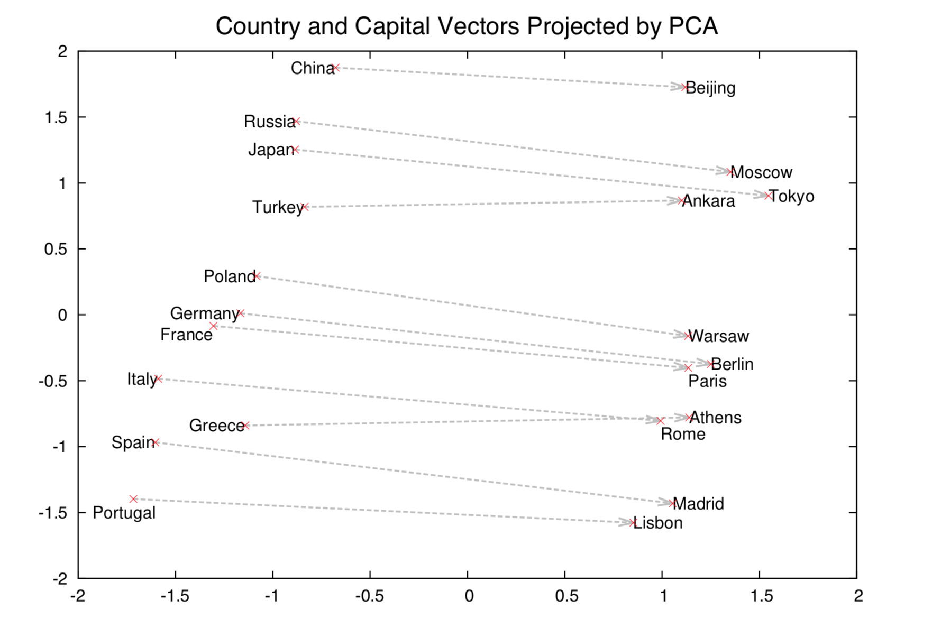
Evaluation
Analogy
vector(‘Beijing’)-vector(‘China’) = vector(‘Paris’)-vector(‘France’)
vector(‘Beijing’)-vector(‘China’)+vector(‘France’)=vector(‘Paris’)

