Slide 1
MySQL Introduction
Notes:
MySQL介绍

Slide 2
Outline
MySQL Introduction & Installation
MySQL Command-Line Tool
MySQL Workbench Introduction
MySQL with Python
Code Example
Notes:
大纲
MySQL数据库软件介绍&安装
MySQL在终端的命令行下的使用
MySQL图形化操作界面MySQL Workbench介绍
MySQL和程序代码结合（以Python为例）
样例代码演示

Slide 3
MySQL Introduction
Open Source (C/C++), Free
High Performance, Low Cost, High Reliability
LAMP (Linux+Apache+MySQL+PHP)
Multi-OS Support (Windows, Linux, MacOS)
API Support (C/C++, C#, Python, PHP, Java)
Notes:
MySQL特点介绍
开放源代码（C/C++），免费
性能高、成本低、可靠性好
流行的LAMP组合（Linux+Apache+MySQL+PHP）
支持多种操作系统（Windows, Linux, MacOS）
API支持多种语言（C/C++, C#, Python, PHP, Java）

Slide 4
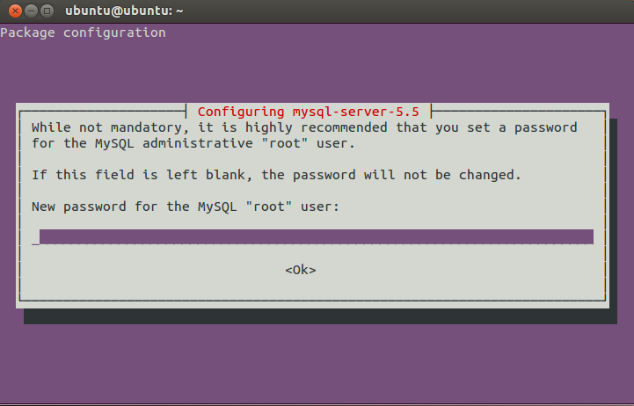
MySQL Installation
OS: Ubuntu Linux
Official Site: http://dev.mysql.com/downloads/mysql/
Select Platform and download a deb package
Latest version: MySQL Community Server 5.7.11
Using apt-get (Recommanded)
sudo apt-get install mysql-server mysql-client
Set a password for root account
For Windows, don’t forget to set Windows system PATH environment variable

Slide 5
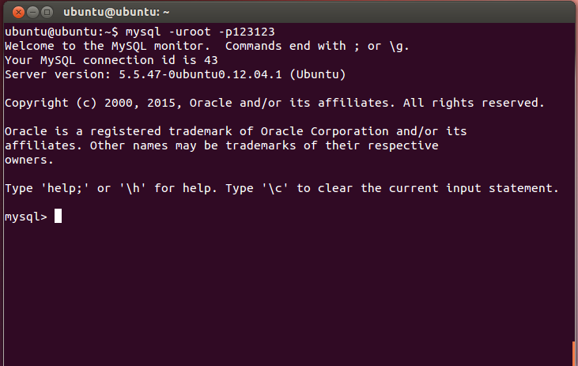
MySQL Command-Line Tool
Login
mysql –u<username> –p<password>
mysql –uroot –p123123
Logout
exit

Slide 6
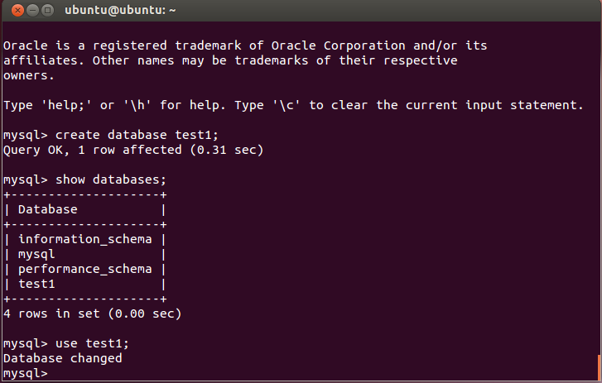
MySQL Command-Line Tool
Input your SQL after “mysql>”

Slide 7
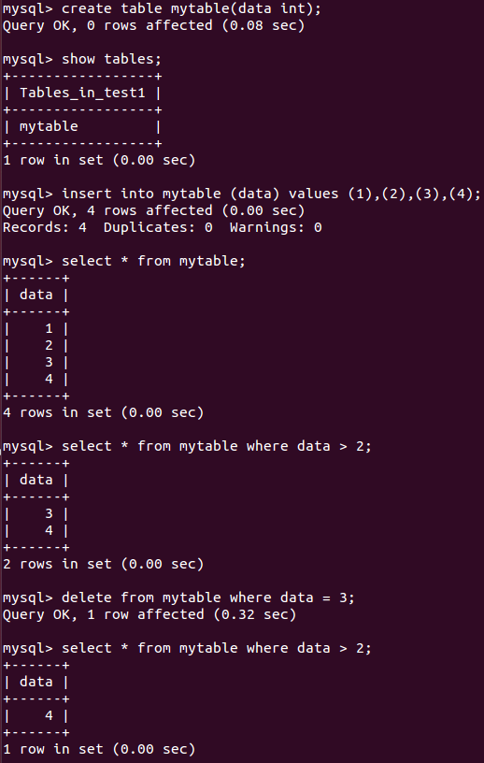
MySQL Command-Line Tool

Slide 8
MySQL Workbench Installation
A visual tool for MySQL
Official Site: http://dev.mysql.com/downloads/workbench/
Select Platform and download a deb package
Latest version: MySQL Workbench 6.3.6
Using apt-get (Recommanded)
sudo apt-get install mysql-workbench
Notes:
MySQL的可视化操作软件

Slide 9
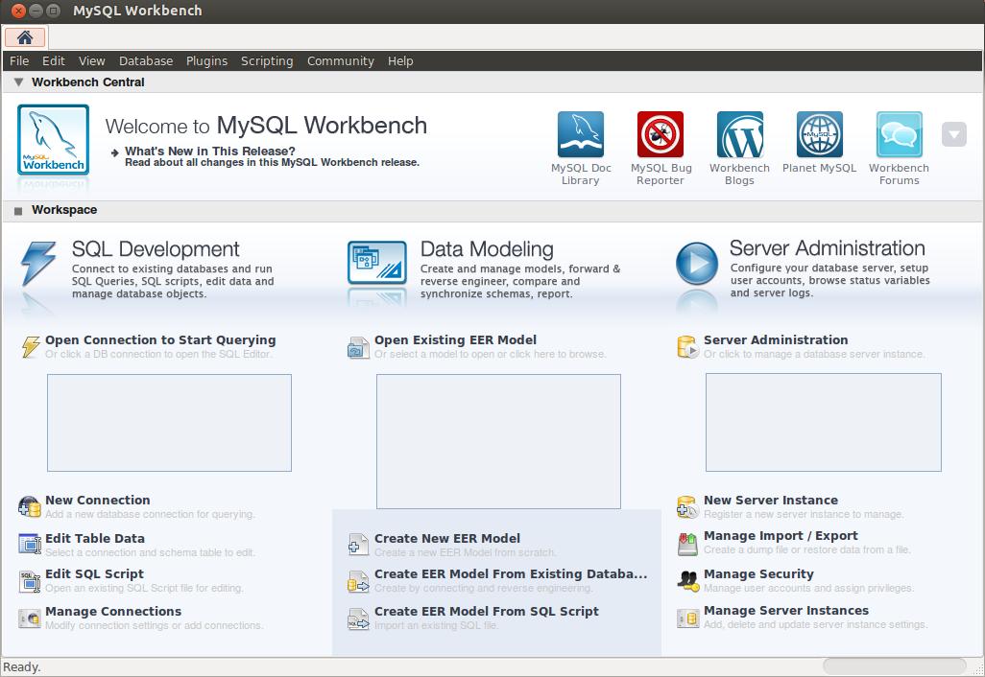
MySQL Workbench Login

Slide 10
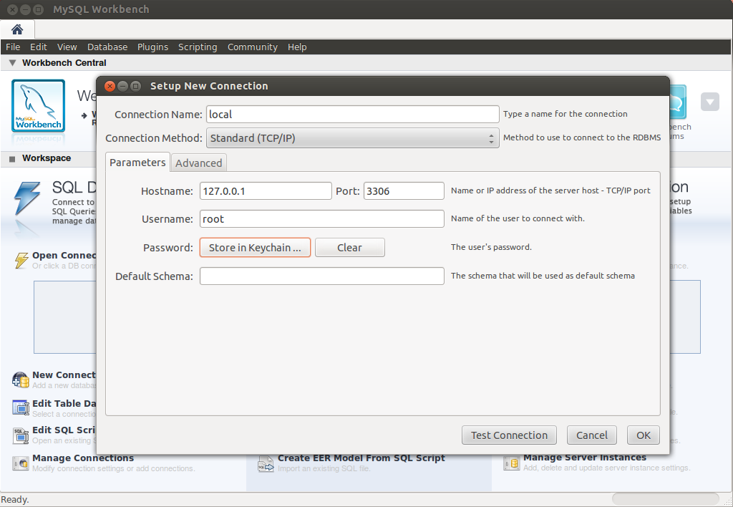
MySQL Workbench Login
Hostname, Port, Username, Password

Slide 11
MySQL Workbench UI

Slide 12
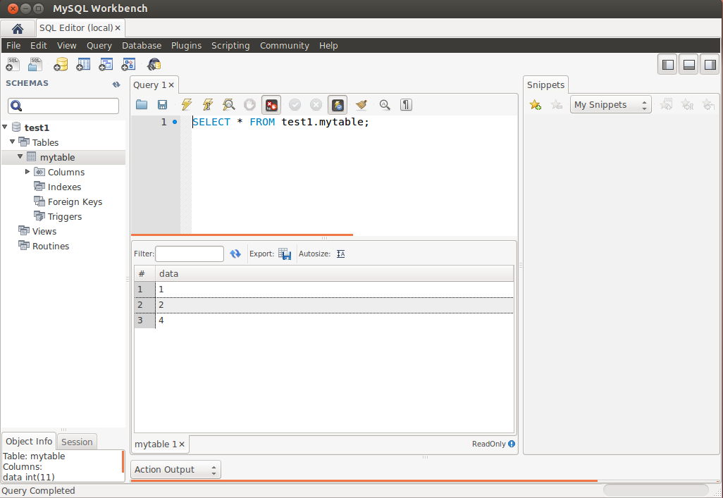
MySQL Workbench Usage

Slide 13
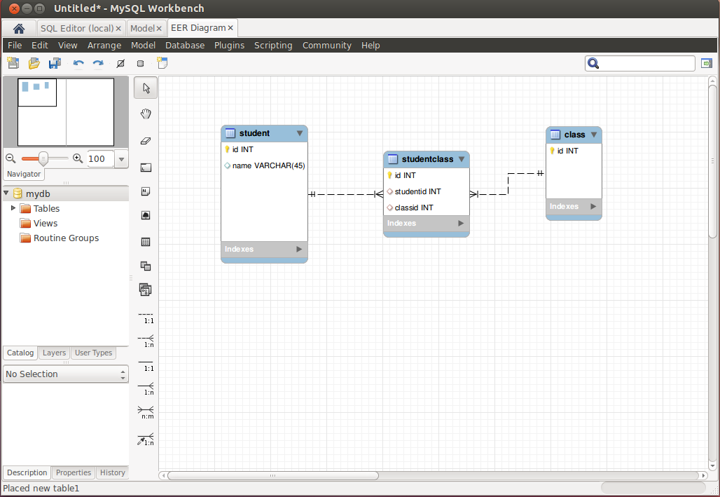
MySQL Workbench ER Model & Forward Engineering
File->New Model->Add Diagam
File->Export
Get SQL Script

Slide 14
DB example
create table students(
sid int,
name varchar(40),
dept varchar(40),
age int,
primary key(sid)
);
create table courses(
cid int,
cname varchar(40),
spring int,
teacher varchar(40),
primary key(cid)
);
create table sc (
sid int references students(sid) ON DELETE CASCADE ON UPDATE CASCADE,
cid int ,
semester int,
cname varchar(40),
grade int
);

Slide 15
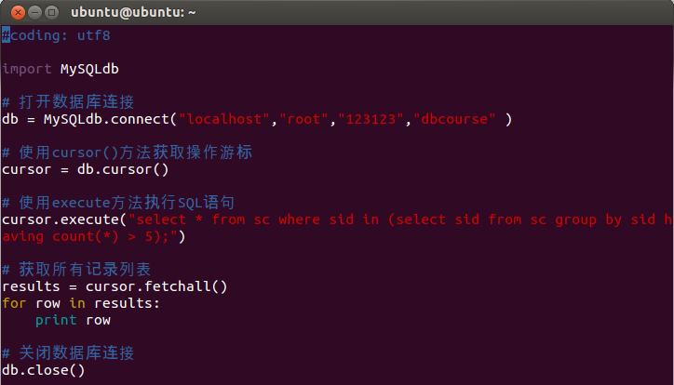
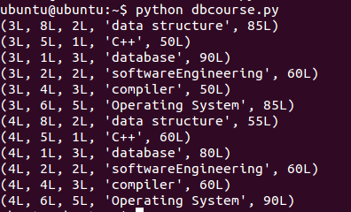
MySQL with Python
Install MySQLdb Lib for Python
sudo apt-get install python-mysqldb

Slide 16
Web.py
Web.py is a web framework for Python
http://webpy.org/
Installation
sudo apt-get install python-pip
sudo pip install web.py
Code example
Special Database API (part of web.py)

Slide 17
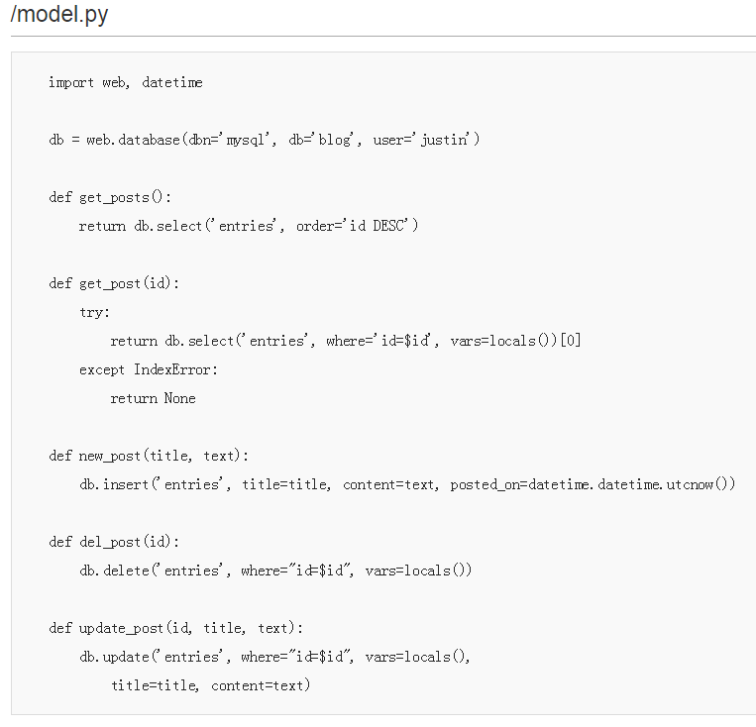
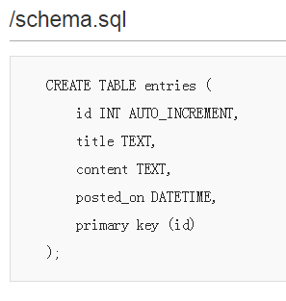
Blog

Slide 18
Other References
https://en.wikipedia.org/wiki/MySQL
http://www.runoob.com/mysql/mysql-install.html
http://blog.csdn.net/ithomer/article/details/5131863
http://www.runoob.com/python/python-mysql.html

Slide 19
如何系统学习MySQL
《深入理解MySQL》（人民邮件出版社 Charles A Bell著）
《深入理解MySQL核心技术》（O'REILLY出版社 中国电力出版社 Sasha Pachev著）
《高性能MySQL》（O'REILLY出版社 电子工业出版社 Baron Schwartz等著）

