Slide 1
Intro to Spark
Lightning-fast cluster computing

Slide 2

What is Spark?
Spark Overview:
A fast and general-purpose cluster computing system.
Notes:
Spark是一个开源的通用并行分布式计算框架

Slide 3
What is Spark?
Spark Overview:
A fast and general-purpose cluster computing system.
It provides high-level APIs in Java, Scala and Python, and an optimized engine that supports general execution graphs.

Slide 4
What is Spark?
Spark Overview:
A fast and general-purpose cluster computing system.
It provides high-level APIs in Java, Scala and Python, and an optimized engine that supports general execution graphs.
It supports a rich set of higher-level tools including:
Spark SQL for SQL and structured data processing
MLlib for machine learning
GraphX for graph processing
Spark Streaming for streaming processing
Notes:
Spark是一个开源的通用并行分布式计算框架，由加州大学伯克利分校的AMP实验室开发，支持内存计算、多迭代批量处理、即席查询、流处理和图计算等多种范式。Spark内存计算框架适合各种迭代算法和交互式数据分析，能够提升大数据处理的实时性和准确性，现已逐渐获得很多企业的支持，如阿里巴巴、百度、网易、英特尔等公司。

Slide 5
Apache Spark
A Brief History

Slide 6
A Brief History: MapReduce
circa 2004 – Google
MapReduce: Simplified Data Processing on Large Clusters
Jeffrey Dean and Sanjay Ghemawat
MapReduce is a programming model and an associated implementation for processing and generating large data sets.
research.google.com/archive/mapreduce.html

Slide 7
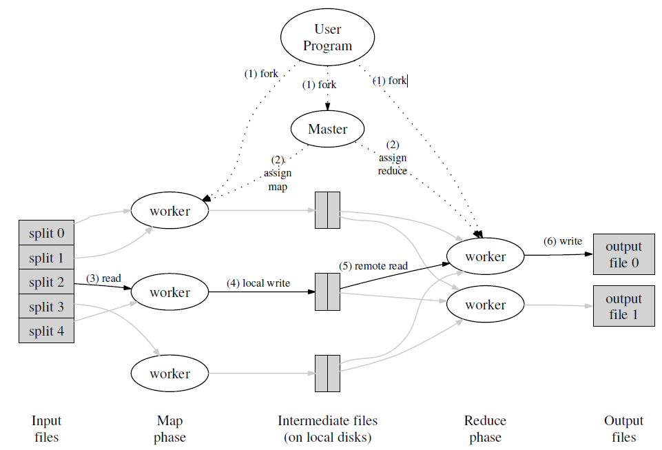
A Brief History: MapReduce
circa 2004 – Google
MapReduce: Simplified Data Processing on Large Clusters
Jeffrey Dean and Sanjay Ghemawat
MapReduce is a programming model and an associated implementation for processing and generating large data sets.
research.google.com/archive/mapreduce.html

Slide 8
A Brief History: MapReduce
MapReduce use cases showed two major
limitations:
1. difficultly of programming directly in MR
2. performance bottlenecks, or batch not
fitting the use cases
In short, MR doesn’t compose well for large
applications

Slide 9
A Brief History: Spark
Developed in 2009 at UC Berkeley AMPLab, then open sourced in 2010, Spark has since become one of the largest OSS communities in big data, with over 200 contributors in 50+ organizations
Unlike the various specialized systems, Spark’s goal was to generalize MapReduce to support new apps within same engine
Lightning-fast cluster computing

Slide 10

A Brief History: Special Member
Lately I've been working on the Databricks Cloud and Spark. I've been responsible for the architecture, design, and implementation of many Spark components. Recently, I led an effort to scale Spark and built a system based on Spark that set a new world record for sorting 100TB of data (in 23 mins).
@Reynold Xin

Slide 11
A Brief History: Benefits Of Spark
Speed
  Run programs up to 100x faster than Hadoop MapReduce in memory, or 10x faster on disk.
Notes:
首先，Spark 是为集群计算中的特定类型的工作负载而设计，即那些在并行操作之间重用工作数据集（比如机器学习算法）的工作负载。为了优化这些类型的工作负载，Spark 引进了内存集群计算的概念，可在内存集群计算中将数据集缓存在内存中，以缩短访问延迟.

Slide 12
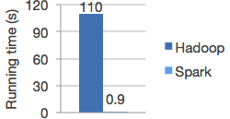
A Brief History: Benefits Of Spark
Speed
  Run programs up to 100x faster than Hadoop MapReduce in memory, or 10x faster on disk.

Slide 13
A Brief History: Benefits Of Spark
Speed
  Run programs up to 100x faster than Hadoop MapReduce in memory, or 10x faster on disk.
Ease of Use
  Write applications quickly in Java, Scala or Python.

Slide 14
A Brief History: Benefits Of Spark
Speed
  Run programs up to 100x faster than Hadoop MapReduce in memory, or 10x faster on disk.
Ease of Use
  Write applications quickly in Java, Scala or Python.
WordCount in 3 lines of Spark
WordCount in 50+ lines of Java MR
Notes:
其中的file是根据HDFS上的文件创建的RDD，后面的flatMap，map，reduceByKey都创建出一个新的RDD，一个简短的程序就能够执行很多个转换和动作。

Slide 15
A Brief History: Benefits Of Spark
Speed
  Run programs up to 100x faster than Hadoop MapReduce in memory, or 10x faster on disk.
Ease of Use
  Write applications quickly in Java, Scala or Python.
Generality
  Combine SQL, streaming, and complex analytics.

Slide 16
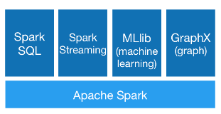
A Brief History: Benefits Of Spark
Speed
  Run programs up to 100x faster than Hadoop MapReduce in memory, or 10x faster on disk.
Ease of Use
  Write applications quickly in Java, Scala or Python.
Generality
  Combine SQL, streaming, and complex analytics.

Slide 17
A Brief History: Key distinctions for Spark vs. MapReduce
handles batch, interactive, and real-time within a single framework
programming at a higher level of abstraction
more general: map/reduce is just one set of supported constructs
functional programming / ease of use
⇒ reduction in cost to maintain large apps
lower overhead for starting jobs
less expensive shuffles
…

Slide 18
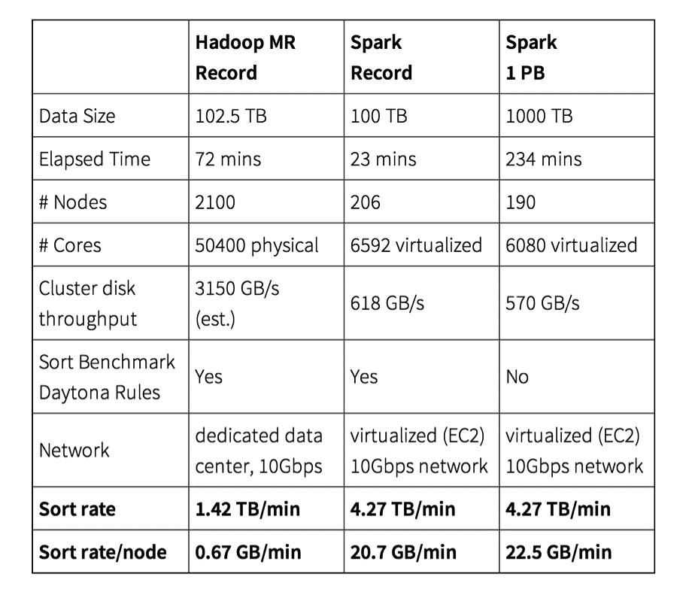
TL;DR: Smashing The Previous Petabyte Sort Record
databricks.com/blog/2014/11/05/spark-officially-sets-a-new-record-in-large-scale-sorting.html

Slide 19
TL;DR: Sustained Exponential Growth
Spark is one of the most active Apache projects
ohloh.net/orgs/apache

Slide 20
TL;DR: Spark Just Passed Hadoop in Popularity on Web
datanami.com/2014/11/21/spark-just-passed-hadoop-popularity-web-heres/
In October Apache Spark (blue line)
passed Apache Hadoop (red line) in
popularity according to Google Trends
Notes:
Spark开源生态系统在2014上半年大幅增长，已迅速成为大数据领域中最活跃的开源项目，HDFS位列第二，其代码变动次数（commits）和行数仅仅有Spark的一半
有超过50个机构250个工程师贡献过代码
2014年7月和2013年六月相比，代码行数几乎扩大三倍。

Slide 21
TL;DR: Spark Expertise Tops Median Salaries within Big Data
oreilly.com/data/free/2014-data-science-salary-survey.csp

Slide 22
Apache Spark
Spark Deconstructed

Slide 23
Spark Deconstructed: Scala Crash Course
Spark was originally written in Scala, which allows concise function syntax and interactive use.
Before deconstruct Spark, introduce to Scala.

Slide 24
Scala Crash Course: About Scala
High-level language for the JVM
Object oriented + functional programming
Statically typed
Comparable in speed to Java*
Type inference saves us from having to write explicit types most of the time
Interoperates with Java
Can use any Java class (inherit from, etc.)
Can be called from Java code

Slide 25
Scala Crash Course: Variables and Functions
Declaring variables:
var x: Int = 7
var x = 7 // type inferred
val y = “hi” // read-only

Slide 26
Scala Crash Course: Variables and Functions
Declaring variables:
var x: Int = 7
var x = 7 // type inferred
val y = “hi” // read-only
Java equivalent:
int x = 7;
final String y = “hi”;

Slide 27
Scala Crash Course: Variables and Functions
Declaring variables:
var x: Int = 7
var x = 7 // type inferred
val y = “hi” // read-only
Functions:
def square(x: Int): Int = x*x
def square(x: Int): Int = {
x*x
}
def announce(text: String) =
{
println(text)
}
Java equivalent:
int x = 7;
final String y = “hi”;

Slide 28
Scala Crash Course: Variables and Functions
Declaring variables:
var x: Int = 7
var x = 7 // type inferred
val y = “hi” // read-only
Functions:
def square(x: Int): Int = x*x
def square(x: Int): Int = {
x*x
}
def announce(text: String) =
{
println(text)
}
Java equivalent:
int x = 7;
final String y = “hi”;
Java equivalent:
int square(int x) {
return x*x;
}
void announce(String text) {
System.out.println(text);
}

Slide 29
Scala Crash Course: Scala functions (closures)
(x: Int) => x + 2 // full version

Slide 30
Scala Crash Course: Scala functions (closures)
(x: Int) => x + 2 // full version
x => x + 2 // type inferred

Slide 31
Scala Crash Course: Scala functions (closures)
(x: Int) => x + 2 // full version
x => x + 2 // type inferred
_ + 2 // placeholder syntax (each argument must be used
exactly once)

Slide 32
Scala Crash Course: Scala functions (closures)
(x: Int) => x + 2 // full version
x => x + 2 // type inferred
_ + 2 // placeholder syntax (each argument must be used
exactly once)
x => { // body is a block of code
val numberToAdd = 2
x + numberToAdd
}

Slide 33
Scala Crash Course: Scala functions (closures)
(x: Int) => x + 2 // full version
x => x + 2 // type inferred
_ + 2 // placeholder syntax (each argument must be used
exactly once)
x => { // body is a block of code
val numberToAdd = 2
x + numberToAdd
}
// Regular functions
def addTwo(x: Int): Int = x + 2

Slide 34
Scala Crash Course: Collections processing
Processing collections with functional programming
val list = List(1, 2, 3)

Slide 35
Scala Crash Course: Collections processing
Processing collections with functional programming
val list = List(1, 2, 3)
list.foreach(x => println(x)) // prints 1, 2, 3
list.foreach(println) // same

Slide 36
Scala Crash Course: Collections processing
Processing collections with functional programming
val list = List(1, 2, 3)
list.foreach(x => println(x)) // prints 1, 2, 3
list.foreach(println) // same
list.map(x => x + 2) // returns a new List(3, 4, 5)
list.map(_ + 2) // same

Slide 37
Scala Crash Course: Collections processing
Processing collections with functional programming
val list = List(1, 2, 3)
list.foreach(x => println(x)) // prints 1, 2, 3
list.foreach(println) // same
list.map(x => x + 2) // returns a new List(3, 4, 5)
list.map(_ + 2) // same
list.filter(x => x % 2 == 1) // returns a new List(1, 3)
list.filter(_ % 2 == 1) // same

Slide 38
Scala Crash Course: Collections processing
Processing collections with functional programming
val list = List(1, 2, 3)
list.foreach(x => println(x)) // prints 1, 2, 3
list.foreach(println) // same
list.map(x => x + 2) // returns a new List(3, 4, 5)
list.map(_ + 2) // same
list.filter(x => x % 2 == 1) // returns a new List(1, 3)
list.filter(_ % 2 == 1) // same
list.reduce((x, y) => x + y) // => 6
list.reduce(_ + _) // same

Slide 39
Scala Crash Course: Collections processing
Functional methods on collections
http://www.scala-lang.org/api/2.10.4/index.html#scala.collection.Seq
Method on Seq[T] | Explanation
map(f: T => U): Seq[U] | Each element is result of f
flatMap(f: T => Seq[U]): Seq[U] | One to many map
filter(f: T => Boolean): Seq[T] | Keep elements passing f
exists(f: T => Boolean): Boolean | True if one element passes f
forall(f: T => Boolean): Boolean | True if all elements pass
reduce(f: (T, T) => T): T | Merge elements using f
groupBy(f: T => K): Map[K, List[T]] | Group elements by f
sortBy(f: T => K): Seq[T] | Sort elements
…..

Slide 40
Spark Deconstructed: Log Mining Example
// load error messages from a log into memory
// then interactively search for various patterns
// base RDD
val file = sc.textFile("hdfs://...")
// transformed RDDs
val errors = file.filter(line => line.contains("ERROR"))
errors.cache()
errors.count()
// action
errors.filter(_.contains("mysql")).count()
// action
errors.filter(_.contains("php")).count()
// https://gist.github.com/ceteri/8ae5b9509a08c08a1132

Slide 41
Spark Deconstructed: Log Mining Example
// base RDD
val file = sc.textFile("hdfs://...")
// transformed RDDs
val errors = file.filter(line => line.contains("ERROR"))
errors.cache()
errors.count()
// action
errors.filter(_.contains("mysql")).count()
// action
errors.filter(_.contains("php")).count()
discussing the other part

Slide 42
Spark Deconstructed: Log Mining Example
At this point, take a look at the transformed
RDD operator graph:
scala> errors.toDebugString
res1: String =
(2) FilteredRDD[2] at filter at <console>:14
| log.txt MappedRDD[1] at textFile at <console>:12
| log.txt HadoopRDD[0] at textFile at <console>:12

Slide 43
Spark Deconstructed: Log Mining Example
// base RDD
val file = sc.textFile("hdfs://...")
// transformed RDDs
val errors = file.filter(line => line.contains("ERROR"))
errors.cache()
errors.count()
// action
errors.filter(_.contains("mysql")).count()
// action
errors.filter(_.contains("php")).count()
Worker
block 1
Driver
Worker
discussing the other part
block 2
Worker
block 3

Slide 44
Spark Deconstructed: Log Mining Example
// base RDD
val file = sc.textFile("hdfs://...")
// transformed RDDs
val errors = file.filter(line => line.contains("ERROR"))
errors.cache()
errors.count()
// action
errors.filter(_.contains("mysql")).count()
// action
errors.filter(_.contains("php")).count()
Worker
block 1
Driver
Worker
discussing the other part
block 2
Worker
block 3

Slide 45
Spark Deconstructed: Log Mining Example
// base RDD
val file = sc.textFile("hdfs://...")
// transformed RDDs
val errors = file.filter(line => line.contains("ERROR"))
errors.cache()
errors.count()
// action
errors.filter(_.contains("mysql")).count()
// action
errors.filter(_.contains("php")).count()
Worker
read
HDFS
block
block 1
Driver
Worker
read
HDFS
block
discussing the other part
block 2
Worker
read
HDFS
block
block 3

Slide 46
Spark Deconstructed: Log Mining Example
// base RDD
val file = sc.textFile("hdfs://...")
// transformed RDDs
val errors = file.filter(line => line.contains("ERROR"))
errors.cache()
errors.count()
// action
errors.filter(_.contains("mysql")).count()
// action
errors.filter(_.contains("php")).count()
cache 1
process,
cache data
Worker
block 1
cache 2
process,
cache data
Driver
Worker
discussing the other part
block 2
cache 3
process,
cache data
Worker
block 3

Slide 47
Spark Deconstructed: Log Mining Example
// base RDD
val file = sc.textFile("hdfs://...")
// transformed RDDs
val errors = file.filter(line => line.contains("ERROR"))
errors.cache()
errors.count()
// action
errors.filter(_.contains("mysql")).count()
// action
errors.filter(_.contains("php")).count()
cache 1
Worker
block 1
cache 2
Driver
Worker
discussing the other part
block 2
cache 3
Worker
block 3

Slide 48
Spark Deconstructed: Log Mining Example
discussing the other part
// base RDD
val file = sc.textFile("hdfs://...")
// transformed RDDs
val errors = file.filter(line => line.contains("ERROR"))
errors.cache()
errors.count()
// action
errors.filter(_.contains("mysql")).count()
// action
errors.filter(_.contains("php")).count()
cache 1
Worker
block 1
cache 2
Driver
Worker
block 2
cache 3
Worker
block 3

Slide 49
Spark Deconstructed: Log Mining Example
discussing the other part
// base RDD
val file = sc.textFile("hdfs://...")
// transformed RDDs
val errors = file.filter(line => line.contains("ERROR"))
errors.cache()
errors.count()
// action
errors.filter(_.contains("mysql")).count()
// action
errors.filter(_.contains("php")).count()
cache 1
process
from cache
Worker
block 1
cache 2
process
from cache
Driver
Worker
block 2
cache 3
process
from cache
Worker
block 3

Slide 50
Spark Deconstructed: Log Mining Example
discussing the other part
// base RDD
val file = sc.textFile("hdfs://...")
// transformed RDDs
val errors = file.filter(line => line.contains("ERROR"))
errors.cache()
errors.count()
// action
errors.filter(_.contains("mysql")).count()
// action
errors.filter(_.contains("php")).count()
cache 1
Worker
block 1
cache 2
Driver
Worker
block 2
cache 3
Worker
block 3

Slide 51
Spark Deconstructed: Log Mining Example
Looking at the RDD transformations and
actions from another perspective…
// load error messages from a log into memory
// then interactively search for various patterns
// base RDD
val file = sc.textFile("hdfs://...")
// transformed RDDs
val errors = file.filter(line => line.contains("ERROR"))
errors.cache()
errors.count()
// action
errors.filter(_.contains("mysql")).count()
// action
errors.filter(_.contains("php")).count()
// https://gist.github.com/ceteri/8ae5b9509a08c08a1132
transformations
action
value
RDD

Slide 52
Spark Deconstructed: Log Mining Example
RDD
// base RDD
val file = sc.textFile("hdfs://...")

Slide 53
Spark Deconstructed: Log Mining Example
transformations
RDD
val errors = file.filter(line => line.contains("ERROR"))
errors.cache()

Slide 54
Spark Deconstructed: Live of a Spark Application
Term | Meaning
Application | User program built on Spark. Consists of a driver program and executors on the cluster.
Driver Program | The process running the main() function of the application and creating the SparkContext
Cluster Manager | An external service for acquiring resources on the cluster (e.g. standalone manager, Mesos, YARN)
Worker Node | Any node that can run application code in the cluster
Executor | A process launched for an application on a worker node, that runs tasks and keeps data in memory or disk storage across them. Each application has its own executors.
Notes:
Application 基于Spark的用户程序，包含了driver程序和集群上的executor
Driver Program 运⾏main函数并且新建SparkContext的程序
Cluster Manager 在集群上获取资源的外部服务(例如:standalone,Mesos,Yarn )
Worker Node 集群中任何可以运行应用代码的节点
Executor 是在一个worker node上为某应用启动的一个进程，该进程负责运行任务，并且负责
将数据存在内存或者磁盘上。每个应用都有各自独立的executors

Slide 55
Spark Deconstructed: Live of a Spark Application
Term | Meaning
Task | A unit of work that will be sent to one executor
Job | A parallel computation consisting of multiple tasks that gets spawned in response to a Spark action (e.g. save, collect); you'll see this term used in the driver's logs.
Stage | Each job gets divided into smaller sets of tasks called stages that depend on each other (similar to the map and reduce stages in MapReduce); you'll see this term used in the driver's logs.
Notes:
Task 被送到某个executor上的工作单元
Job 包含很多任务的并⾏计算，可以看做和Spark的action对应
Stage 一个Job会被拆分很多组任务，每组任务被称为Stage(就像Mapreduce分map任务和reduce任务一样)

Slide 56
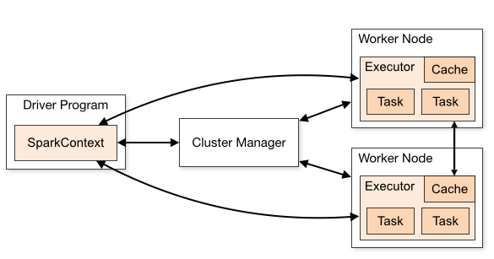
Spark Deconstructed: Live of a Spark Application
Notes:
Executor，实际任务的运行，最终都由Executor类来执行，Executor对每一个task启动一个taskRunner类，并通过ExecutorBackend的接口
返回task运行结果

Slide 57
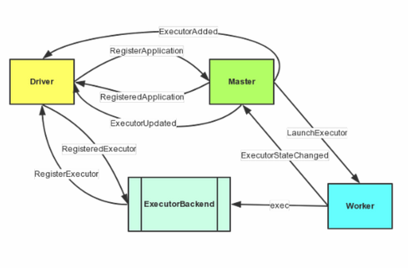
Notes:
1、Driver通过AppClient向Master发送了RegisterApplication消息来注册Application，Master收到消息之后会发送RegisteredApplication通知Driver注册成功，Driver的接收类还是AppClient。
2、Master接受到RegisterApplication之后会触发调度过程，在资源足够的情况下会向Woker和Driver分别发送LaunchExecutor、ExecutorAdded消息。
3、Worker接收到LaunchExecutor消息之后，会执行消息中携带的命令，执行CoarseGrainedExecutorBackend类(图中仅以它继承的接口ExecutorBackend代替)，执行完毕之后会发送ExecutorStateChanged消息给Master。
4、Master接收ExecutorStateChanged之后，立即发送ExecutorUpdated消息通知Driver。
5、Driver中的AppClient接收到Master发过来的ExecutorAdded和ExecutorUpdated后进行相应的处理。

Slide 58
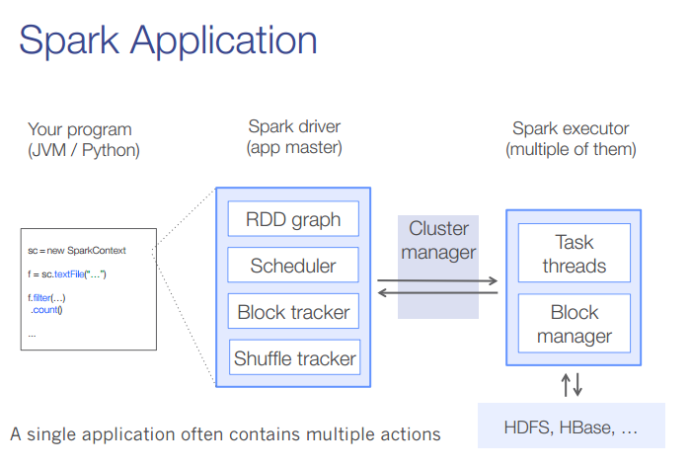
Spark Deconstructed: Live of a Spark Application
Notes:
1、Driver程序的代码运行到action操作，触发了SparkContext的runJob方法。
3、DAGScheduler把2、SparkContext比较懒，转手就交给DAGScheduler。
Job划分stage，然后把stage转化为相应的Tasks，把Tasks交给TaskScheduler。
4、通过TaskScheduler把Tasks添加到任务队列当中，转手就交给SchedulerBackend了。
5、调度器给Task分配执行Executor，SchedulerBackend负责执行Task。
在初始化SparkContext的时候会初始化一系列内容，例如会查看内存的设置情况。
SparkContext在初始化的时候也会创建和启动scheduler
集群核心组件中的Block tracker适用于Block和partition对应关系的管理器
Shuffle tracker是用于记录Shuffle操作过程细节的
在实际的Driver Program运行的时候每个Partition都会有一个Task负责运行，
也就是说有多少partition就会有多少个task在运行，而这些task是并发的运行在executor中

Slide 59
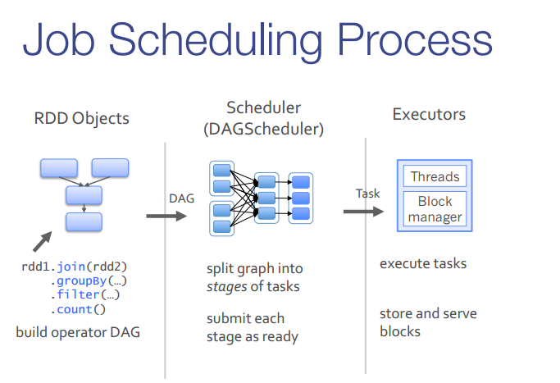
Spark Deconstructed: Live of a Spark Application
Notes:
从上图中可以看出由RDD Objects产生DAG，然后进入DAGScheduler阶段

Slide 60
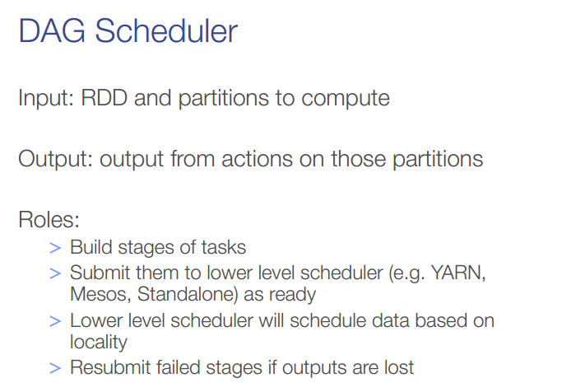
Spark Deconstructed: Live of a Spark Application
Notes:
DAGScheduler是面向Stage的高层次的调度器，把DAG拆分成多个Task，每组Task都是一个Stage
记录RDD被存入磁盘的操作，同时要寻求Task的最优化调度，例如数据本地性等；
DAGScheduler还要监视因为Shuffle输出导致的失败，如果发现这种失败，可能就要重新提交该Stage。

Slide 61
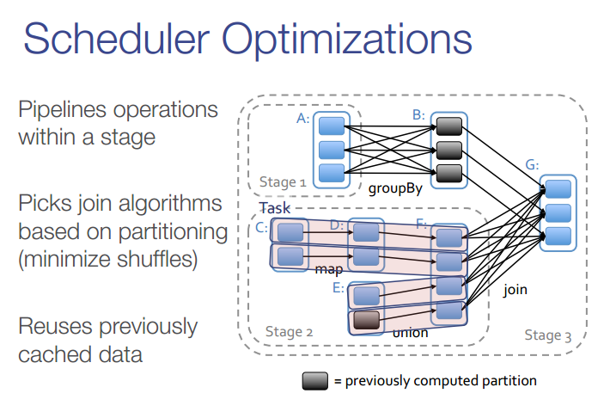
Spark Deconstructed: Live of a Spark Application
Notes:
Spark对于有向无环图Job进行调度，确定阶段（Stage），分区（Partition），流水线（Pipeline），任务（Task）和缓存（Cache），进行优化，并在Spark集群上运行Job。RDD之间的依赖分为宽依赖（依赖多个分区）和窄依赖（只依赖一个分区），在确定阶段时，需要根据宽依赖划分阶段。根据分区划分任务。

Slide 62
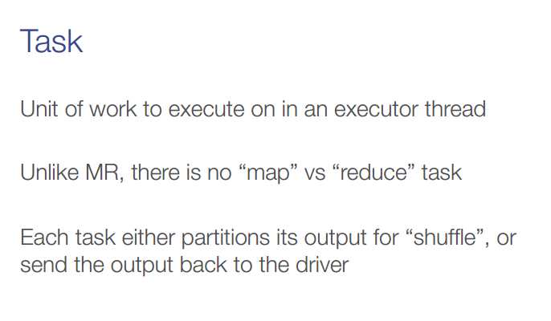
Spark Deconstructed: Live of a Spark Application
Notes:
RDD的计算是在Task中完成的

Slide 63
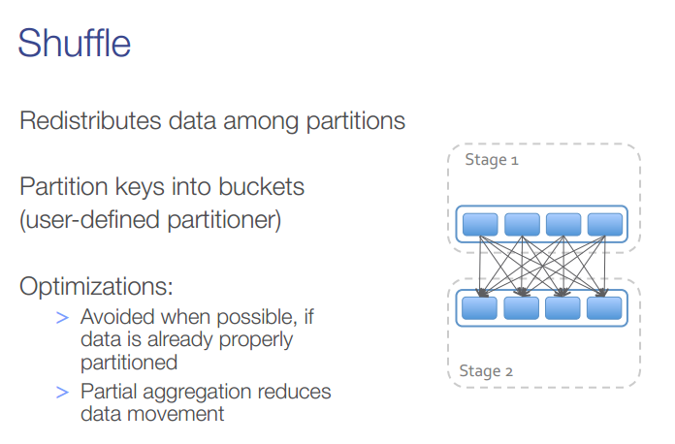
Spark Deconstructed: Live of a Spark Application
Notes:
Spark的操作模型是基于RDD的，当调用RDD的reduceByKey、groupByKey等类似的操作的时候，就需要有shuffle了。再拿出reduceByKey这个来讲
shuffle指的是在一个all-to-all操作中将数据再分割和聚合的操作
一个shuffle包含两组任务：1. 产生shuffle数据的阶段；2.使用shuffle数据的阶段。
一个job在map时的shuffle操作基于以下原则：所有用于同一个reduce操作的结果都会被写入到相邻的组别中，以便获取数据时更为简单。

Slide 64
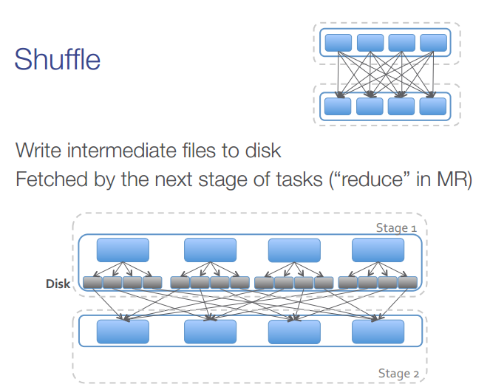
Spark Deconstructed: Live of a Spark Application
Notes:
中间结果也放在HDFS文件系统中
但这里中间结果放在内存中，内存放不下了会写入本地磁盘，而不是HDFS。

Slide 65
Apache Spark
Spark Essential

Slide 66
Spark Essential: SparkContext
First thing that a Spark program does is create a SparkContext object, which tells Spark how to access a cluster
In the shell for either Scala or Python, this is the sc variable, which is created automatically
Other programs must use a constructor to instantiate a new SparkContext
Then in turn SparkContext gets used to create other variables
Notes:
SparkContext在初始化的时候也会创建和启动scheduler

Slide 67
Spark Essential: SparkContext
Scala:
scala> sc
res: spark.SparkContext = spark.SparkContext@470d1f30
Python:
>>> sc
<pyspark.context.SparkContext object at 0x7f7570783350>

Slide 68
Spark Essential: Master
The master parameter for a SparkContext
determines which cluster to use
master | description
local | run Spark locally with one worker thread (no parallelism)
local[k] | run Spark locally with K worker threads (ideally set to # cores)
spark://HOST:PORT | connect to a Spark standalone cluster; PORT depends on config (7077 by default)
mesos://HOST:PORT | connect to a Mesos cluster; PORT depends on config (5050 by default)

Slide 69
Spark Essential: Master
spark.apache.org/docs/latest/cluster-
overview.html
Worker Node
Executor
cache
task
task
Driver Program
Cluster Manager
SparkContext
Worker Node
Executor
cache
task
task

Slide 70
Spark Essential: Clusters
master connects to a cluster manager to allocate resources across applications
acquires executors on cluster nodes – processes run compute tasks, cache data
sends app code to the executors
sends tasks for the executors to run
Worker Node
Executor
cache
task
task
Driver Program
Cluster Manager
SparkContext
Worker Node
Executor
cache
task
task

Slide 71
Spark Essential: RDD
Resilient Distributed Datasets (RDD) are the primary abstraction in Spark – a fault-tolerant collection of elements that can be operated on in parallel
There are currently two types:
parallelized collections – take an existing Scala collection and run functions on it in parallel
Hadoop datasets – run functions on each record of a file in Hadoop distributed file system or any other storage system supported by Hadoop
Notes:
RDD就是一个不可变的带分区的记录集合，RDD也是Spark中的编程模型。Spark提供了RDD上的两类操作，Transformation and action。转换是用来定义一个新的RDD，包括map, flatMap, filter, union, sample, join, groupByKey, cogroup, ReduceByKey, cros, sortByKey, mapValues等，动作是返回一个结果，包括collect, reduce, count, save, lookupKey。

Slide 72
Spark Essential: RDD
two types of operations on RDDs: transformations and actions
transformations are lazy
(not computed immediately)
the transformed RDD gets recomputed when an action is run on it (default)
however, an RDD can be persisted into storage in memory or disk
Notes:
Scala中通过lazy关键字来定义惰性变量，惰性变量只能是不可变变量。例如下面，只有在调用惰性变量b的toString方法的时候，才会去实例化b这个变量。

Slide 73
Spark Essential: RDD
Scala:
scala> val data = Array(1, 2, 3, 4, 5)
data: Array[Int] = Array(1, 2, 3, 4, 5)
scala> val distData = sc.parallelize(data)
distData: spark.RDD[Int] = spark.ParallelCollection@10d13e3e
Python:
>>> data = [1, 2, 3, 4, 5]
>>> data
[1, 2, 3, 4, 5]
>>> distData = sc.parallelize(data)
>>> distData
ParallelCollectionRDD[0] at parallelize at PythonRDD.scala:229

Slide 74
Spark Essential: RDD
Spark can create RDDs from any file stored in HDFS or other storage systems supported by Hadoop, e.g., local file system, Amazon S3, Hypertable, HBase, etc.
Spark supports text files, SequenceFiles, and any other Hadoop InputFormat, and can also take a directory or a glob (e.g. /data/201404*)
transformations
action
value
RDD

Slide 75
Spark Essential: Transformations
Transformations create a new dataset from an existing one
All transformations in Spark are lazy: they do not compute their results right away – instead they remember the transformations applied to some base dataset
optimize the required calculations
recover from lost data partitions

Slide 76
Spark Essential: Transformations
transformation | description
map(func) | return a new distributed dataset formed by passing each element of the source through a function func
filter(func) | return a new dataset formed by selecting those elements of the source on which func returns true
flatMap(func) | similar to map, but each input item can be mapped to 0 or more output items (so func should return a Seq rather than a single item)
sample(withReplacement, fraction, seed) | sample a fraction fraction of the data, with or without replacement, using a given random number generator seed
union(otherDataset) | return a new dataset that contains the union of the elements in the source dataset and the argument
distinct([numTasks])) | return a new dataset that contains the distinct elements of the source dataset

Slide 77
Spark Essential: Transformations
transformation | description
groupByKey([numTasks]) | when called on a dataset of (K, V) pairs, returns a dataset of (K, Seq[V]) pairs
reduceByKey(func, [numTasks]) | when called on a dataset of (K, V) pairs, returns a dataset of (K, V) pairs where the values for each key are aggregated using the given reduce function
sortByKey([ascending], [numTasks]) | when called on a dataset of (K, V) pairs where K implements Ordered, returns a dataset of (K, V) pairs sorted by keys in ascending or descending order, as specified in the boolean scending argument
join(otherDataset, [numTasks]) | when called on datasets of type (K, V) and (K, W), returns a dataset of (K, (V, W)) pairs with all pairs of elements for each key
cogroup(otherDataset, [numTasks]) | when called on datasets of type (K, V) and (K, W), returns a dataset of (K, Seq[V], Seq[W]) tuples – also called groupWith
cartesian(otherDataset) | when called on datasets of types T and U, returns a dataset of (T, U) pairs (all pairs of elements)

Slide 78
Spark Essential: Actions
action | description
reduce(func) | aggregate the elements of the dataset using a function func (which takes two arguments and returns one), and should also be commutative and associative so that it can be computed correctly in parallel
collect() | return all the elements of the dataset as an array at the driver program – usually useful after a filter or other operation that returns a sufficiently small subset of the data
count() | return the number of elements in the dataset
first() | return the first element of the dataset – similar to take(1)
take(n) | return an array with the first n elements of the dataset – currently not executed in parallel, instead the driver program computes all the elements
takeSample(withReplacement, fraction, seed) | return an array with a random sample of num elements of the dataset, with or without replacement, using the given random number generator seed

Slide 79
Spark Essential: Actions
action | description
saveAsTextFile(path) | write the elements of the dataset as a text file (or set of text files) in a given directory in the local filesystem, HDFS or any other Hadoop-supported file system. Spark will call toString on each element to convert it to a line of text in the file
saveAsSequenceFile(path) | write the elements of the dataset as a Hadoop SequenceFile in a given path in the local filesystem, HDFS or any other Hadoop-supported file system. Only available on RDDs of key-value pairs that either implement Hadoop's Writable interface or are implicitly convertible to Writable (Spark includes conversions for basic types like Int, Double, String, etc).
countByKey() | only available on RDDs of type (K, V). Returns a `Map` of (K, Int) pairs with the count of each key
foreach(func) | run a function func on each element of the dataset – usually done for side effects such as updating an accumulator variable or interacting with external storage systems

Slide 80
Spark Essential: Persistence
Spark can persist (or cache) a dataset in memory across operations
Each node stores in memory any slices of it that it computes and reuses them in other actions on that dataset – often making future actions more than 10x faster
The cache is fault-tolerant: if any partition of an RDD is lost, it will automatically be recomputed using the transformations that originally created it

Slide 81
Apache Spark
Simple Spark Demo

Slide 82
Simple Spark Demo: WordCount
Definition:
This simple program provides a good test case
for parallel processing, since it:
requires a minimal amount of code
demonstrates use of both symbolic and
numeric values
isn’t many steps away from search indexing
serves as a “Hello World” for Big Data apps
A distributed computing framework that can run
WordCount efficiently in parallel at scale
can likely handle much larger and more interesting
compute problems
count how often each word appears
in a collection of text documents
void map (String doc_id, String text):
for each word w in segment(text):
emit(w, "1");
void reduce (String word, Iterator group):
int count = 0;
for each pc in group:
count += Int(pc);
emit(word, String(count));

Slide 83
Simple Spark Demo: WordCount
Scala:
val file = sc.textFile("hdfs://...")
val counts = file.flatMap(line => line.split(" "))
.map(word => (word, 1))
.reduceByKey(_ + _)
counts.saveAsTextFile("hdfs://...")
Python:
from operator import add
f = sc.textFile("hdfs://...")
wc = f.flatMap(lambda x: x.split(' ')).map(lambda x: (x,1)).reduceByKey(add)
wc.saveAsTextFile("hdfs://...")

Slide 84
Simple Spark Demo: WordCount
Scala:
val file = sc.textFile("hdfs://...")
val counts = file.flatMap(line => line.split(" "))
.map(word => (word, 1))
.reduceByKey(_ + _)
counts.saveAsTextFile("hdfs://...")
Python:
from operator import add
f = sc.textFile("hdfs://...")
wc = f.flatMap(lambda x: x.split(' ')).map(lambda x: (x,1)).reduceByKey(add)
wc.saveAsTextFile("hdfs://...")
Checkpoint:
how many “Spark” keywords?

Slide 85
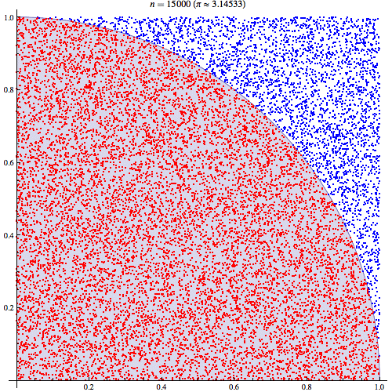
Simple Spark Demo: Estimate Pi
Next, try using a Monte Carlo method to estimate
the value of Pi
wikipedia.org/wiki/Monte_Carlo_method

Slide 86
Simple Spark Demo: Estimate Pi
val count = spark.parallelize(1 to NUM_SAMPLES).map{i =>
val x = Math.random()
val y = Math.random()
if (x*x + y*y < 1) 1 else 0
}.reduce(_ + _)
println("Pi is roughly " + 4.0 * count / NUM_SAMPLES)

Slide 87
Simple Spark Demo: Estimate Pi
val count = spark.parallelize(1 to NUM_SAMPLES).map{i =>
val x = Math.random()
val y = Math.random()
if (x*x + y*y < 1) 1 else 0
}.reduce(_ + _)
println("Pi is roughly " + 4.0 * count / NUM_SAMPLES)
Checkpoint:
how estimate do you get for Pi?

Slide 88
Apache Spark
Spark SQL

Slide 89
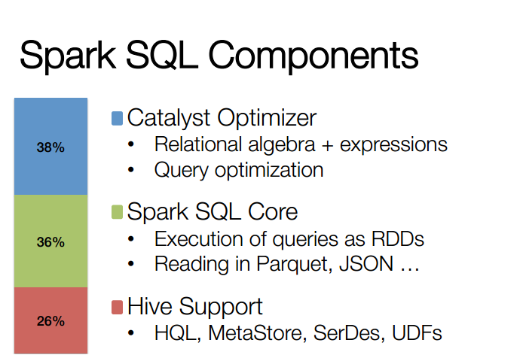
Notes:
自从去年Spark Submit 2013 Michael Armbrust分享了他的Catalyst(查询优化框架)，到至今1年多了,Spark SQL的贡献者从几人到了几十人，而且发展速度异常迅猛
原因主要有以下2点：
1、整合：将SQL类型的查询语言整合到 Spark 的核心RDD概念里。这样可以应用于多种任务，流处理，批处理，包括机器学习里都可以引入Sql。
2、效率：因为Shark受到hive的编程模型限制，无法再继续优化来适应Spark模型里。

Slide 90
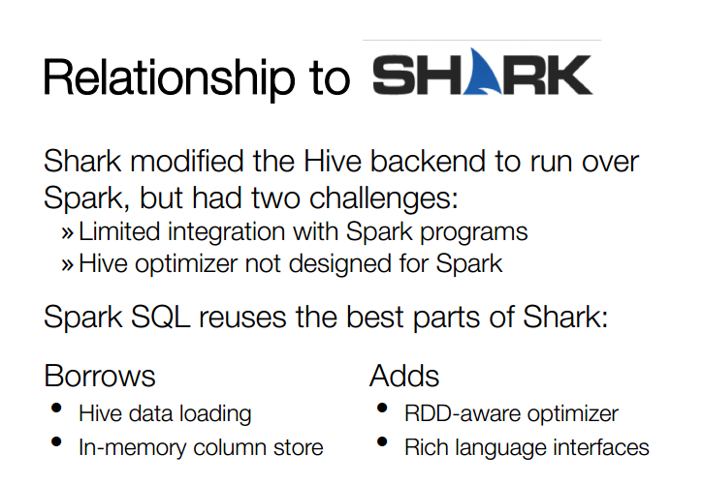
Notes:
Shark即Hive on Spark，本质上是通过Hive的HQL解析，把HQL翻译成Spark上的RDD操作，然后通过Hive的metadata获取数据库里的表信息，实际HDFS上的数据和文件，会由Shark获取并放到Spark上运算。

Slide 91
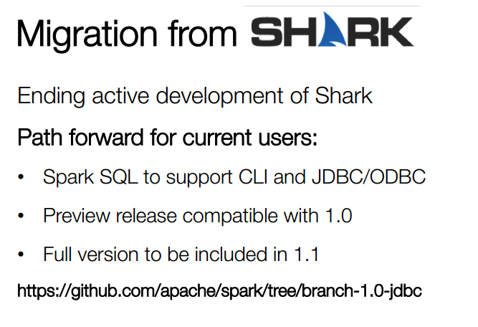

Slide 92
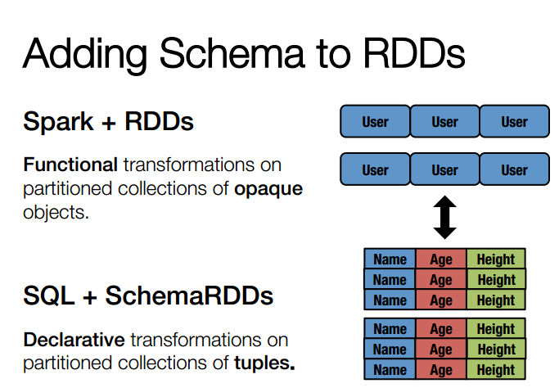
Notes:
在把SQL解析成逻辑执行计划之后，利用Catalyst包里的一些类和接口，执行了一些简单的执行计划优化，最后变成RDD的计算

Slide 93
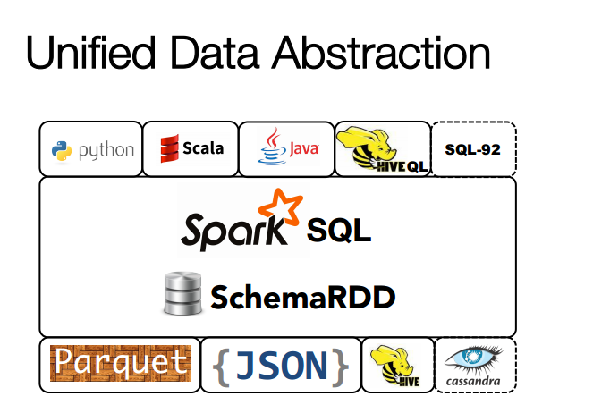
Notes:
Parquet 支持列式存储文件格式

Slide 94
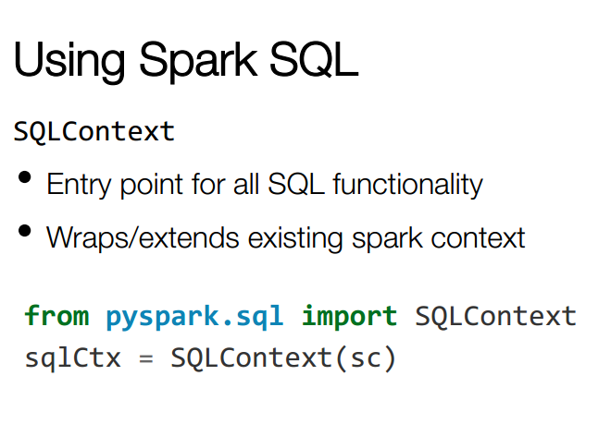

Slide 95
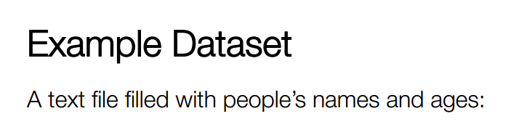
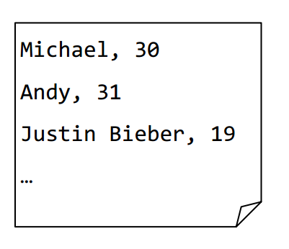

Slide 96
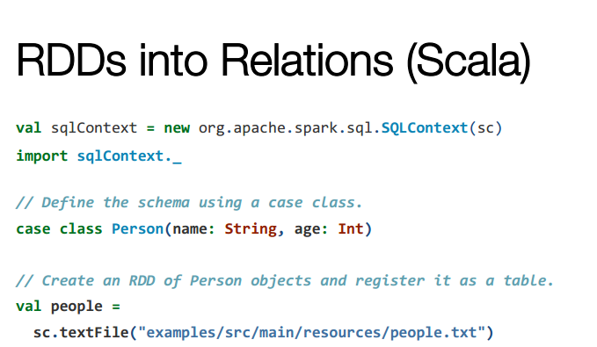
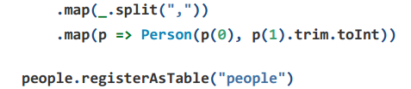

Slide 97
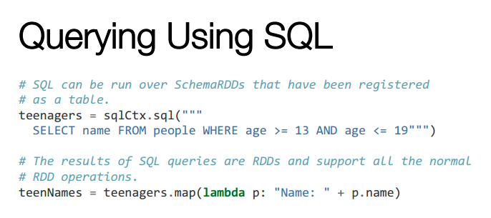

Slide 98
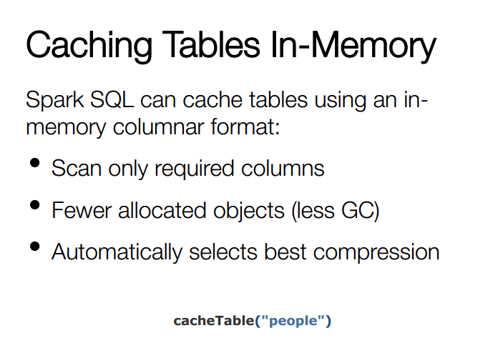

Slide 99
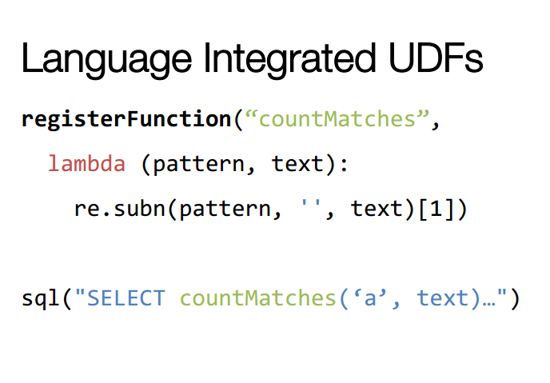

Slide 100
Reference:
Spark Overview: http://spark.apache.org/documentation.html
Scala Learning(Tutorials):
http://www.scala-lang.org/documentation/
Spark SQL源码分析: http://blog.csdn.net/oopsoom/article/details/38257749

