Slide 1
Crowdsourcing to Indoor Localization based on Wireless Fingerprint
Zhicheng Gu

Slide 2
Outline
Introduction
System Model and Algorithm
Main Results and Performance
Discussion
Simulation
Conclusion

Slide 3
Crowdsourcing
Crowdsourcing systems is an effective large-scale human-powered platform for performing tasks.
Image Classification
Recommendation
Transcription
Proofreading

Slide 4
Crowdsourcing
Tasks
Tasks
Workers
Workers
Allocate the tasks
Collect the answers
Do the inference and find true(estimate) answers

Slide 5
Indoor Localization
Manual Configuration
Outdoor:
Global Positioning System (GPS)
Indoor:
Physical Measurements
Received Signal Strength (RSS)
Power
Time (TOA)
Angle
Channel response
……

Slide 6
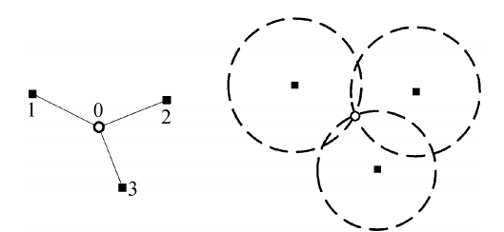
Indoor Localization
Mapping Methods
Geometric Mapping
Multipath Effects Indoors
Fingerprinting
Building a fingerprint database
Crowdsourcing
Pattern Matching Approach
Objective:
Get high accuracy of the localization results
Notes:
collect signal features of all possible locations in the area of interests to build a fingerprint database
Localization is then the process of matching the measured fingerprints at an unknown location with those in the database and
returning the location corresponding to the best-fitted fingerprint.

Slide 7
Outline
Introduction
System Model and Algorithm
Main Results and Performance
Discussion
Simulation
Conclusion

Slide 8
System Model
l₁× l₂ Indoor region
l_{a}× l_{b} cell
M =(l₁/l_{a})× (l₂/l_{b}) cells
N transmitters
{R_{j} ; j = 1,2··· ,N}
Objectives:
A. Building the database
B. Matching
$$l_{2}$$
$$l_{b}$$
$$l_{a}$$
$$l_{1}$$
Notes:
The objectives of indoor localization is tell the user which cell he is in. Since we use fingerprinting mapping method, we need to design a calibration
method. We use crowdsourcing to collect signal features of all possible locations in the area to build a fingerprint database.

Slide 9
System Model
A. Building the database
Workers submit their receive signal
We get the fingerprint of each cells
by
Then the database is

Slide 10
System Model
A. Building the database
B. Matching
Users
Submit their receive signal
We do the matching by following algorithm
$$n$$
$$m$$

Slide 11
Matching Algorithm
k : the number of users
i : the number of cells
j : the number of signal

Slide 12
Matching Algorithm

Slide 13
Outline
Introduction
System Model and Algorithm
Main Results and Performance
Discussion
Simulation
Conclusion

Slide 14
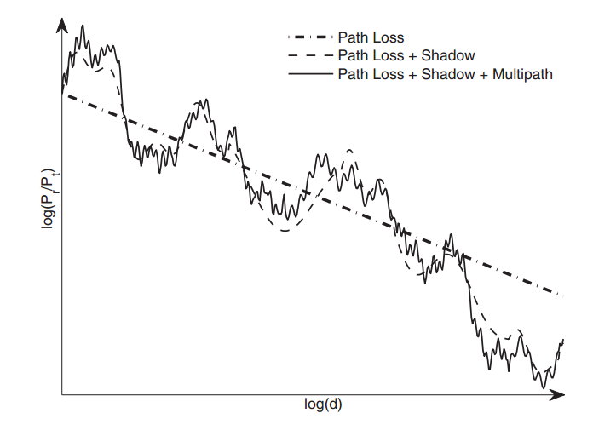
Main Results
Spatial Variations due to Multipath*
*From RSSI to CSI: Indoor Localization via Channel Response

Slide 15
Main Results
Metric:
Consider the error probability between adjacent cells for one signal

Slide 16
Main Results
Workers choose the places to do the measurement randomly

Slide 17
Main Results
Using Lindeberg-Levy Theorem (Central limit theorem)
We can get
Further, consider total signal number N

Slide 18
Outline
Introduction
System Model and Algorithm
Main Results and Performance
Discussion
Simulation
Conclusion

Slide 19
Discussion
Two Main Errors
Extrinsic Error
presence of obstacles
multipath and shadowing effects
environmental dynamics
Intrinsic Error
limitations of hardware and software
unreliable of human
Notes:
Extrinsic Error :physical effects
Our system tend to eliminate the influence of the intrinsic error and the obstacles and shadowing effects in extrinsic one. But since our system
need the environment to be statics, it can not deal with the signal noise and environment dynamics of the extrinsic error.

Slide 20
Discussion
Static System
The database is static
The environment is static
t
Calibrating
Mapping
t
Calibrating
Mapping
Calibrating
Mapping
Environment changes
Notes:
physical effects
Our system tend to estimate the influence of the intrinsic error and the obstacles and shadowing effects in extrinsic one. But since our system
need the environment to be statics, it can not deal with the signal noise and environment dynamics of the extrinsic error.

Slide 21
Outline
Introduction
System Model and Algorithm
Main Results and Performance
Discussion
Simulation
Conclusion

Slide 22
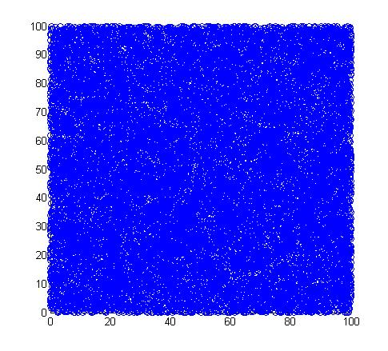
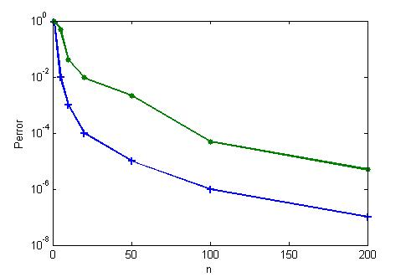
Simulation
Use a 100*100 indoor region l₁= l₂=100
10000 workers M=10000
There are noise influence on workers answers

Slide 23
Outline
Introduction
System Model and Algorithm
Main Results and Performance
Discussion
Simulation
Conclusion

Slide 24
Conclusion
Propose a indoor localization system based on wireless fingerprint with crowdsourcing approach
Design the calibrating allocation method and the mapping algorithm
Show the performance through analysis and simulation
Future Work:
More theoretical analysis on accuracy
Incentive mechanism design
Practical application

Slide 25
Thank You

Slide 26
Q&A
What accuracy could this system achieve?
The accuracy depends on the reliability of applications
There is a lower bound of this system

Slide 27
Q&A

Slide 28
Q&A
The influence of the dynamic environment?
Static System
The database is static
The environment is static
t
Calibrating
Mapping
Calibrating
Mapping
Environment changes

Slide 29
Q&A
Why don’t use hamming distance when matching?
Our system allow the combination of different measurement. The information collected by different methods have different units and can not be calculated together
Different information tend to have different weight
Eliminate the shape noisy influence

Slide 30
Thank You

