Slide 1
Predict User’s Attitudes with Internal and External Factors in OSN
Presented by: Wanning Jiang

Slide 2
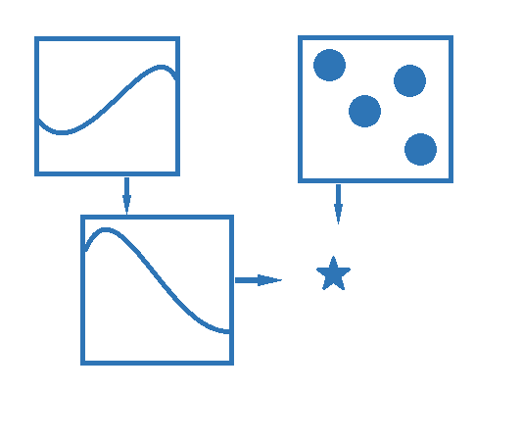
Background
Target
Predict whether a user holds an active attitude towards a piece of information
Information diffusion scheme in my work
External Influence
Internal Influence
Individual variance
Problems arise
event profile
P(expose)
Neighborhood
P(infection)
Expose time
Notes:
Since I use the epidemic spreading model, the term infect means…expose…
Our target is to predict …. Considering …..factors…
So I build a scheme of information diffusion…
Previous work…

Slide 3
Background
Question1: Each user has a limited budget of attention
namely a limited frequency of pulling content
Question2: The external influence is not easy to measure
Hitting news——Burst of attention
Question3: User’s reflex arc is different
You see and post at once, while he is often behind the trend
Notes:
2. Which is unpredicted

Slide 4
Outline
Background
Internal Infection
External Infection
Solution and analysis
Future work
Notes:
So now, we have to look at the

Slide 5
Internal Inflection
Social network graph
Each user :
The probability of infection from is
A change to survival analysis:
Usually
Now let the death rate is not certainly 0
Notes:
The probability …. Is analysised in the survival model, T means the time we post the message, the expression means by t, we have got infected
We make a change to this classical model. Which means we may not post the message finally, at the rate a.
So how to define a?

Slide 6
Internal Inflection
Death rate is a logistic classification
The features
Notes:
We defined a as a logistic classification problem.(黑板)
First 2 is the frequency of send weibo.
Second 2 is the directional concern

Slide 7
Internal Inflection
The death function should be
Decreasing
Within [0,1)
So the form is where
Hazard function——the death rate conditional on survival at t
Notes:
With a defined, we can rewrite the infect probability, this expression is qualified. Because it is descending, and in a range.
(后一句要手指着说)

Slide 8
Outline
Background
Internal Infection
Enternal Infection
Solution and analysis
Future work
Notes:
Internal infection is easy, Then we can move to a more complicated one.

Slide 9
External Infection
Several concerns:
There are multi-sources that can spread the information
Users’ strategy towards the sources are different
User may see the information but do not post it on the social network, namely, a gap between seeing and posting
Solutions:
Consider a event profile
Learn a user’s habit through the training set
Build a gap function
event profile
P(expose)
Neighborhood
P(infection)
Expose time

Slide 10
External Infection
Two steps:
Exposes (Bernoulli)
Infection (Binary)
Notes:
To see means to be exposed

Slide 11
External Infection——Exposes
At any time, expose rate follows a Poisson distribution
In a time slot, the probability of an expose is
Y represents the external profiles
Notes:
To simplify, we assume poisson

Slide 12
External Infection——Exposes
Concern in defining the features Y:
Interaction between platforms
Advertisement on webpages
Vector of heat of news
User’s gender

Slide 13
External Infection
Two steps:
Exposes (Bernoulli)
Infection (Binary)

Slide 14
External Infection——Gap function
The probability of infection immediately after the zth expose
Assume: and
Than the cumulative probability of infection from external at time t is
For z=1 to 4
others
Notes:
If a user will post a message, the expose times will be within 4
…..and here P means we use a bernuli distribution

Slide 15
Outline
Background
Internal Infection
Enternal Infection
Solution and analysis
Future work

Slide 16
Solution
In summary, the infection probability is
Maximize the training data likelihood to derive parameters
Notes:
But there is a difficulty

Slide 17
Solution
The is very hard because of
Solution:
EM algorithm
Z is then a latent classification of every I
Basic idea: iteratively calculate Z and other parameters
Notes:
The sigma Z item is very hard to derive with respect to z

Slide 18
Solution
The is very hard because of
Solution:
EM algorithm
Z is then a latent classification of every I
Basic idea: iteratively calculate Z and other parameters
Notes:
Iteratively …… with these two fuctions

Slide 19
Solution
Initial the parameters arbitrarily, then do the following 2 steps iteratively
E-step:
M-step:
Notes:
Let me introduce the basic ideas of EM
First we arbitrarily….
E step is to determin z as a latent threshold of post.
M-step use the z in e step to determin other parameters.

Slide 20
Solution
In M-step, by derive and we can get the two vectors
The result is like: (when = 1)
Notes:
Lets see the computational complexity

Slide 21
Computational complexity
Depend on iterative step length
N*logistic iteration times*EM iteration times
Notes:
The sigma Z item is very hard to derive with respect to z
Although the expression is complicated, the items in it is pre-determined variables

Slide 22
Outline
Background
Internal Infection
Enternal Infection
Solution and analysis
Future work

Slide 23
Future work
The advantage of current model
The concern about external influence
A realistic model of user’s habits
Dynamic and individual variant

Slide 24
Future work
Shortages:
Convolutional interaction between internal and external information sources
Bernoulli distribution is not so realistic because its accuracy highly depend on the time slot choice

Slide 25
Future work
Besides we need to extend this model:
The first and second platform is an interesting point to mine
Predict the system characteristics, such as
The end of the spreading time
The final infected nodes
Viewing every node in a stochastic process

Slide 26
THANK YOU

