Slide 1
6×6 MIMO System
An advanced referential testbed
Presenter: Jingwei Li
2014/05/27
Notes:
Hello everyone! I’m Li Jingwei. Thanks for your attention! It’s my great honor to give you my presentation here. And today my topic is about a 6×6 MIMO System. I will give you a brief introduction to this system.

Slide 2
Outline
Hardware Configuration
6x6 MIMO System in LabVIEW
Future work
Notes:
Here comes the outline.
My presentation is divided into 3 parts as follows:
First is the Hardware Configuration of the system,
Then comes the main part, which is the implementation of the system in Labview.
And finally the future work to be done.

Slide 3
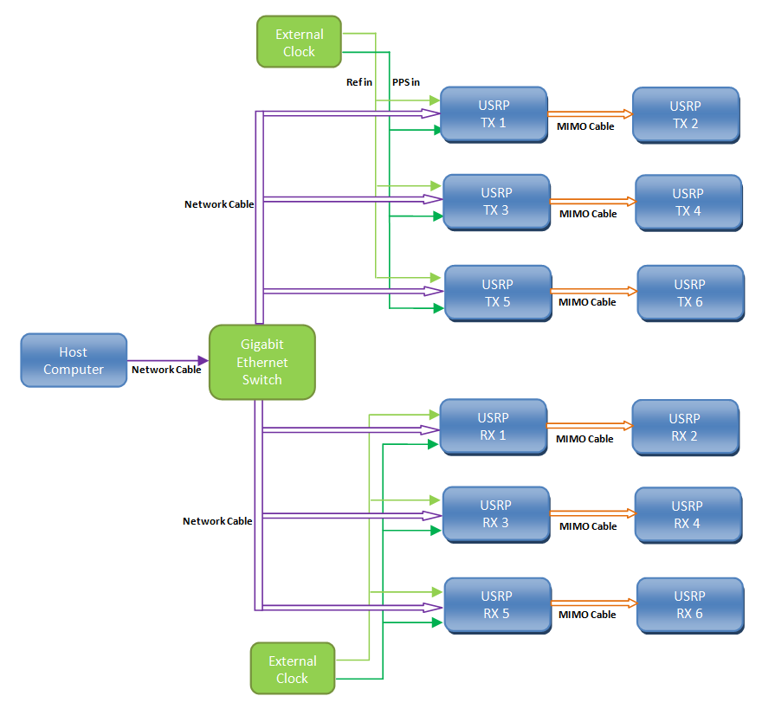
Hardware Configuration
One PC(or two) with a free Gigabit Ethernet port
Gigabit Ethernet switch
12 USRPs (NI USRP-2920 is used)
12 antennas
2 external clocks
Notes:
As for hardware configuration,
we need One PC with a free Gigabit Ethernet port to connect with a Gigabit Ethernet switch.
And then we connect the switch with USRP transceivers for data exchange.
Also we can use two PC and two switches,
one for transmitters , the other for receivers.
There should be at least 12 USRP transceivers for a 6x6 system
because individual transceivers are not capable of two simultaneous transmits or receives.
Last but not least,
the external clocks for synchronization.

Slide 4
6x6 MIMO System in LabVIEW
Software Components
LabVIEW VI codes
Simulation testbed
Notes:
Then comes the main part--6x6 MIMO System in LabVIEW
And it also consists of 3 parts.
Software components to run the system;
Codes;
And a simulation testbed without USRP almost the same with the real one.

Slide 5
Software Components
NI LabVIEW
NI-USRP Version
NI LabVIEW Modulation Toolkit
NI LabVIEW Mathscript RT Module
Notes:
Here list the softwares.
The last three are the plug-ins for the first.
It's worth mentioning that
the last one makes LabVIEW possible to support matlab codes.

Slide 6
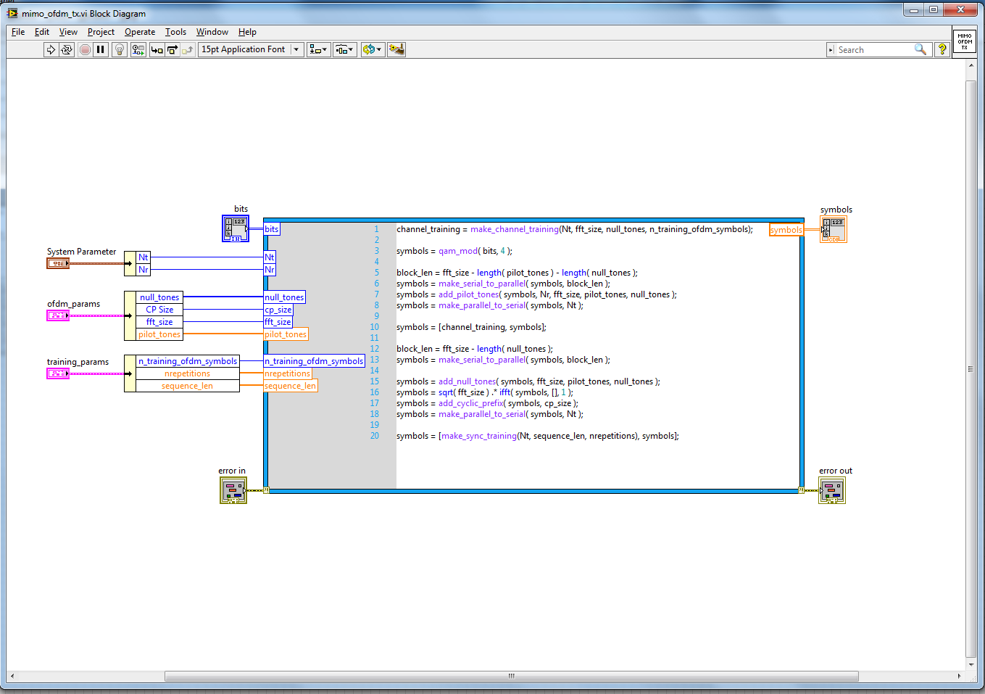
Matlab coded VI Style
Matlab codes
IO ports
Notes:
As is an example,
Give the Mathscript Node input and output ports,
And in the mathscript node,
we use matlab codes to implement the function body.

Slide 7
LabVIEW VI codes
Initial USRP Parameters
TX Part
RX Part
Notes:
In the codes part, I will show you the details of the system.
First is the software configuration
followed with Transmitter and receiver part.

Slide 8
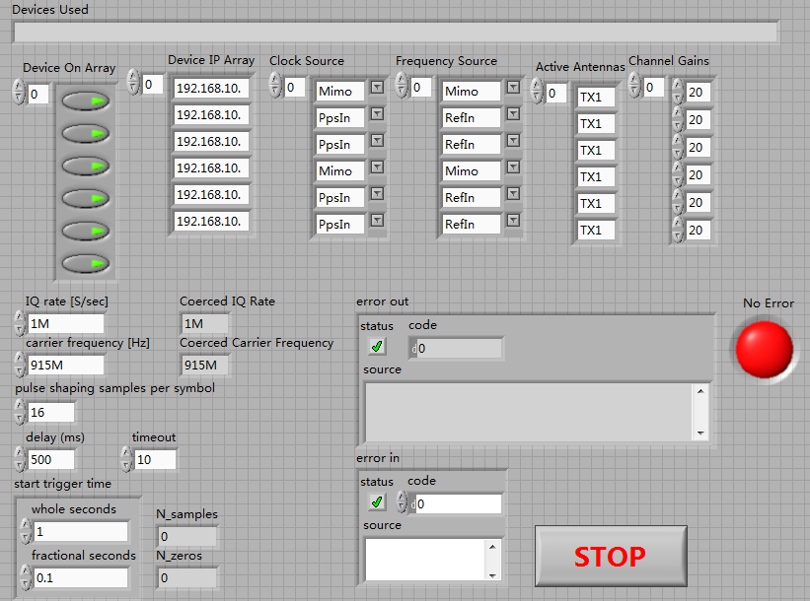
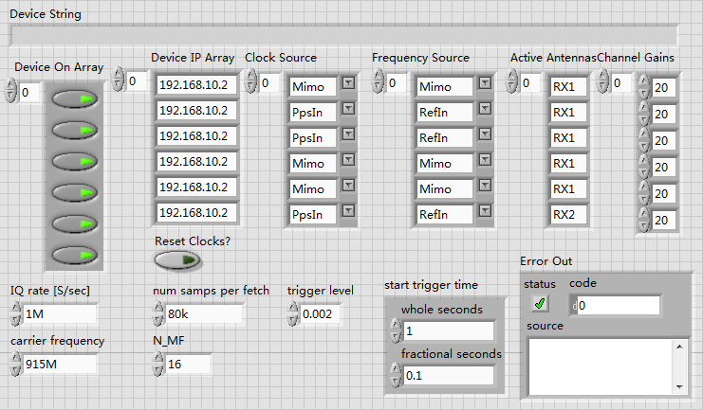
Initial parameters
TX
RX
Notes:
the above 2 figures shows parameters for USRP configuration in the front panel.
And you can see they are almost the same
which includes device parameters , IQ rate and carrier frequency.
(pulse shaping samples per symbol : for generate pulse shaping filter coeffiencients)
(delay : make the data transmit after delay from trigger point)
(timeout : specifies the time to wait, in seconds, before returning an error if the requested number of samples have not been generated.
)
(N_MF : matched samples per symbol)
(trigger level : is for checking whether the data packages have come)

Slide 9
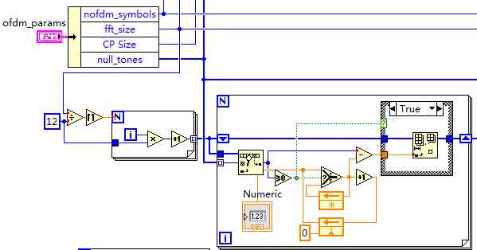
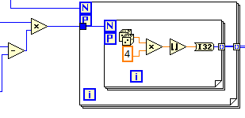
TX Part
Notes:
In transmitter part
First we use OFDM parameters
to set null tones and pilot tones with no data.
Here tones means frequency point in OFDM.
And also we have to calculate the data size to be transmitted.
Second, generate that amount of PN sequence (ranged from 0 to 3)as the information sequence.

Slide 10
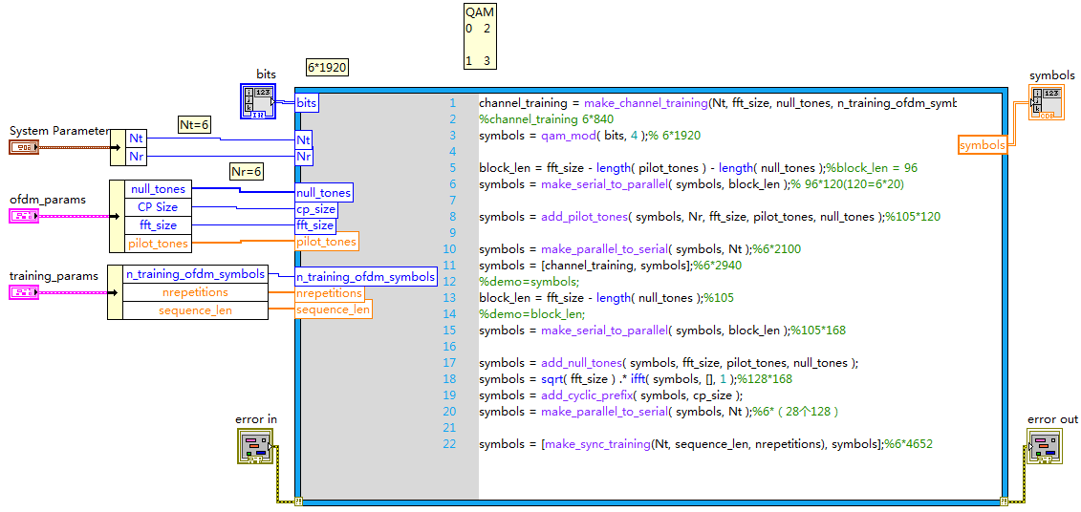
TX Part (cont’d)
Notes:
Then we use the information sequence to produce OFDM symbols.
By serial-parallel conversion and reversal, we can realize the interleaving step
and inserting the pilot tones
which is for channel estimation and phase tracking
in receiver side.
(interleaving is for decentralizing the error)
After that we do the fast flourier transformation and normalize the energy.
By adding cyclic prefix,
we can maintain the signals from different channels
still orthogonal to each other
otherwise it will be destroyed by group delay effect.
(through a same channel, different frequency signal will have different time delay)
By adding synchronizing training sequence,
we use it to check whether the package have come.
after all these steps,
we get the OFDM symbols for transmission.

Slide 11
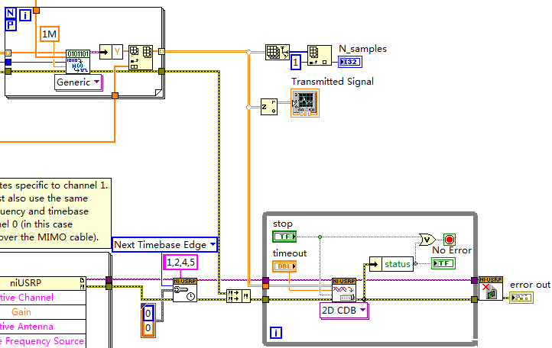
TX Part (cont’d)
Pulse shaping
synchronizing
Transmit
Notes:
Through a pulse shaping filter,
Then we could send the signal out.
(The signal's spectrum is determined by the pulse shaping filter used by the transmitter.Its purpose is to make the transmitted signal better suited to the communication channel),

Slide 12
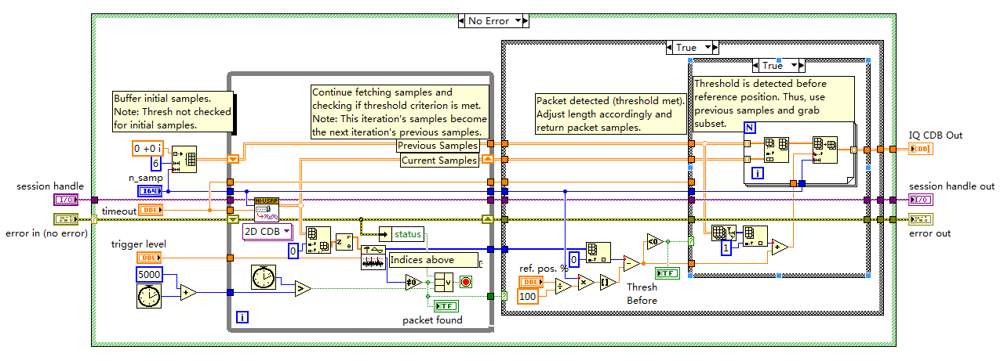
RX Part
Threshold detecting
Notes:
When it comes to the Receiver part,
the steps are totally the opposite order compared to the transmitter part.
But before that, the most important step
is to detect the data package.
As is depicted, we set the trigger threshold as the criterion.
This detect part keeps fetching samples,
once the threshold is reached, the receiving steps begin.

Slide 13
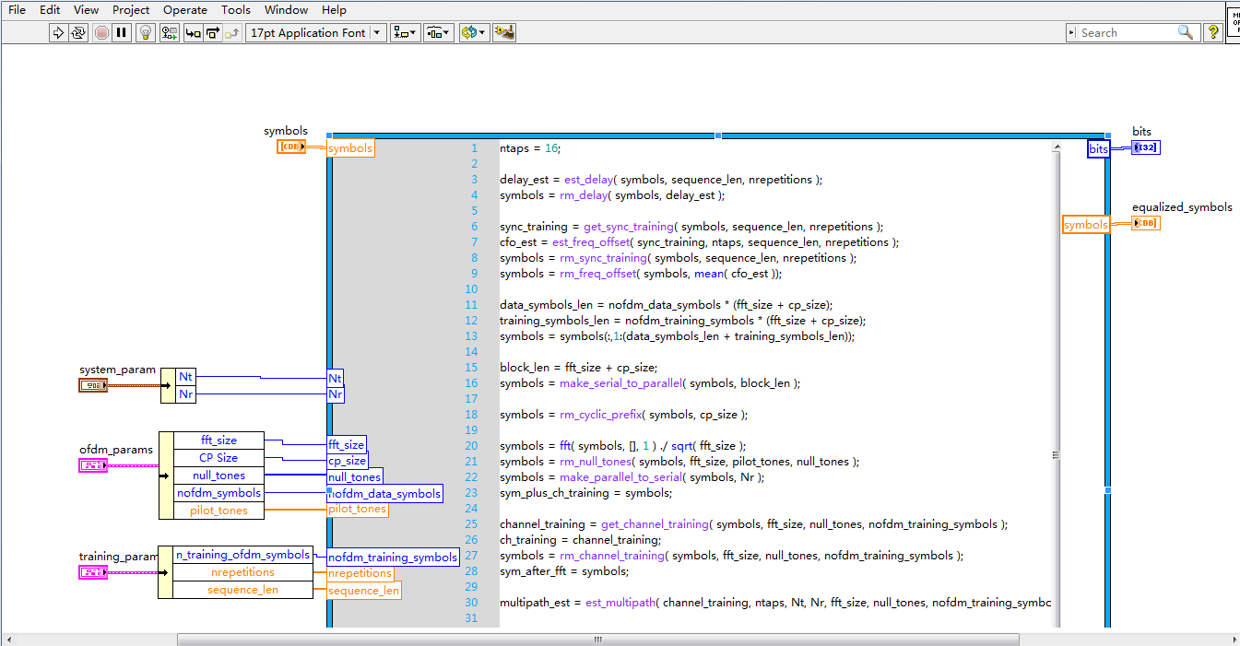
RX Part (cont’d)
Notes:
And this is the reversal decoding steps, which totally correspond to the encoding steps.
(Q&A:For matlab coding style
Give the Mathscript Node input and output ports,
In the mathscript node, we can use matlab codes to implement the function body. And for a complex VI function, it will be rather easier and clear to implement by mathscript.
But for labview graphical coding style, the signal flow in labview will make the VI run faster.

Slide 14
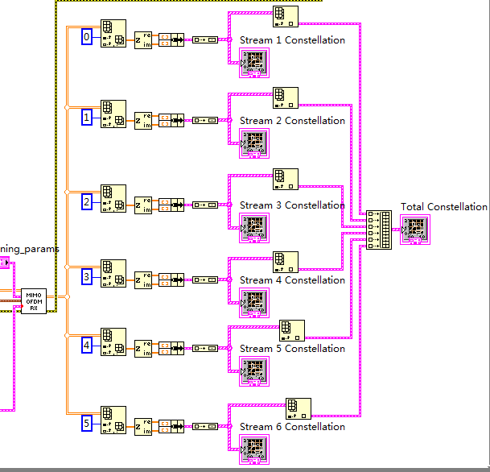
RX Part (cont’d)
Notes:
After that we get the information sequence after constellation mapping.
Thus we could check the performance of the system from constellation map in receiver side.

Slide 15
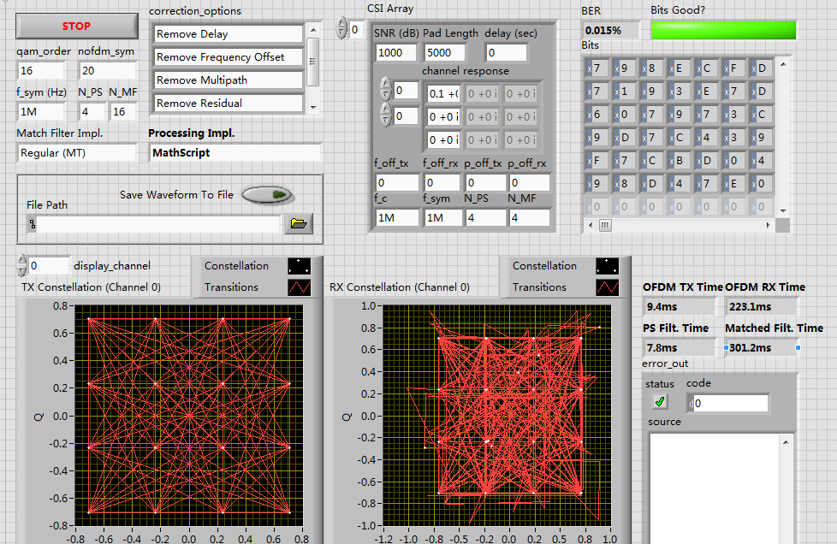
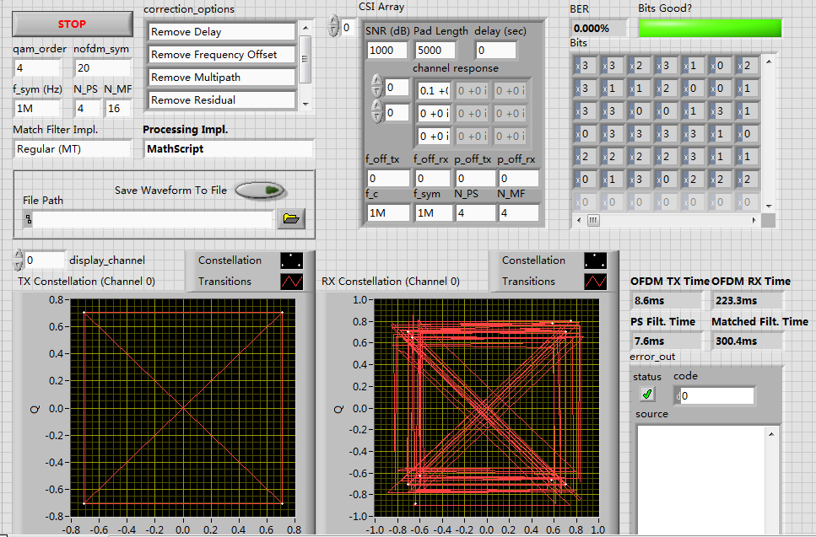
Simulation testbed
16 QAM
4 QAM
Notes:
And here this system also has a simulation testbed which could be run without USRP.
The above are the 2 example simulations of 16 QAM and 4 QAM.
You can see it works out the correct constellation maps.(some shaking)
(constellation maps are the most efficient method to check the code correctness in communication system. It means we could refer to its structure in MIMO)

Slide 16
Future work
The best synchronization training sequence
MIMO part
Notes:
As the title of my presentation is
An advanced referential testbed,
This 6*6 system is a referential testbed for our mimo relay group.
Since recently we have achieved the SISO Discontinuous-OFDM part which is the central part of our system.
Next we will work out the best training sequence for synchronization in receiver side.
And finally add the MIMO part into our system.

Slide 17
Q&A
Notes:
That’s all. Any questions?
For matlab coding style
Give the Mathscript Node input and output ports,
In the mathscript node, we can use matlab codes to implement the function body. And for a tedious VI function, it will be rather easier and clear to code.
But for labview graphical coding style, the signal flow in labview will make the VI run faster.

Slide 18
Thank You!

