Slide 1
Satisfaction Games in Graphical Multi-resource Allocation
Sun Ruijia 5110309622

Slide 2
Outline
Motivation
System model
Convergence of Nash Equilibria
Simulation
Conclusion

Slide 3
Outline
Motivation
System model
Convergence of Nash Equilibria
Simulation
Conclusion

Slide 4
Motivation
Communication system
Resource allocation
limited
users
Centralized manner
Distributed manner
Maximize the total utility
Notes:
In communication system, resource allocation is always the fundamental problem – the limited resources and the increasing demand. How to allocate the resources efficiently among so many users to maximize the total utility has always been on focus. Typically there are two different approaches. The first one is the centralized manner while the other depends on the autonomous users or entities, which is called the distributed manner.

Slide 5
Motivation
Centralized manner
Head operator
entities
resources
Best results
Massive amounts of information
NP hard
Notes:
If there is a leader, every thing will work much better. This is the advantages of centralized manner. In a centralized manner, there is a head operator controls the whole system. The operator collects almost all information about every entities within the system. It will analyze the current situation and comes out a best result. Then the operator will make plans and allocate the resources to each entities to reach his best result.
This approach seems quite perfect, right? However in practice, centralized manner is often difficult to realize. Firstly, due to the heterogeneity of users, the operator needs gather massive amounts of information to perform the optimization. Secondly, finding the system-wide optimal solution is usually NP hard.
Thus this approach is sometimes not suitable.

Slide 6
Motivation
Distributed manner
users
make decisions for itself
Convergence
Price of anarchy
Game theory
Congestion games, potential games…
Notes:
In a distributed manner, however, such problems can be avoided. In a distributed manner, each user makes the resource allocation decision locally to meet its own demand, while taking the network dynamics and other users’ actions into consideration. This approach is flexible and particularly suitable. But the distributed manner also has its own problem, that is, the convergence and the price of anarchy. To analyze these issue, models in game theory have been utilized, such as the congestion games, potential games. We have different game models for different situations.

Slide 7
Motivation
Listen to music
Read e-book
Browse the webpages
Watch the video
…
QoS
Satisfaction game
Multi-resource allocation games
Object replication
Satisfaction multi-resource allocation games
Notes:
Nowadays everybody has a smartphone right? We may use it to listen to music, read e-books, browse the webpages or watch the videos. Our demand for QoS varies according to what we use it for, that is, the QoS for watching a video must be higher than the QoS for browsing a webpage. It is also obvious that we don’t need the QoS to be as high as possible. (For example, when listening to music, once the music can be played fluently, the listener will be satisfied and doesn’t need a higher QoS.) Thus, the model of satisfaction game is proposed in <Quality of Service Games for Spectrum Sharing>. In this paper, only single channel allocation is considered. But in practice, cases exist about multi-resource allocation problems. Such as object replication, where each node(entities) can has a storage capacity Ki which it uses to replicate objects locally. Thus we need to extend the original satisfaction games into multi-resource allocation model.

Slide 8
Outline
Motivation
System model
Convergence of Nash Equilibria
Simulation
Conclusion

Slide 9
System model
N nodes (entities) want to compete for R resources.
Nodes can be represented by an interference graph according to their locations and each node has a set of neighbors.
The more nodes in neighbor set of node i choose the same resource, the less the QoS received by node i is.
Each node has a demand QoS.
Once the QoS is larger than or equal to the demand, the user is satisfied.
Each node can collect more than one resource.

Slide 10
System model
N nodes (entities) want to compete for R resources.
Nodes can be represented by an interference graph according to their locations and each node has a set of neighbors.
The more nodes in neighbor set of node i choose the same resource, the less the QoS received by node i is.
Each node has a demand QoS.
Once the QoS is larger than or equal to the demand, the user is satisfied.
Each node can collect more than one resource.

Slide 11
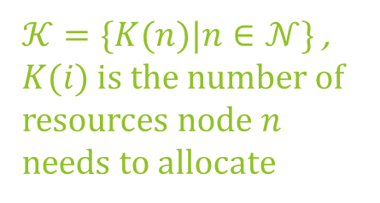
System model
$𝒦=\{K(n)|n∈𝒩\}$ , $K(i)$ is the number of resources node $n$ needs to allocate
$ℛ=\left\{0,1,2,…R\right\}$
the set of resources
$D_{n}≥0$
The QoS demand of node n
$$(𝒩, ℛ, (Q_{n}^{r})_{n∈𝒩,r∈ℛ}, (D_{n})_{n∈𝒩}, 𝒢, K, 𝒜)$$
$𝒢=\left(N,E\right):$ interference graph
QoS received by user n who has selected resource 𝑟
$𝒩=\{1,2,3,…,N\}$
the set of nodes
Strategy profile: $𝒜=\{A_{n}|n∈𝒩\}$, where $A_{n}=\{a_{n}^{r}|r∈ℛ\}$
Indicator $a_{n}^{r}=\left\{\begin{aligned}1, if resource r is allocated by node n \\ 0, otherwise \end{aligned}\right.$

Slide 12
System model
$$(𝒩, ℛ, (Q_{n}^{r})_{n∈𝒩,r∈ℛ}, (D_{n})_{n∈𝒩}, 𝒢, K,𝒜)$$
$$𝒢=\left(N,E\right)$$
$N\left(n\right):$ the neighbor of node $n$, who will interfere with node $i$ if they collect the same resource
1
3
4
Node 3 and 2 are the neighbors of node 1 while node 4 is not.
2

Slide 13
System model
$$(𝒩, ℛ, (Q_{n}^{r})_{n∈𝒩,r∈ℛ}, (D_{n})_{n∈𝒩}, 𝒢, K,𝒜)$$
$$(Q_{n}^{r})_{n∈𝒩,r∈ℛ}$$
Congestion level: the number of node in the set of n’s neighbors choosing the resource r
QoS
$$I_{n}^{r}$$

Slide 14
System model
$$(𝒩, ℛ, (Q_{n}^{r})_{n∈𝒩,r∈ℛ}, (D_{n})_{n∈𝒩}, 𝒢, K,𝒜)$$
$$(Q_{n}^{r})_{n∈𝒩,r∈ℛ}$$
Congestion level: the number of node in the set of n’s neighbors choosing the resource r
QoS
$$I_{n}^{r}=\left|\left\{n∈𝒩\left(n\right):a_{n}^{r}=1\right\}\right|$$
Entity n collects resource r
$$(D_{n})_{n∈𝒩}$$
Threshold $T_{n}^{r}$
$I_{n}^{r}≤T_{n}^{r}$: entity is satisfied
$I_{n}^{r}>T_{n}^{r}$: entity is dissatisfied
$$T_{n}^{r}$$
$$I_{n}^{r}$$

Slide 15
System model
$$(𝒩, ℛ, (Q_{n}^{r})_{n∈𝒩,r∈ℛ}, (D_{n})_{n∈𝒩}, 𝒢, K,𝒜)$$
$$(Q_{n}^{r})_{n∈𝒩,r∈ℛ}$$
$$I_{n}^{r}=\left|\left\{n∈𝒩\left(n\right):x_{n}=r\right\}\right|$$
Threshold $T_{n}^{r}$
QoS
$$U_{n}^{r}=\left\{\begin{aligned}1, if I_{n}^{r}≥T_{n}^{r} \\ 0, if I_{n}^{r}<T_{n}^{r}\end{aligned}\right.$$
$$U_{n}=\sum_{r}{U_{n}^{r}}$$
$$(D_{n})_{n∈𝒩}$$
$$(𝒩, ℛ,T_{n}^{r}, 𝒢, K)$$
$$T_{n}^{r}$$
$$I_{n}^{r}$$

Slide 16
System model
The evicted set: $E_{n}\left(t\right)=\{r|a_{n}^{r}\left(0\right)=1∧a_{n}^{r}\left(t\right)=0\}$
The inserted set: $I_{n}\left(t\right)=\{r|a_{n}^{r}\left(0\right)=0∧a_{n}^{r}\left(t\right)=1\}$
1,2,3
3,5,6
$E_{n}\left(t\right)=\left\{1,2\right\}$
$I_{n}\left(t\right)=\{5,6\}$
Notes:
Since our model is a multi-resource model, every time an entity update his strategy, he will evict several resources and insert the same amount of resources within his timeslot. Thus we define the evicted set and the inserted set. Before that we need to define a_{nr}

Slide 17
Outline
Motivation
System model
Convergence of Nash Equilibria
Simulation
Conclusion

Slide 18
Convergence of NE
Key concept in game theory
Definition 1 (Better Reply Update). The event where a player n changes its choice of strategy from $x_{n}$ to r is a better reply update if and only if $U_{n}\left(r, x_{−n}\right)>U_{n}\left(x_{n}, x_{−n}\right)$, where we write the argument of the function as $x=(x_{n},x_{−n})$ with $x_{−n}=(x_{1},…,x_{n−1},x_{n+1},…,x_{N})$ representing the strategy profile of all users except player n.
Notes:
As stated before, the general better reply step may introduce loop in our improvement path. We introduce a modified better reply.
Thus, we can represent our multi-resource update process with several single-resource update process.

Slide 19
Convergence of NE
Definition 2 (Pure Nash Equilibrium). A strategy profile $x$ is a pure NE if no users at $x$ can perform a better reply update, i.e., $U_{n}\left(r, x_{−n}\right)>U_{n}\left(x_{n}, x_{−n}\right)$ for any $r∈ℛ and n∈𝒩.$
Definition 3 (Finite Improvement Property). A game has the finite improvement property if any asynchronous better reply update process terminates at a pure NE within a finite number of updates.
Notes:
As stated before, the general better reply step may introduce loop in our improvement path. We introduce a modified better reply.
Thus, we can represent our multi-resource update process with several single-resource update process.

Slide 20
Convergence of NE
Definition 4 (modified better reply) An modified better reply for multi-resource allocation problem is that for $∀r∈E_{n}(t)$, $U_{n}^{r}\left(t\right)=0;$ and for $∀r∈I_{n}(t)$, $U_{n}^{r}\left(t\right)=1$. $\left|E_{n}\left(t\right)\right|=\left|I_{n}\left(t\right)\right|≤K(n)$.
Time slot 1 for node n₁
…
Time slot 1 for node n
…
Time slot 1 for node n_{n}
Update resource 1
Update resource 2
…
…
Update resource K(n)
Notes:
As stated before, the general better reply step may introduce loop in our improvement path. We introduce a modified better reply.
Thus, we can represent our multi-resource update process with several single-resource update process.

Slide 21
Convergence of NE
Theorem 1. In satisfaction game for graphical multi-resource allocation, FIP can be guaranteed under modified better reply.
Proof:
Potential function:
A function $Φ$: $×_{n}(𝒜_{n})→ℝ$ is a generalized ordinal potential function for the game if the change of $Φ$ is strictly positive if an arbitrary player n increases his utility by changing his strategy from $A_{n}$ to $A_{n}^{′}$. Formally, $U_{n}\left(A_{n}^{′}, A_{−n}\right)>U_{n}\left(A_{n}, A_{−n}\right)⟹Φ\left(A_{n}^{′}, A_{−n}\right)>Φ\left(A_{n}, A_{−n}\right)$
When $Φ\left(A_{n}^{}, A_{−n}\right)$ is the maximum value, then NE is reached.

Slide 22
Convergence of NE
Theorem 1. In satisfaction game for graphical multi-resource allocation, FIP can be guaranteed under modified better reply.
Proof:
$$Φ\left(A\right)=\sum_{n}{\sum_{r}{F_{n}^{r}\left(A_{n},A_{−n}\right)}}$$
$$F_{n}^{r}=\left\{\begin{aligned}2T_{n}^{r}−I_{n}^{r}\left(A\right), if a_{n}^{r}=1 \\ 0, if a_{n}^{r}=0\end{aligned}\right.$$
$$r$$
dissatisfied
$$r^{′}$$
satisfied
$$T_{n}^{r}≤I_{n}^{r}−1$$
$$T_{n}^{r^{′}}≥I_{n}^{r^{′}}$$
$$F_{n}^{r^{′}}−F_{n}^{r}≥I_{n}^{r^{′}}−I_{n}^{r}+2$$
Notes:
Since we can represent the multi-resource allocation with the single-resource allocation model, here we just prove for a single-resource better reply, this function holds.

Slide 23
Convergence of NE
Theorem 1. In satisfaction game for graphical multi-resource allocation, FIP can be guaranteed under modified better reply.
Proof:
$$Φ\left(A\right)=\sum_{n}{\sum_{r}{F_{n}^{r}\left(A_{n},A_{−n}\right)}}$$
$$F_{n}^{r}=\left\{\begin{aligned}2T_{n}^{r}−I_{n}^{r}\left(A\right), if a_{n}^{r}=1 \\ 0, if a_{n}^{r}=0\end{aligned}\right.$$
Node N(n)_{1,} …., N(n)_{n-1}, n, N(n)_{n+1}…
Node N(n)_{1,} …., N(n)_{n-1}, N(n)_{n+1}…
$$\sum_{−n}{F_{i}^{r^{′}}}−\sum_{−n}{F_{i}^{r}}=I_{n}^{r}−I_{n}^{r^{′}}$$
Notes:
Since we can represent the multi-resource allocation with the single-resource allocation model, here we just prove for a single-resource better reply, this function holds.

Slide 24
Convergence of NE
Theorem 1. In satisfaction game for graphical multi-resource allocation, FIP can be guaranteed under modified better reply.
Proof:
$$Φ\left(A\right)=\sum_{n}{\sum_{r}{F_{n}^{r}\left(A_{n},A_{−n}\right)}}$$
$$F_{n}^{r}=\left\{\begin{aligned}2T_{n}^{r}−I_{n}^{r}\left(A\right), if a_{n}^{r}=1 \\ 0, if a_{n}^{r}=0\end{aligned}\right.$$
$$\sum_{n}{F_{n}^{r^{′}}}−\sum_{n}{F_{n}^{r}}≥2$$
For a modified better reply by node n, $Φ\left(A\right)$ will increase at least 2
Notes:
Since we can represent the multi-resource allocation with the single-resource allocation model, here we just prove for a single-resource better reply, this function holds.

Slide 25
Convergence of NE
Theorem 1. In satisfaction game for graphical multi-resource allocation, FIP can be guaranteed under modified better reply.
Proof:
$$Φ\left(A\right)=\sum_{n}{\sum_{r}{F_{n}^{r}\left(A_{n},A_{−n}\right)}}$$
$$F_{n}^{r}=\left\{\begin{aligned}2T_{n}^{r}−I_{n}^{r}\left(A\right), if a_{n}^{r}=1 \\ 0, if a_{n}^{r}=0\end{aligned}\right.$$
$$−N≤−I_{n}^{r}<F_{n}^{r}≤2T_{n}^{r}<2N+2$$
$$\frac{1}{2}\left(3N+2\right)N\sum_{n}{K(n)}$$
$$Φ\left(A\right)<\left(3N+2\right)N\sum_{n}{K(n)}$$

Slide 26
Outline
Motivation
System model
Convergence of Nash Equilibria
Simulation
Conclusion

Slide 27
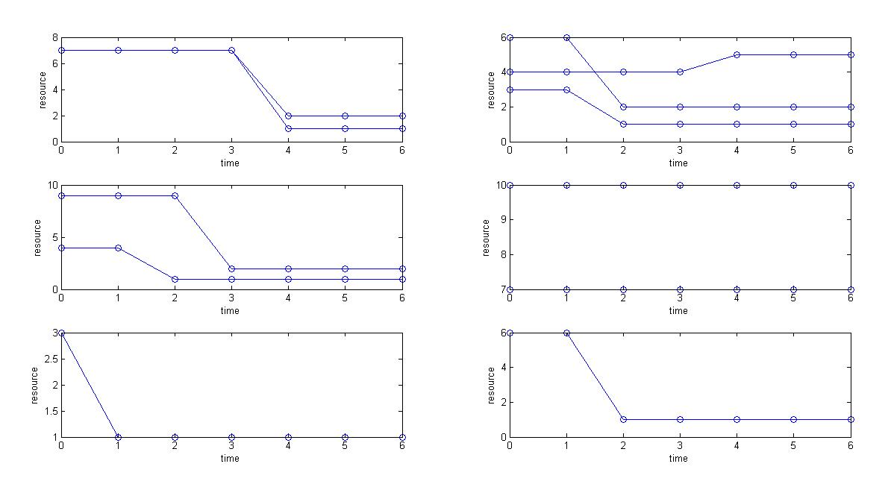
Simulation
N=6
R=10
Set the threshold $T_{n}^{r}$, interference graph and the initial stage randomly

Slide 28
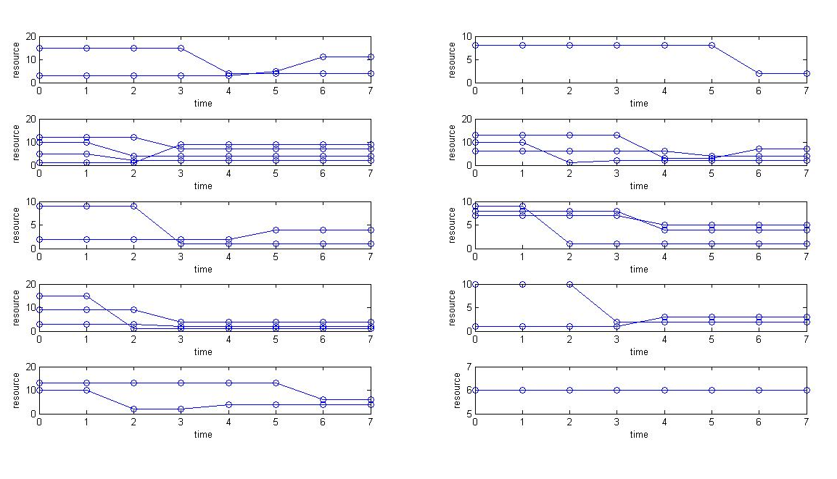
Simulation
N=10
R=15

Slide 29
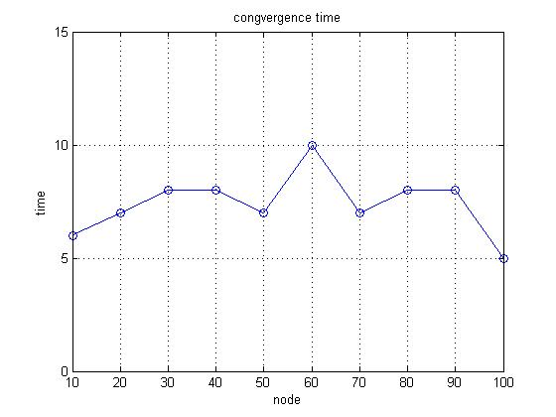
Simulation
R=[7,15,25,35,45,53,65,75,83,92];
N=[10,20,30,40,50,60,70,80,90,100];

Slide 30
Outline
Motivation
System model
Convergence of Nash Equilibria
Simulation
Conclusion

Slide 31
Conclusion
We use the distributed manner to solve the resource allocation problems
Instead of single resource allocation, we propose that every node can collect more than one resource
Utilize the satisfaction game model to make the allocation problem more practical
Using a modified better reply strategy guarantees that NE can be reached.

Slide 32
Conclusion
Future work
Find a faster way than asynchronous update for converge
To collect more resources (so that we can reduce the demand for each resource) to guarantee that the node is satisfied with every resource he collects.

Slide 33
Q&A

Slide 34
Thank you!

