Slide 1
Relieving Hotspots in Data Center Networks with
Wireless Neighborways
Liqin Shan
June 3. 2014
Notes:
Hello everyone, my name is Shanliqin. It will be my honor to introduce how to relieving Hotspots in Data Center Networks with Wireless Neighborways. Besides, I will introduce some of my recent work.

Slide 2
Outline
Motivation & Objective
Fat-Tree Topology
Design of Wireless Neighborways
IP Address Setting
Traffic Enginerring (Lyaponov Optimizing)
Simulation
Future Work

Slide 3
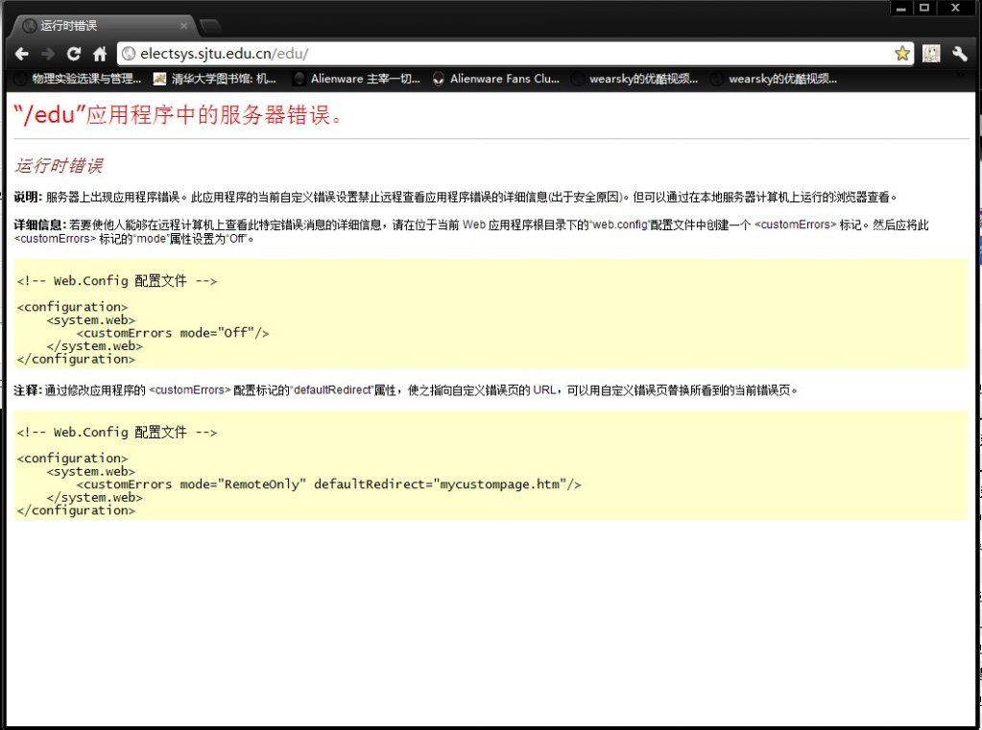
Motivation & Objective I/II
Failed to select courses in electsys.sjtu !
Notes:
I suppose that all of you here have seen this page, and you will have the similar experience when you are selecting courses in the website of SJTU, that you may not even log into this website. A possible reason is that there are congestion happens in the data center of the website in SJTU.

Slide 4
Motivation & Objective I/II
We propose to integrate 60GHz wireless links into data center network(DCN)
Objectives:
  Relieve the hotspots.
Notes:
So in this paper, we proposed to integrate 60GHz wireless links into data center network.
Congestion will degrade the performance of DCN, as previously mentioned. In other word, congestion will happen in some certain node in the whole network. And we call these node hotspot. So our design is to relieve these hotspots. // and we also have some by-products:

Slide 5
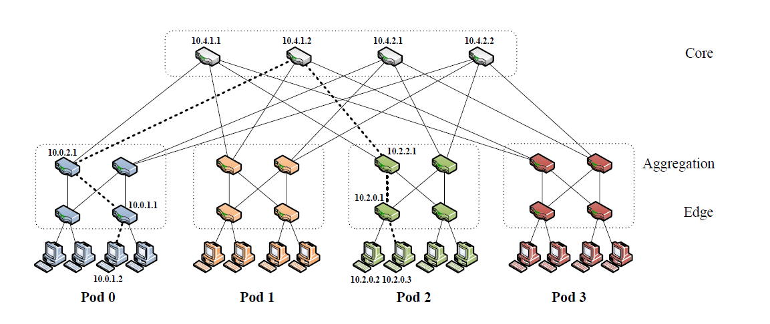
  Fat-Tree Topology
Switches
Top of Rack Switch
(ToR)
Servers
Notes:
This figure show you a famous data center topology which is also the basis of our design: Fat-Tree topology. It has three layers, the core layer, the aggregation layer and the edge layer, these three layers are composed of switches. In reality, servers are placed on a rack, and on the top of each rack, there is a switch called Top of Rack switch. A Top of Rack switch has connections with all servers in the rack. In this kind of topology, switches in the edge layer is the ToR switch.

Slide 6
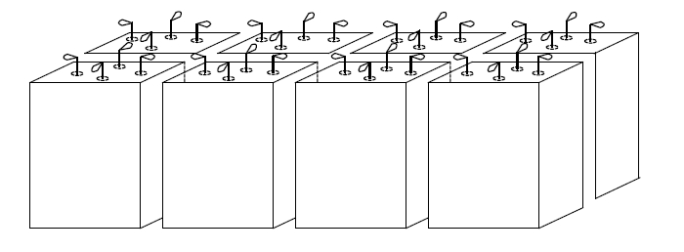
Design of Wireless Neighborways
There are four 60GHz directional antennas on each ToR, establishing wireless links with four neighboring ToR switch around.
Notes:
In our design, we equip four 60GHz directional antennas on each ToR, establishing wireless links with four neighboring ToR switch around.
The reason why we use 60GHz wireless links is that this kind of technology supports high-transmission rate and short-transmission distance. Note that the wireless links can only be established between the neighboring ToRs because of the short-transmission distance, and the advantage of it is the low interference.

Slide 7
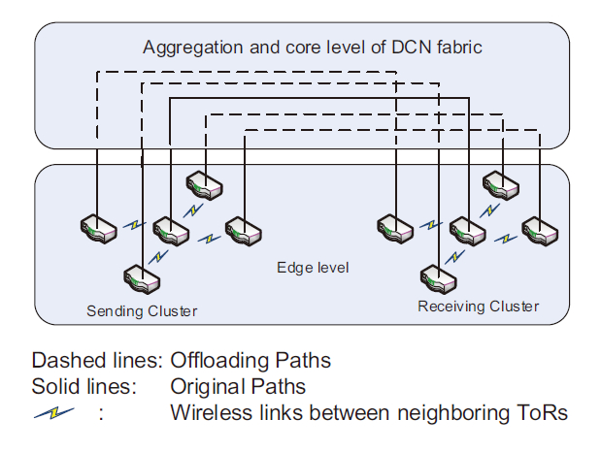
Design of Wireless Neighborways
There are three steps in a complete transmission.
Notes:
Look at this picture, the switches in this figure are ToRs switches, the solid line means the original path for a transmission process without wireless links.
Now I will show you the process of a complete transm ission in our new design.
A complete transmission contains three steps:
First, the sender switch will transmit some data to its four neighboring switches.
Then, these switches would transmit data to the receiver switches and corresponding neighboring switches around the receiver. Note that the transmission in this step is through wired links in the aggregation and core layer.
Finally, the data will aggregate from the neighboring switches to the receiver.
Thus, compared to the original paths within pure wired links, we now have some more offloading paths in this transmission process due to the wireless links. In other word, now we have more switches to share the pressure of the hotspot switch, so the hotspot is relieved.

Slide 8
Design of Wireless Neighborways
There are three steps in a complete transmission.
Notes:
In last slide, we may see that there are only four extra offloading paths in the transmission, however due to the multi-paths transmission, there could be more paths from one switch to the others, totally up to twenty-five paths, as shown in this figure. However, there are some constraints to these paths that any two of them should be independent to each other. This is to avoid to incur new hotspots. That means these paths probably cannot be active at the same time.

Slide 9
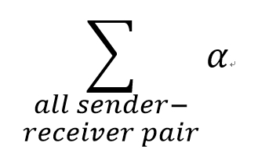

IP Address Setting
Offloading Factor:$α= n_{s}∙n_{d} −n$
Optimizing Problem:
  max
  s.t. Topology Contraints
Notes:
So for a certain sender- and- receiver pair, we now define an offloading factor alpha, which indicates to what extent this pair can benefit from our design. The offloading factor is actually the number of effective offloading paths for each pair. So now we may form an optimizing problem to maximize the sum of all alpha of each sender and receiver pair in the whole data center network. The solution of this problem is the layout of the data center, or we may say after solving this optimizing problem, we have establish a corresponding relationship between the physical layout and the logical layout of the data center topology.

Slide 10

Traffic Engineering
Lyaponov Optimizing Method
Cache Occupancy Rate $β$
Define $L\left(t\right)= \frac{1}{2}\sum{β^{2}(t)}$
Prefer to use $∆\left(t\right)=L\left(t+1\right)−L\left(t\right)$
Notes:
Compared to the linear assignment method, we now proposed to use the Lyaponov optimizing method to solve the problem. The method is based on the cache occupancy rate beta, which indicates to what extent a hotspot suffers from congestion.
We now form a function to measure the degree of the whole data center suffering from the conjestion. This function L(t) is half the sum of square of all beta in the data center. This function is reasonable because to make it small, it requires all beta to be enough small.
However, using L(t) to be the objective function is not very perfect, because what we need it to relieve the hotspots, which means that we need the network to be more stable. In other word, minimizing L(t) doesn’t necessarily means the resources have been fully utilized.
Thus, we use a new function delta(t), which is the difference of L(t) between two time slots.

Slide 11
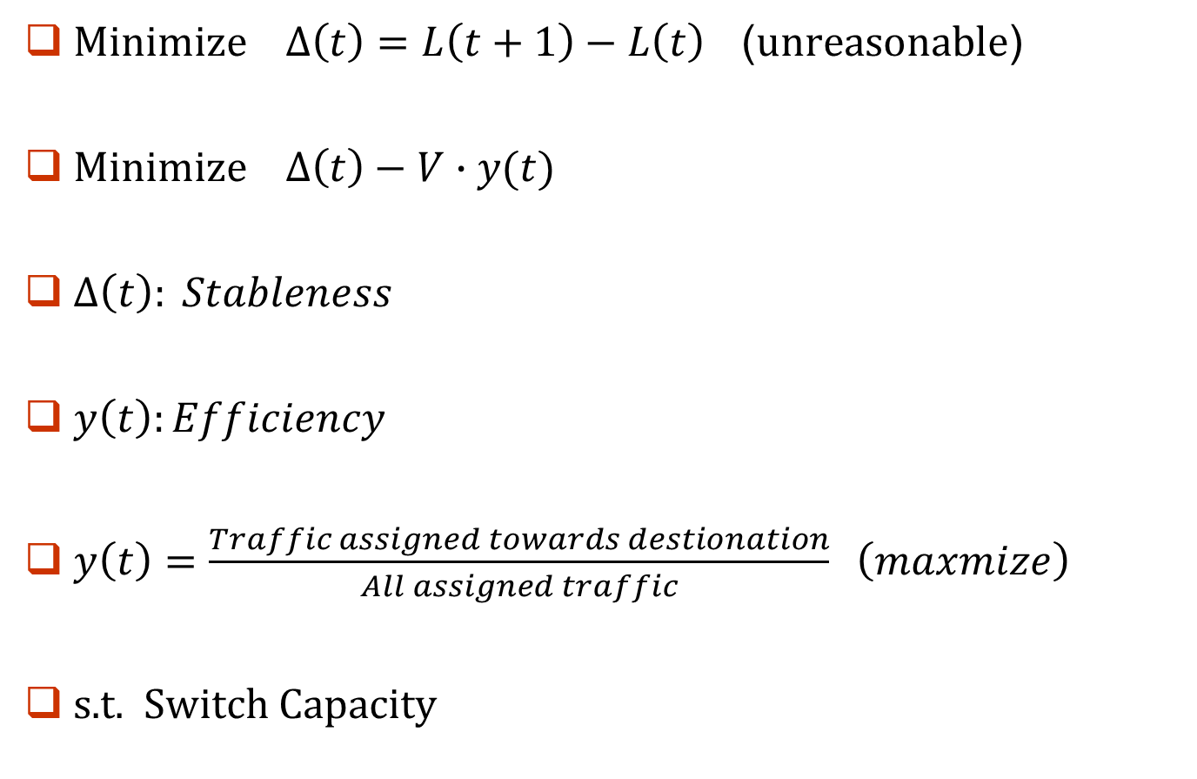
Traffic Engineering
$Minimize ∆\left(t\right)=L\left(t+1\right)−L\left(t\right)$ (unreasonable)
$Minimize ∆\left(t\right)−V∙y(t)$
$∆\left(t\right): Stableness$
$y\left(t\right):Efficiency$
$y\left(t\right)=\frac{Traffic assigned towards destionation}{All assigned traffic} \left(maxmize\right)$
s.t. Switch Capacity
Notes:
To minimize the delta(t) seems to be reasonable, because it minimize the changing of states in the data center, which helps to make data center more stable. However, in this function, the assignment is just based on the purpose to make the network stable. In other word, it neglects the efficiency of the data center.
It means that, the assignment cannot help the traffic flow to reach its destination as quickly as possible. So now we form an new optimizing function, which is the proportional sum of delta(t) and y(t). Delta(t) represents for the stableness and y(t) represents for the efficiency. There is a trade-off between stableness and the efficiency, and it yields to parameter V.
Here y(t) represents for the efficiency, and we define it to be the ratio of the traffic assigned to transmit towards the destination to the amount of all traffic flow. This is reasonable, because in order to make the network more stable, there must be some traffic flow to detour from their shortest path to the destination, so this ratio is not always be one.
Thus now, we have form a new optimizing problem based on the Lyaponov method.

Slide 12
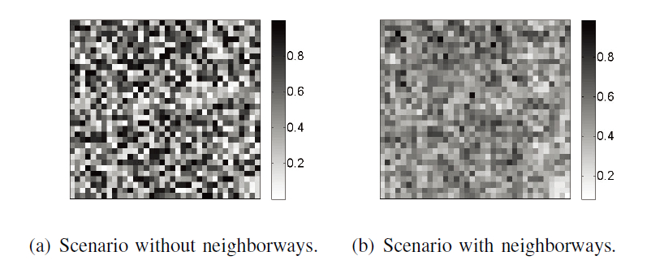
Simulation Results
1152 ToRs
Switch Fabric: 20Gbps
Wireless Link Capacity: 4Gbps
Notes:
Here I may introduce the simulation results by MATLAB.
Here we used 1152 ToRs, and set the switch fabric, which is the T is the previous formulations. The wireless link capacity is set to be 4Gbps.
These two pictures shows the hotspot map in the DCN, and each pixel in the graph represents a switch. The darker the pixel’s color is,
The hotspot suffers more from the congestion. In Fig.(a), it shows that the workloads of switches are seriously unbalanced.
The effectiveness of neighborways are illustrated in Fig. (b), where the number of black and white nodes are reduced and
more nodes are in the color of grey. This means that the hotspots have been relieved.

Slide 13
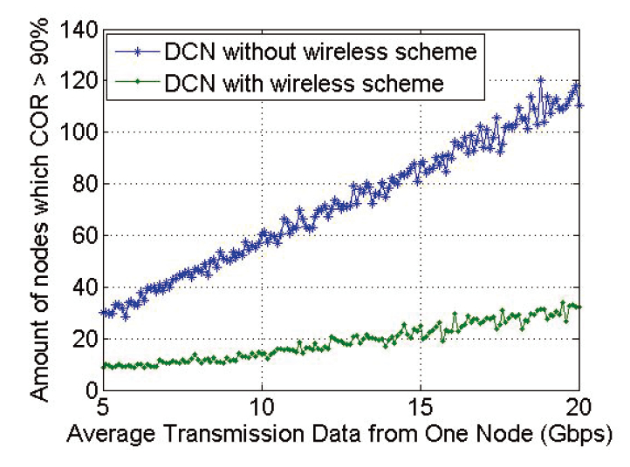
Simulation Results
1152 ToRs
Switch Fabric: 20Gbps
Wireless Link Capacity: 4Gbps
Notes:
Then we randomly choose sending switches, and assign output traffic from the sending node in the range between
5Gbps and 20Gbps. We count the number of switches whose cache occupancy rate is over 90%. It is clear that the our design scheme can largely
reduce the number of hotspots in the DCN compared to that without wireless links.

Slide 14
Future Work
Determine the parameter V by self-learning algorithm.
Simulate by ns3.

Slide 15
End
Thank You !

