Slide 1
RFID-based indoor localization
Wang Zepeng
2016/06/07

Slide 2
目录 Contents
1
Introduction
2
System
3
Experiment
4
Conclusion and Q&A

Slide 3
目录 Contents
1
Introduction
2
System
3
Experiment
4
Conclusion and Q&A

Slide 4
Introduction
Radio Frequency IDentification
Tag power provided by the reader’s signal.
Tag modulate(ASK) and then backscatter the signal
Reader demodulate the signal
Half Duplex

Slide 5
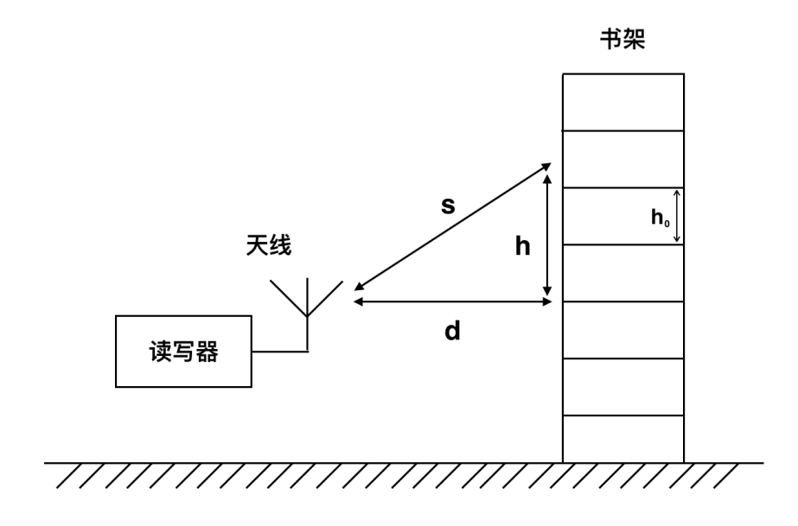
Introduction
Shelf
Find which shelf the book is on.
Aim to find s,
Then we can calculate h.
Antenna
Reader

Slide 6
Related work
Our work
WLAN and BLE localization
Expensive to deploy devices
Need power
Mostly based on RSSI – distortion
RFID localization
RSS,TOA,TDOA,RSP,PDOA
Multi-reader or multi-antenna or multi frequency
No cables and powers for tag, suitable for massive deployment on books.
Combine RSSI and phase information
One antenna for one area.
Notes:
Why not others
wifi and ble: high power consumption [some evidence]
high cost[some evidence]
sensitive to multipath effect, tag orientation and other interference in the atmosphere. [detail later]
Why RFID
passive tags, no consideration in change tags massively.
tag price as low as $0.08/piece.
one-to-many transfer, more robust. (reference or evidence to be found)
RSS receive signal strength
TOA time of arrival
TDOA time difference of arrival
RSP receive signal phase
PDOA phase difference of arrival

Slide 7
目录 Contents
1
Introduction
2
System
3
Experiment
4
Conclusion and Q&A

Slide 8
Basic idea
One reader, one antenna and one frequency
In the first half wavelength:
$d=\frac{λ}{2}×\frac{φ}{2π}=\frac{c}{4π}×\frac{φ}{f}$.
Notes:
Backscatter 去回各半波长，所以才是4pi f.

Slide 9
Outside the half wavelength
Use RSSI as an anchor
RSSI approximately follows the log attenuation model.
In practice, detect the point where phase hops from 0 to $2π$.

Slide 10
目录 Contents
1
Introduction
2
System
3
Experiment
4
Conclusion and Q&A

Slide 11
Phase of Arrival - Distance
Notes:
921.625 half lambda=0.16275600m
4freq half lambda all around 16cm
That's why we only use one frequency's PDOA - we only find one accurate frequency.

Slide 12
Distance estimation within half wavelength
Notes:
error is tolerable.

Slide 13
Out of one half wavelength

Slide 14
Out of one half wavelength(cont.)

Slide 15
Distance estimation within one meter

Slide 16
目录 Contents
1
Introduction
2
System
3
Experiment
4
Conclusion and Q&A

Slide 17
Conclusion
Realized
A RFID localization system range up to 3.6 meters.
To do
More reliable approach, like another frequency or use phase instead of RSSI as anchors.

Slide 18
Q&A

