Slide 1
Android Programming Use Wex5 to Develope HTML5 APP
Chuqi Wang, SEIEE
2016-05

Slide 2
HTML5 Application
Taobao
HTML5 App
Web apps run in mobile browsers and can also be repackaged as native apps on the various mobile platforms. With the wide range of platforms to support, combined with the sheer power of mobile browsers, developers are turning to HTML5 as a “write one, run many” solution.
QQ
Hybird
Wechat
Native

Slide 3
HTML5 Application
HTML5 App is not a simple browser.
WebView was originally designed to allow local applications to process and display web content.
PhoneGap builds a bridge between JavaScript code and native code (for example, Java) to . This bridge allows the JavaScript code to call the local code.
Source: http://www.uml.org.cn/safe/201406115.asp

Slide 4
WeX5
Solution of Front-end design, Back-end, test, pack of H5 app.
Source: http://docs.wex5.com/wex5-introduction/

Slide 5
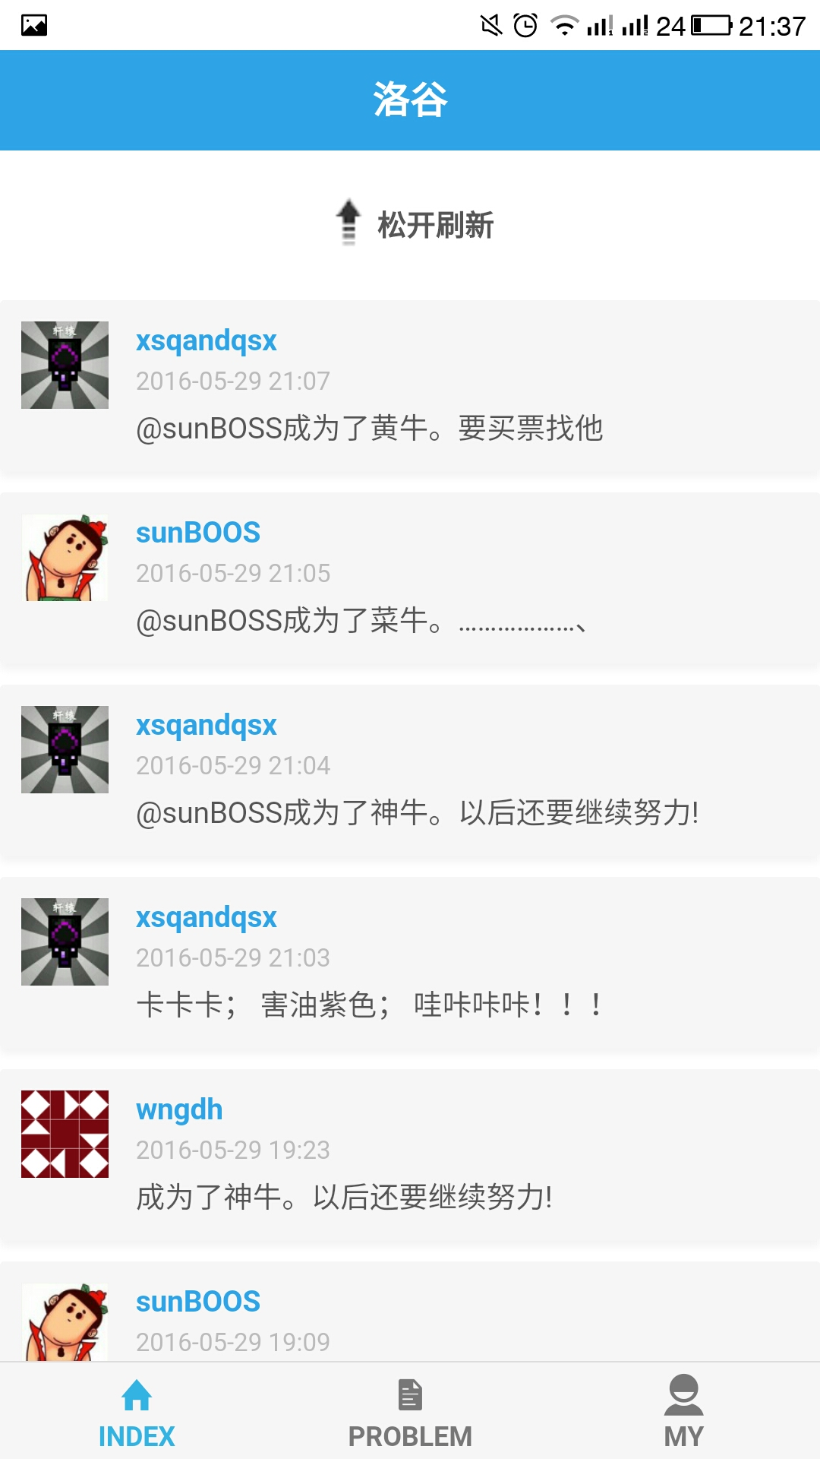
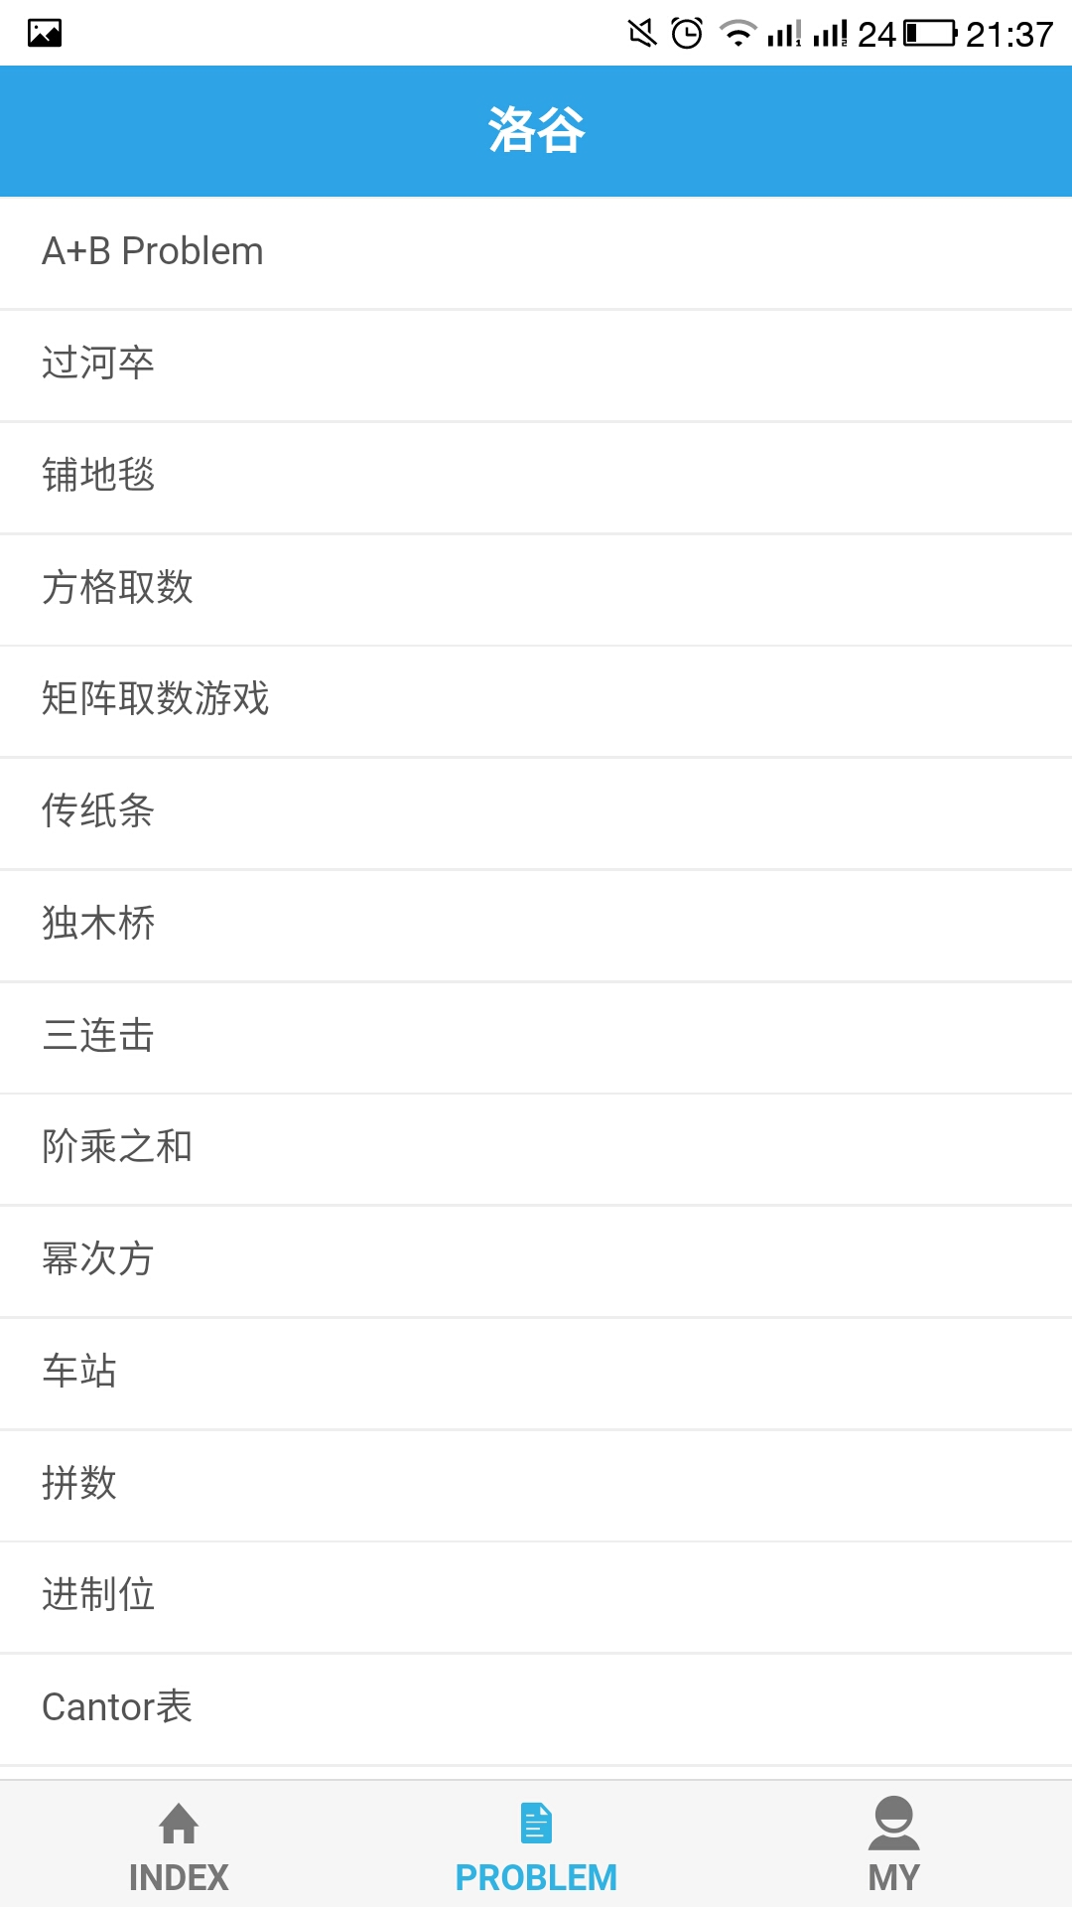
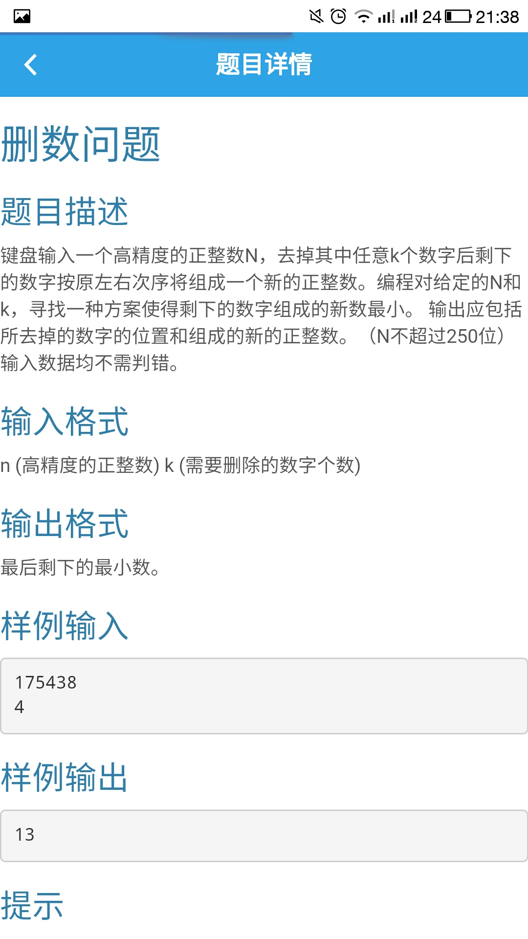
Luogu App (time consuming: 1.5d)

Slide 6
Developing Procedure
Environment Installing
Data model constructing
Interface designing
Testing and packing
YOU DON'T NEED TO KNOW ABOUT JAVA.
(but HTML, CSS, JS knowledge is required)

Slide 7
WeX5 IDE
what you see is what you gain

Slide 8
Environment Installing
WeX5 ( http://www.wex5.com/ )
Download and Unzip
Don't need to install
Run the Studio.

Slide 9
Data model constructing
It can control the various types of data.
Manage data
Coding on data

Slide 10
Interface designing
Drag the components
Bind with the UI components.
When the data change, the ui elements.

Slide 11
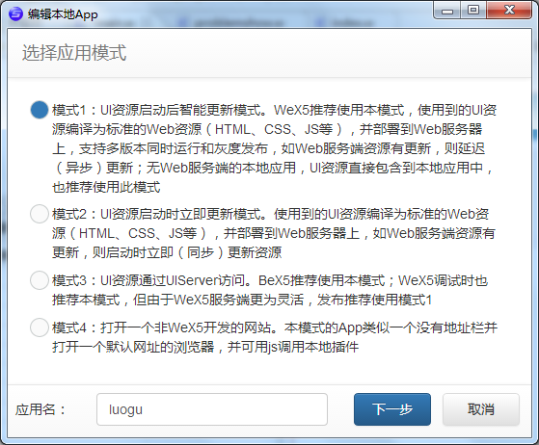
Testing and packing
Test: use chrome
Packing: There is a wizard
Can get the final .apk file
ios app is difficult.

Slide 12
Thank you
and Q&A

