Slide 1
Indoor localization
ZHANG YIFAN

Slide 2
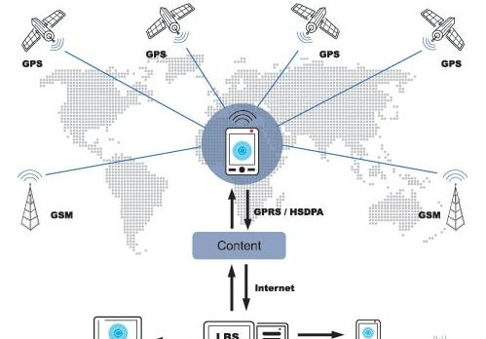
LBS（location based service）
GNSS(global navigation satellite system）GPS(USA),GLONASS(RUSSIA),Galileo（Europe）北斗（China）

Slide 3
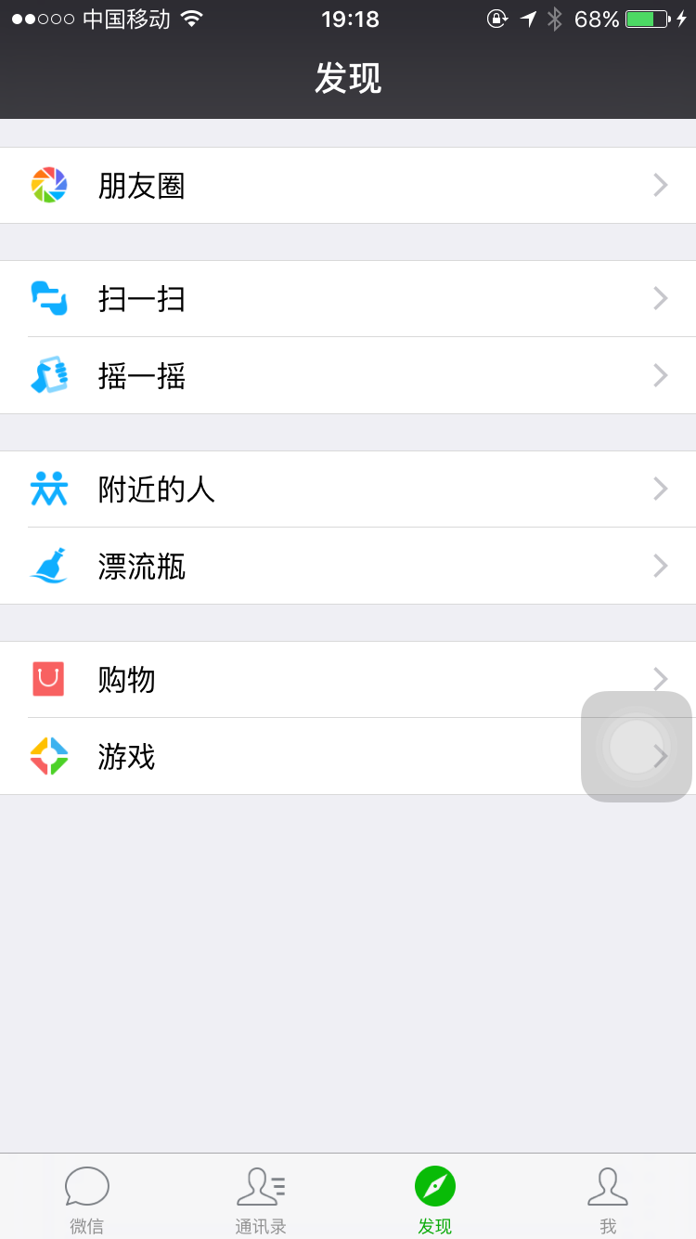
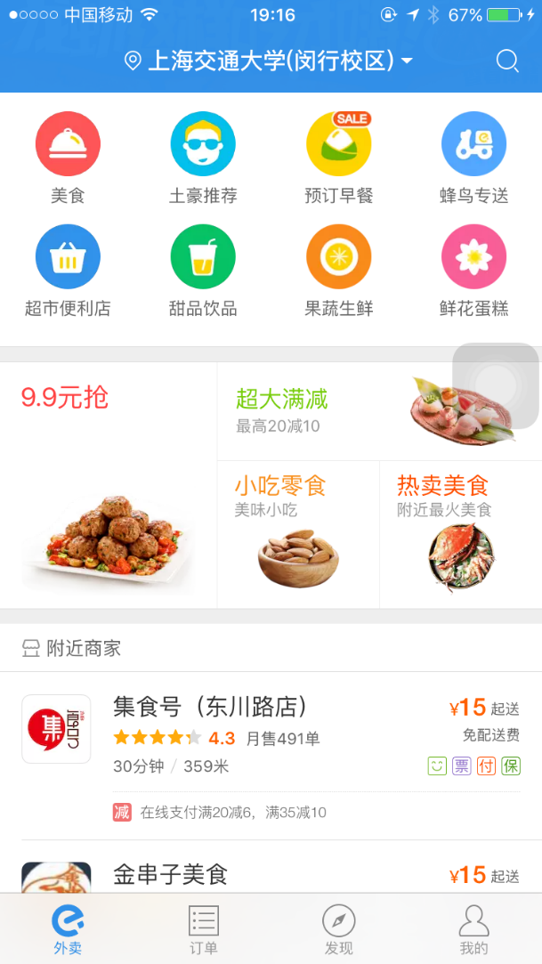
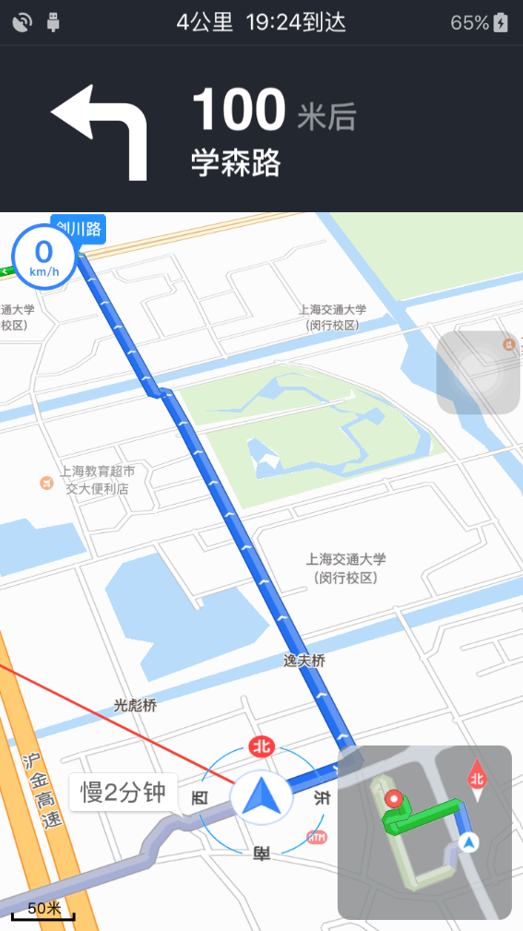
LBS（location based service）
Navigation，Traffic Control
Convenience Service
Social Activity

Slide 4
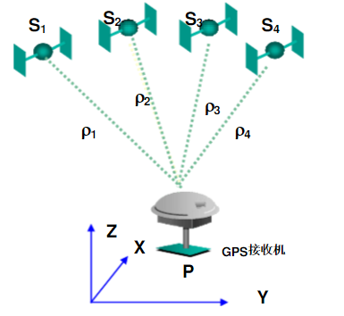
LBS
Satellite | Distance
S1 | ρ1
S2 | ρ2
S3 | ρ3
S4 | ρ4

Slide 5
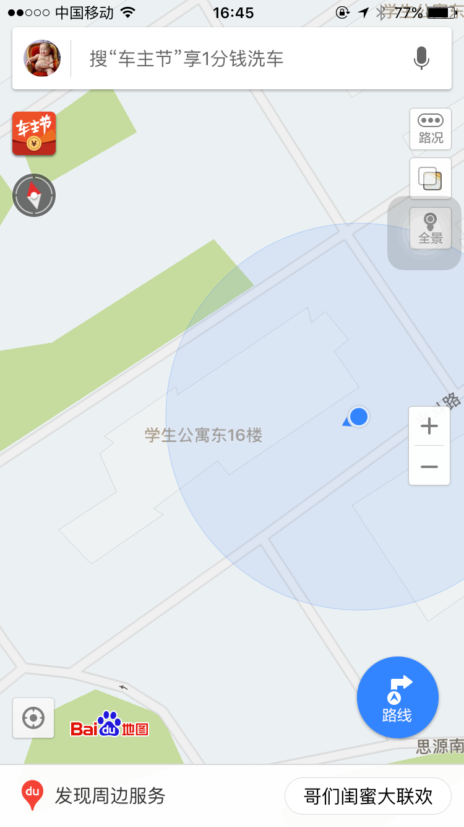
Problems
Signals cut out by buildings
Multipath effect
Shadow effect
Other wireless device

Slide 6
Fingerprinting based indoor localization

Slide 7
PROCEDURE OF FINGERPRINTING BASED INDOOR LOCALIZATION

Slide 8
MY EXPERIMENT
PREPARATION
FINGERPRINTING DATABASE
SOFTWARE
MAP
COLLECTING DATA
ONLINE
COLLECTING DATA
CALCULATION
CALCULATION

Slide 9
SOFTWARE
WirelessMon

Slide 10
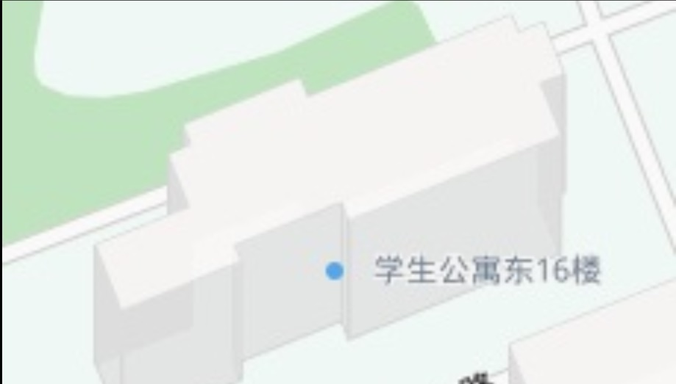
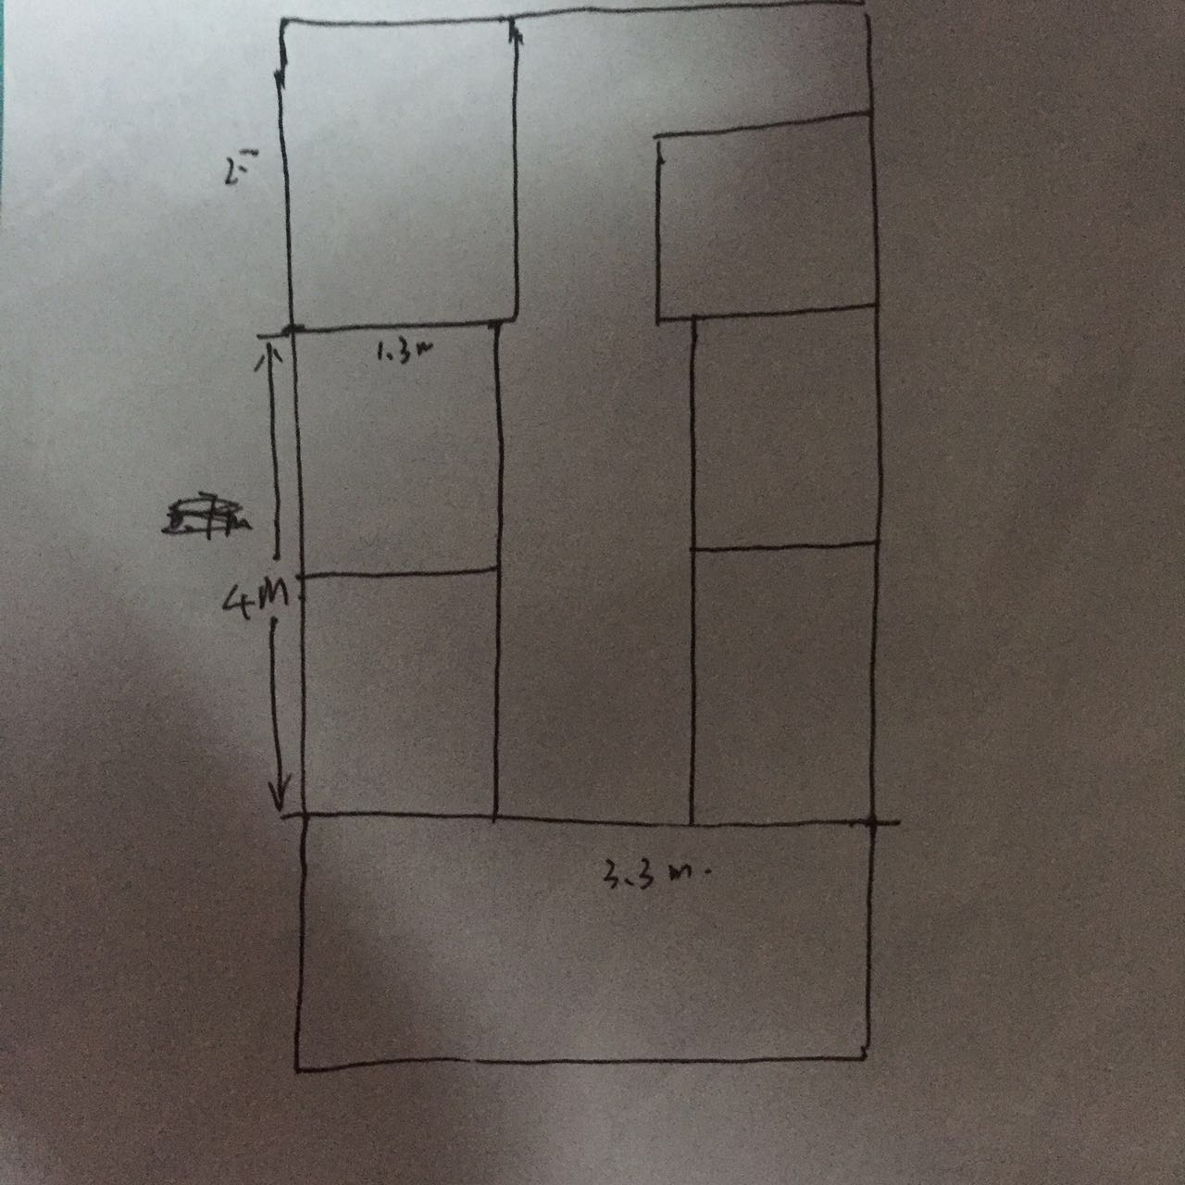
MAP

Slide 11
My fingerprint database
序号 | 坐标 | p2psearch | 403 | FAST | DEJURE | DORM503
1 | (0.3,1.2) | -27 | -54 | -62 | -66 | -67
2 | (0.3,2.8) | -42 | -25 | -74 | -69 | -64
3 | (0.6,0.9) | -24 | -57 | -57 | -58 | -64
4 | (2.4,6.6) | -54 | -66 | -75 | -73 | -73
5 | (0.1,6.6) | -64 | -59 | -62 | -75 | -75
6 | (0.1,-1.5) | -47 | -60 | -68 | -79 | N/A
7 | (3.2,4.2) | -48 | -60 | -75 | -79 | -75
8 | (2.4,3.2) | -41 | -45 | -65 | -60 | -66
9 | (1.5,1.7) | -28 | -45 | -64 | -62 | -68
10 | (1.8,4) | -45 | -51 | -72 | -64 | -65

Slide 12
Online data collecting
序号 | P2psearch | 403 | FAST | DEJURE | DORM503
1 | -36 | -45 | -71 | -62 | -64

Slide 13
Algorithm
1.NN（nearest neighborhood）
2.KNN（K-nearest neighborhood）

Slide 14
Calculation
81 | 81 | 81 | 16 | 9 | 268 | 16.37071
36 | 400 | 9 | 49 | 0 | 494 | 22.22611
144 | 144 | 196 | 16 | 0 | 500 | 22.36068
324 | 441 | 16 | 121 | 81 | 983 | 31.35283
784 | 196 | 81 | 169 | 121 | 1351 | 36.75595
121 | 225 | 9 | 289 | #VALUE! | #VALUE! | #VALUE!
144 | 225 | 16 | 289 | 121 | 795 | 28.19574
25 | 0 | 36 | 4 | 4 | 69 | 8.306624
64 | 0 | 49 | 0 | 16 | 129 | 11.35782
81 | 36 | 1 | 4 | 1 | 123 | 11.09054
For NN the result is （2.4,3.2）
For k-NN， if k=2，the result is（2.0,3.6）
if k=3， the result is （1.9，2.96）
The actual coordinate is （1.8,3.0）

Slide 15
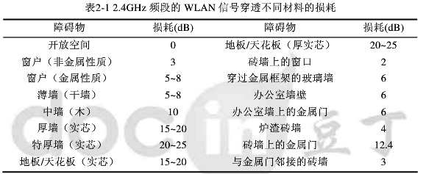
Problems
Facility problems
1.1 wirelessmon
1.2 laptop
1.3 router
1.4 other device’s influence
Not enough fingerprint database

Slide 16
Thank you

