Slide 1
ZeroRank: Ranking Newly Published Scientific Literatures Without Citations
June 7, 2016 Zhenyu Song

Slide 2
Contents
1
Motivation
2
Implementation
3
Experiments
4
Future Work

Slide 3
Contents
1
Motivation
2
Implementation
3
Experiments
4
Future Work

Slide 4
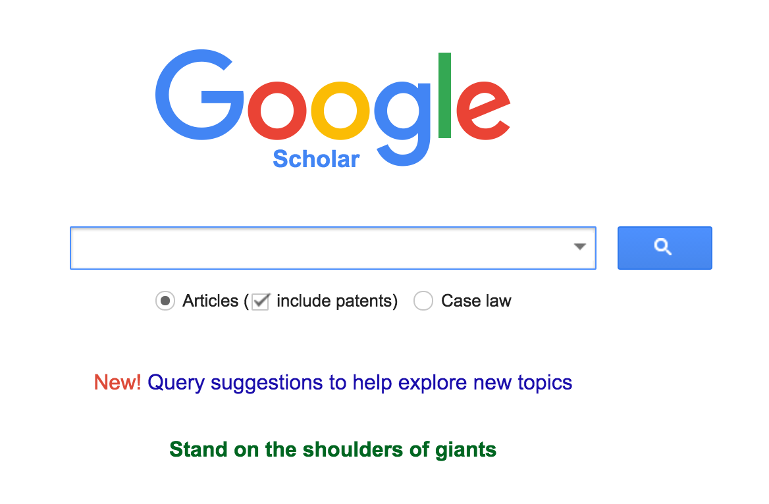


Motivation
Ranking scientific literatures is an important and fundamental task:
Search Engine
Recommendation System
Academic Rewarding

Slide 5
Motivation
Current ranking algorithms focus on papers published long ago. But it is interesting to consider the papers published just now.
Ranking newly Published Scientific Literatures Without Citations
ZeroRank

Slide 6
Problem Definition
We only focus on the edge of paper network
Author, venue, affiliation and time information can help

Slide 7
Contents
1
Motivation
2
Implementation
3
Experiments
4
Future Work

Slide 8
Structure
ZeroWalk
Feature extractor
Learning to Rank
Model trainer

Slide 9
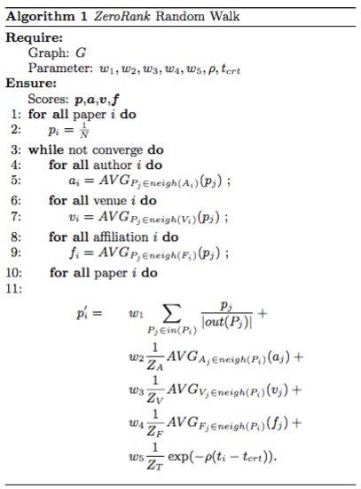
ZeroWalk
Compute author/venue/ affiliation authority score
Compute paper’s PageRank score
Compute author/venue/ affiliation hub score
Compute paper’s time variant score
Compute new paper score

Slide 10
Learning to Rank
ZeroWalk
Feature 1
Feature 2
…
Feature n
Ranking Model
Real Rank 1
Real Rank 2
…
Real Rank n
Learning to Rank

Slide 11
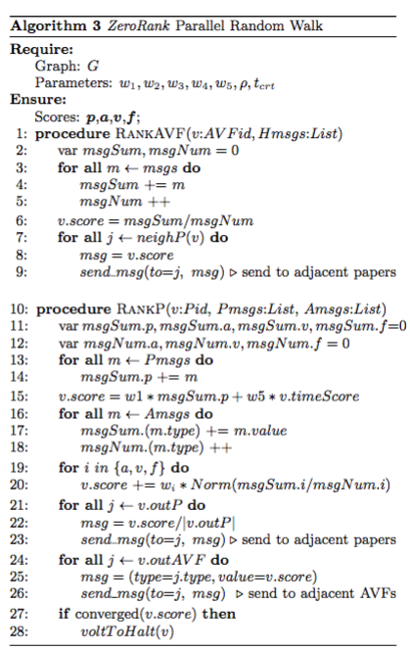
Parallel ZeroWalk by Spark
ZeroWalk takes up major time
ZeroWalk
Spark ZeroWalk

Slide 12
Contents
1
Motivation
2
Implementation
3
Experiments
4
Future Work

Slide 13
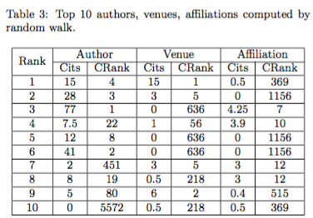
Feature Extraction
ZeroWalk can detect the popular authors, venues and affiliations.
The poor dataset of Affiliation limits the ability.

Slide 14
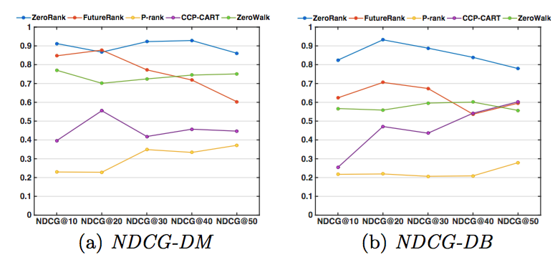
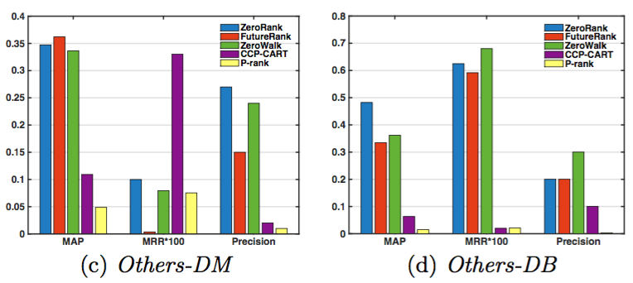
Zero Citation Ranking
NDCG preforms excellent!
MAP, MRR, Precision seems good
The metrics are not exactly matches, tradeoff exists!

Slide 15
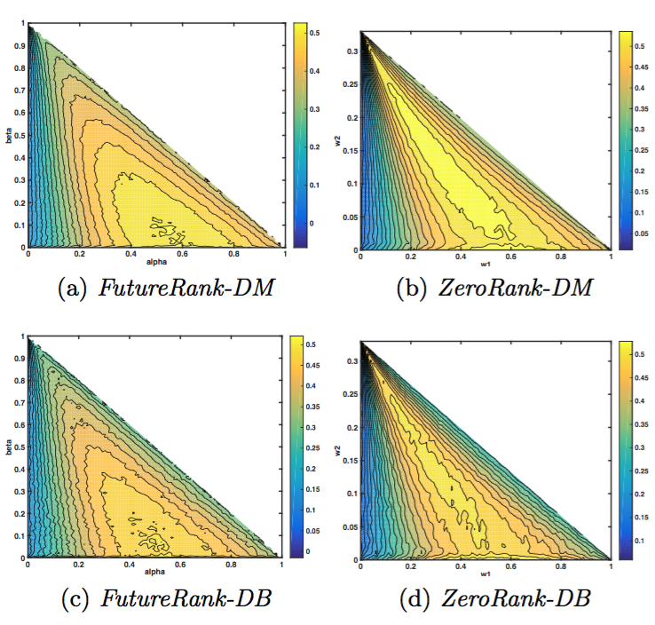
Performance on Varying Parameters
ZeroRank outperforms FutureRank on most parameters on both datasets

Slide 16
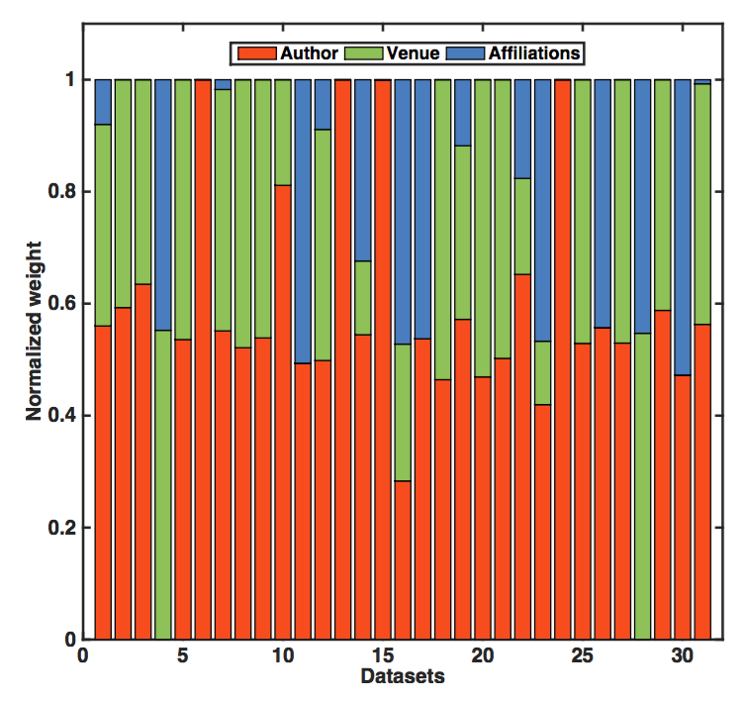
Feature Importance
A popular “authors” dominates whether a paper will receive more citations
Affiliation seems to be not so important

Slide 17
Contents
1
Motivation
2
Implementation
3
Experiments
4
Future Work

Slide 18
Future Walk
Words information embedded
More experiments on other fields
Study why “author” seems so important

Slide 19
Q&A

