Slide 1
Network economics
Wi-Fi offloading /Auction(reverse auction)
Presented by Li Yiqing

Slide 2
Outline
Introduction
Paper: A Bandwidth Trading Marketplace for Mobile Data Offloading
System model
Optimal auction
Greedy auction
Numerical results
Future work

Slide 3
Outline
Introduction
Paper: A Bandwidth Trading Marketplace for Mobile Data Offloading
System model
Optimal auction
Greedy auction
Numerical results
Future work

Slide 4
Introduction
Offloading
cellular data traffic is growing exponentially, and this trend is expected to continue
The current best practice is for service providers to augment the cellular network capacity by deploying alternative wireless technologies

Slide 5
Introduction
Wi-Fi offloading
Heterogeneous Mobile Networks: mobile operators can opportunistically exploit Wi-Fi access networks to improve the QoS experienced by their customers, while reducing the power consumption of their networks by switching the underused base stations off

Slide 6
Introduction
Auction
An auction is a process of buying and selling goods or services by offering them up for bid, taking bids, and then selling item(s) to the highest bidders.
How do offloading and auction combine?
Mobile operators need to buy traffic capacity from the Wi-Fi APs.

Slide 7
Introduction
Reverse auction
One buyer, multiple sellers.
Sellers give out their bids and then buyer decides to choose
Challenge: the misbehavior of few agents /dishonest bids
Reverse truthful auction

Slide 8
Outline
Introduction
Paper: A Bandwidth Trading Marketplace for Mobile Data Offloading
System model
Optimal auction
Greedy auction
Numerical results
Future work

Slide 9
Paper: A Bandwidth Trading Marketplace for Mobile Data Offloading 2013,INFOCOM
propose and analyze a reverse auction
present an innovative payment rule(individual rationality and incentive compatibility)
Since the optimal reverse auction is NP-hard, we further propose a greedy algorithm
Perform a numerical analysis and comparative evaluation of the proposed optimal and greedy algorithms

Slide 10
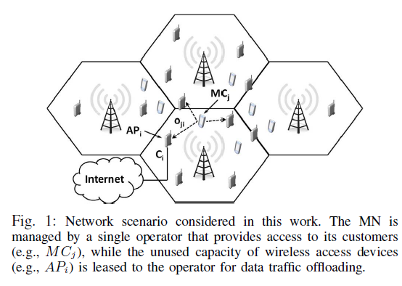
System Model
Base station(BS)
Wireless access point (AP) AP owner i
Mobile customers (MC) MC j
AP submits bid [$b_{i}$, $C_{i}$] (truthful when $b_{i}$ = $v_{i}$)
$p_{i}$as the price that AP is paid
the utility of AP i :
Channel utilization:

Slide 11
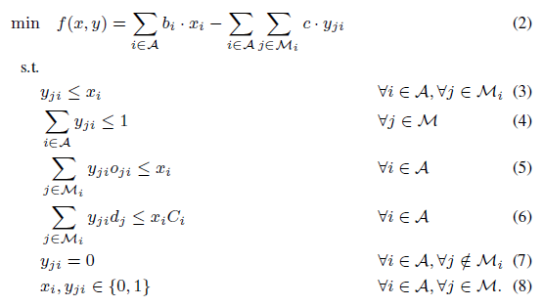
Optimal Auction
M: the set of MCs
$M_{i}$:the MCs that are in the radio range of AP i
c: trade-off value representing the gain of operator by offloading traffic of MC j to AP i

Slide 12
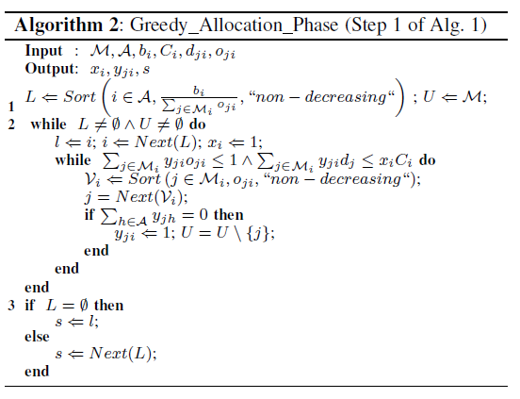
Greedy Auction
(1) the allocation phase, which selects the APs in ascending order of their bid

Slide 13
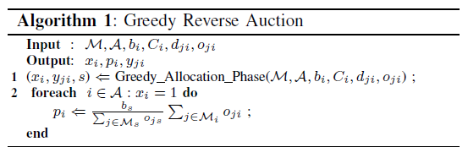
Greedy Auction
(2) the payment phase, which establishes the price paid to each winner as a function of the first unused AP in the sorted list (the first looser).

Slide 14
Numerical Results
7 cell sites---Each Macro Base Station (BS) installed around a central site serves 3 sectors, resulting in 21 sectors in total.
10 APs randomly placed within each sector, and vary the number of MCs in the [2, 10] range.
$b_{i}$: a uniform distribution with mean value equal to 10

Slide 15
Numerical Results

Slide 16
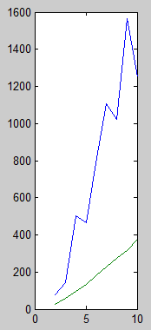
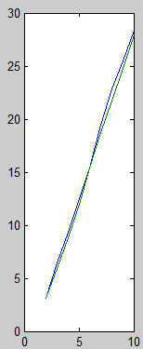
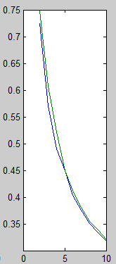
Numerical Results
G_m
G_u
$o_{ij}$randomly chosen
cost winner JFI

Slide 17
Outline
Introduction
Paper: A Bandwidth Trading Marketplace for Mobile Data Offloading
System model
Optimal auction
Greedy auction
Numerical results
Future work

Slide 18
Future Work
The optimal auction algorithm must be finished otherwise the comparison is not enough
The model can be improved to be more complex as considering which one is better to access by Wi-Fi or use cellular network for users

Slide 19
Thank you !

