Slide 1
Collaborative Deep Learning for Recommender System Course Project of the Mobile Internet
Hanyun Xu
2016/05/23

Slide 2
outline
Introduction
Collaborative Deep Learning Model
Experiment Result
Future Work

Slide 3
INTRODUCTION

Slide 4
Existing methodS for RS
Content-based methods
Collaborative Filtering (CF)
- based methods
Make use of
User profile/discription
→ Not that easy to collect
Make use of
Past activity/preferences
e.g. user rating on items
Hybrid methods
Combining above two

Slide 5
LIMITATIONS
Because of privacy concerns, it is generally more difficult to collect user profiles than past activities.
The prediction accuracy often drops significantly when the ratings are very sparse.
they cannot be used for recommending new products which have yet to receive rating information from users.
Consequently, it is inevitable for CF-based methods to exploit auxiliary information and hence hybrid methods have gained popularity in recent years.

Slide 6
Motivation
CDL --
Collaborative
Deep Learning
CTR --
Collaborative
topic regression
more appealing than shallow models in that the features can be learned automatically (e.g., effective feature representation is learned from text content)
It is a probabilistic graphical model that seamlessly integrates a topic model, latent Dirichlet allocation (LDA) , and a model-based CF method, probabilistic matrix factorization (PMF)
Merit -- it produces promising and interpretable results
Demerit -- the latent representation learned is often not effective enough especially when the auxiliary information is very sparse.
inferior to shallow models such as CF in capturing and learning the similarity and implicit relationship between items.
This calls for integrating deep learning with CF by performing deep learning collaboratively.

Slide 7
Collaborative Deep Learning (CDL)

Slide 8
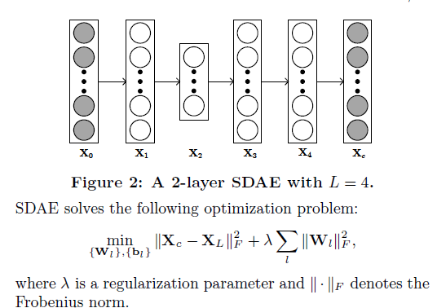
0 SDAE
Introduction
Collaborative Deep Learning Model
Experiment Result
Future Work
Notes:
Hierarchical
SDAE is a feedforward neural network for learning
representations (encoding) of the input data by learning to
predict the clean input itself in the output

Slide 9
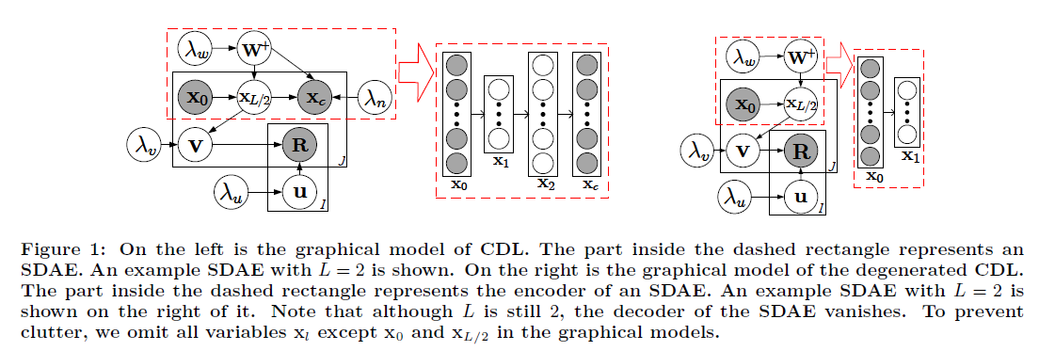
01 CDL
Introduction
Collaborative Deep Learning Model
Experiment Result
Future Work
Notes:
hierarchical

Slide 10
Experiment Result

Slide 11
Dataset & baselines
Dataset
Citeulike-a: 5551 users & 16980 items
Citeulike-t: 7947 users & 25975 items
Netflix: movies
Models for comparison
CMF --- Collective Matrix Factorization is a model incorporating different sources of information by simultaneously factorizing multiple matrices.
SVDFeature --- SVDFeature is a model for feature-based collaborative filtering.
CTR --- Collaborative Topic Regression is a model performing topic modelin(LDA) and collaborative filtering(PMF) simultaneously
Notes:
It is a probabilistic graph-
ical model that seamlessly integrates a topic model, latent
Dirichlet allocation (LDA) [5], and a model-based CF method,
probabilistic matrix factorization (PMF)

Slide 12
Comparison result
In the dense setting
Notes:
We can see that CTR is a strong baseline which beats DeepMusic, CMF, and SVDFeature in all datasets even though DeepMusic has a deep architecture.
obvious superiority in the sparse setting

Slide 13
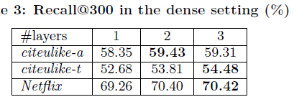
Comparison result
By seamlessly integrating deep representation learning for content information and CF for the rating matrix, CDL can handle both the sparse rating matrix and the sparse text information much better and learn a much more effective latent representation for each item and hence each user.
Notes:
the recall@300 （a estimation mechanism ） results, when CDL with different numbers of layers are applied to the three datasets under both the sparse and dense settings. As we can see, for citeulike-t and Netfix, the recall increases as the number of layers increases.
Note that the results are somewhat different for the first two datasets although they are from the same domain. This is due to the different ways in which the datasets were collected

Slide 14
Future Work

Slide 15
Future work
Incorporating other side information so that the Bayesian nature of CDL also provides potential performance boost
the convolutional neural network model which, among other things, can explicitly take the context and order of words into account. Further performance boost may be possible when more deep learning models like this is applied.
Notes:
performance can be achieved by jointly performing deep representation learning for the content information and collaborative filtering for the ratings (feedback) matrix.
As far as we know, CDL is one of the first hierarchical Bayesian model to bridge the gap between state-of-the-art deep learning models and RS.

Slide 16
THANK YOU

