Slide 1
Bluetooth Cochlear
Bluetooth connection & GAIA protocol
Guanghua Cheng
2016/05/26

Slide 2
Look Ahead
Outline
Bluetooth connection
GAIA protocol
Current work
Future work

Slide 3
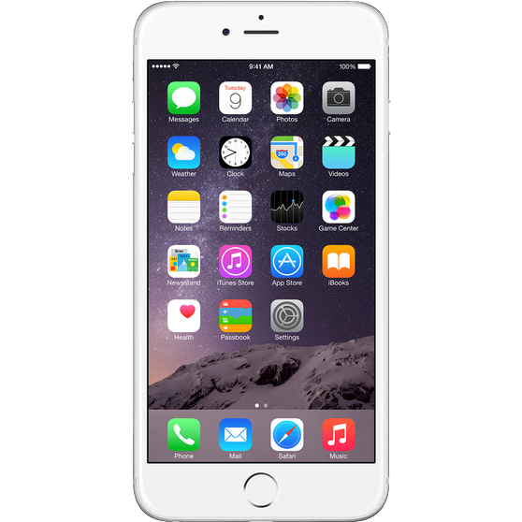
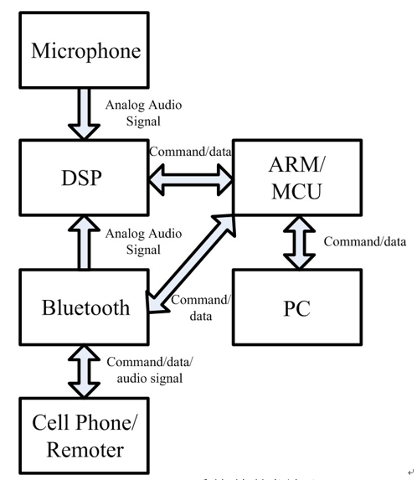
Outline of artificial Cochlear
The prototype we used in laboratory.
A simple architecture of android or IOS mobile device communicated with Bluetooth board
command
ack
CSR Bluetooth board
Notes:
In laboratory we have archetype of phone to board
computer to board
Protocol bridges phone and board with command send from phone, acknowledge packet sent from board.
All packet shall follow certain structure, here that’s GAIA protocol.

Slide 4
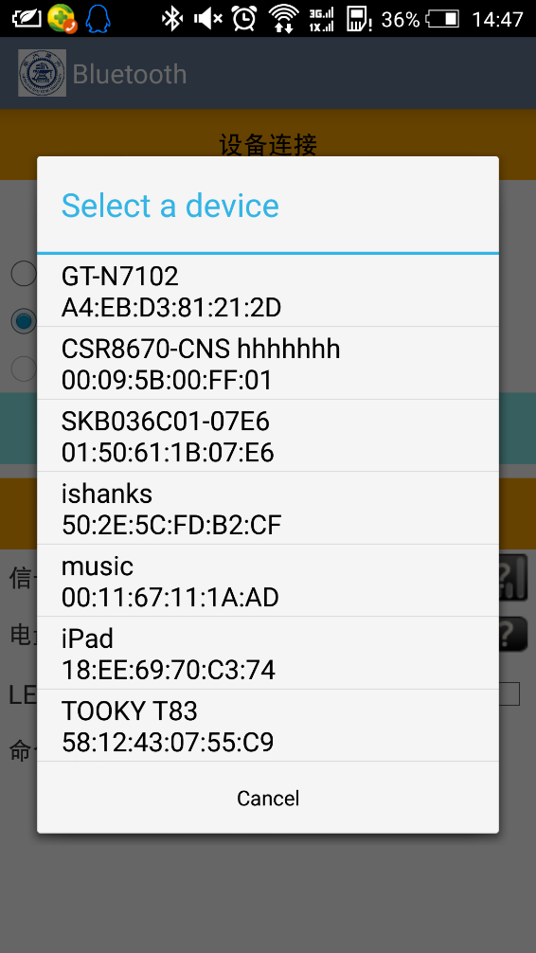
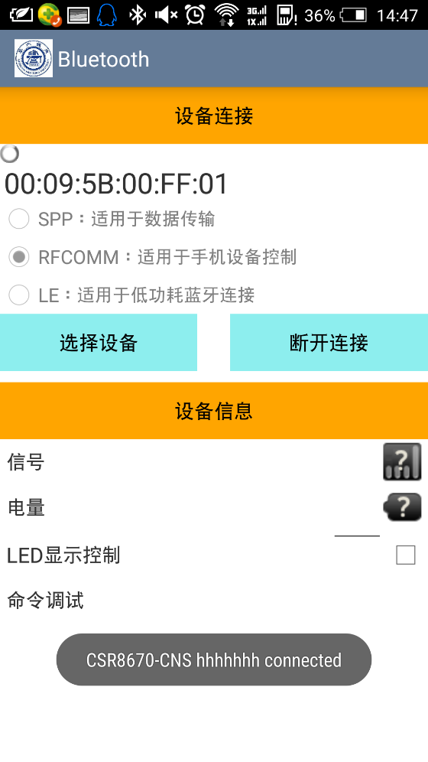
Bluetooth connection - setup
A list of all device available
UUID of per device recorded after
connection
A device is selected to pair with
Socket connection setup
Via a Bluetooth connection adapter
socket is set up
Connection can be interrupted
Notes:
To begin with:
Phone search the outer for available device.
Additionally, a list of device once paired with is maintained.
The connection is initialized with socket connection.
Connection can be interrupted during pairing.

Slide 5
GAIA protocol - outline
GAIA: CSR GAIA (Generic Application Interface Architecture) implements an end-to-end, host-agnostic ecosystem supporting host application access to device functionality.
Fixed form defined by GAIA protocol:
A packet within GAIA form has its parameter in payload given its command form specified with command ID.
Notes:
To introduce GAIA simply, this protocol ….
Start: One octet with the fixed value 0xff. Version: One octet. Flags: One octet. Bits within this field control protocol options.
Length: total length of packet Vendor ID: This 16-bit field qualifies the command ID. Command ID: This 16-bit field identifies the individual command. Payload: The payload contains any information required to be passed by a specific command. Check: One octet. If present this field is determined by XOR together the other octets in the packet. checksum

Slide 6
GAIA protocol - process
Mobile device:
device cipher required information obtained from user interface into GAIA packet, then pass it to Bluetooth board.
Board:
decipher packet passed from device, then according to the command ID part adopt different methods.
Pass corresponding acknowledge packet to device including required message.
Notes:
The acknowledge packet has its command fixed as changing the first octet being 8.
Types of command:
Configuration
Control commands
Polled status commands
File and partition commands
Debugging commands
Notification commands…

Slide 7
Current work
Bluetooth pair
Voice communication
Command protocol
Data transfer
App programing
URAT control
User register
BLE
Notes:
Bluetooth pair: pair and maintain pairing along with store device information
Voice communication: phone microphone compatible with Bluetooth board speaker
Command protocol: based on GAIA protocol, supplemented with new features
Data transfer: allow data transfer with voice transfer simultaneously
App programing: android and IOS app
URAT control: ensure communication bridging PC and board as well as communication bridging phone and board
User register: a user register and recording system built up on server
BLE: Bluetooth low energy communication, based on GATT protocol

Slide 8
Future work
Switch between BLE and Bluetooth
Build up user community
Build up IOS Bluetooth adapter
Promising algorithm:
mode identify
noise reduction
Notes:
Protocol switching: BLE has lower energy consumption
Mode identify & noise reduction:
algorithm used for handling voice shall change when in different milieu
e.g. place with considerable clamor should weaken noise, emphasize voice
while quiescence place should amplify sound
in all, algorithm adapt to environment to pick out specific sound

Slide 9
Q&A
Thanks for watching

