Slide 1
Hadoop-based Distributed Web Crawler
Zhen-Feng Shi
Search Engine Group
Research Center of Intelligent Internet of Things（IIoT)
Department of Electronic Engineering
Shanghai Jiaotong Univ.

Slide 2
Look Ahead
Motivation
Brief Introduction to Hadoop
Distributed Web Crawler
Current Work
Future Work

Slide 3
Motivation
Data Academic Search Engine
Motivation
Hadoop
Distributed
Web Crawler
Current Work
Future Work
Fetch Data?
IEEE
Systematic Crawler
Notes:
Data plays an essential role in our academic search engine.
Once we have multiple data source on local, we can establish a unified data store, which is also called data warehouse to guarantee the accuracy and consistency.
And then to support the upper layer functions like recommending or analyzing from the theory group.
The problem is, how to fetch these data from web into our local server?
Two strategy:
1. Aim at specific website, design specific crawler to crawl the data. Drawbacks: wasteful duplication of effort. So many websites.
2. Crawl papers from google scholar. Drawbacks: Google itself is the biggest crawler on earth. He knows how to crawl and how to prevent to be crawled better than us. Therefore, we are doomed to be blocked.

Slide 4
Motivation
Why not Nutch?
A well matured, production ready Web crawler
Great for batch processing
Two thirds of the system is designed for search engine
No helpful to accurate extraction
Instead of the title of HTML, we need
Paper titles, authors, abstracts, DOI, etc…
Secondary development
== Complete destruction
Motivation
Hadoop
Distributed
Web Crawler
Current Work
Future Work
Notes:
There are some famous open source web crawler such as nutch.
Nutch is a well matured, production ready web crawler.
And it is great for batch processing.
But don’t we use it?

Slide 5
open-source software
Reliable, scalable, distributed computing
Four modules
Hadoop Common
Hadoop Distributed File System (HDFS™)
Hadoop YARN
Hadoop MapReduce
Map() -- filtering and sorting
Reduce() -- summary operation
Web Crawler -- Not a common application of Hadoop
Zero input, infinity output
Most of works done in Map()
Motivation
Hadoop
Distributed
Web Crawler
Current Work
Future Work
Notes:
Hadoop Common provides The common utilities that support the other Hadoop modules.
HDFS is a distributed file system that provides high-throughput access to application data
YARN is a framework for job scheduling and cluster resource management.
MapReduce is based on YARN, for parallel processing of large data sets.
Basically, it has two procedure, map and reduce. Map performs filtering and sorting, and reduce performs summary operation
(such as sorting students by first name into queues, one queue for each name)
(such as counting the number of students in each queue, yielding name frequencies)
Web crawler is not a common scenario of Hadoop. It has zero input, but infinity output. Therefore, most of our work can be done in the map() procedure.
But Hadoop is also helpful due to its powerful distribution management.

Slide 6
Distributed Web Crawler
Crawled
List
IEEE
Watch Dog(Job Scheduler)
Data Warehouse
Motivation
Processing
Node 1
Hadoop
ACM
Processing
Node 2
Distributed
Web Crawler
MAG
Current Work
Processing
Node N
Future Work
Arxiv
/Processing

Slide 7
Current Work
Cluster with Hadoop
One master
Two Slaves
A running crawler on Hadoop
Efficiency Comparison
2 Cores + multi thread : 1.92 paper / sec
Hadoop : 6.5 paper / sec
Production
CiNii Articles: 1 million papers
ERIC: 1.3 million papers
Motivation
Hadoop
Distributed
Web Crawler
Current Work
Future Work

Slide 8
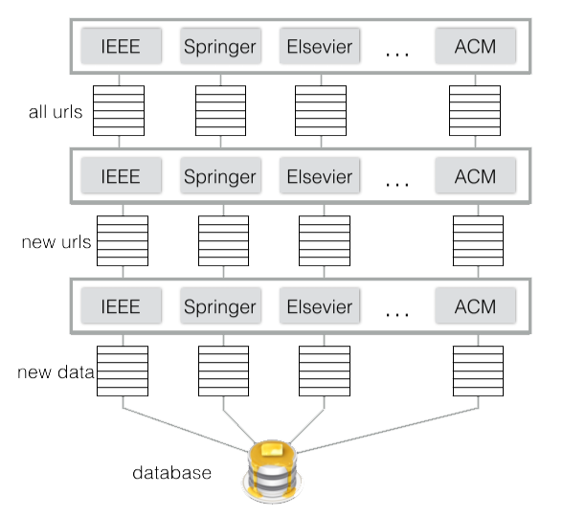
Future Work
More sources
SAO/NASA
Europe PMC
CiteSeerX
…
Automation and Surveillance
Few intervention
Always up to date
Motivation
Hadoop
Distributed
Web Crawler
Current Work
Future Work

Slide 9
Thanks
Q&A

