Slide 1
Indoor Positioning
王子天
School of Electronic Information and Electrical Engineering
SJTU
Notes:
I’m Wang Zitian from the School of Electronic Information and Electrical Engineering. I worked in indoor positioning group in Professor Tian’s lab this semester.

Slide 2
Index
Positioning Methods: Fingerprinting & AOA & TOF
Current Work: Bluetooth positioning with CC2541
Future Work: LE Piconet

Slide 3
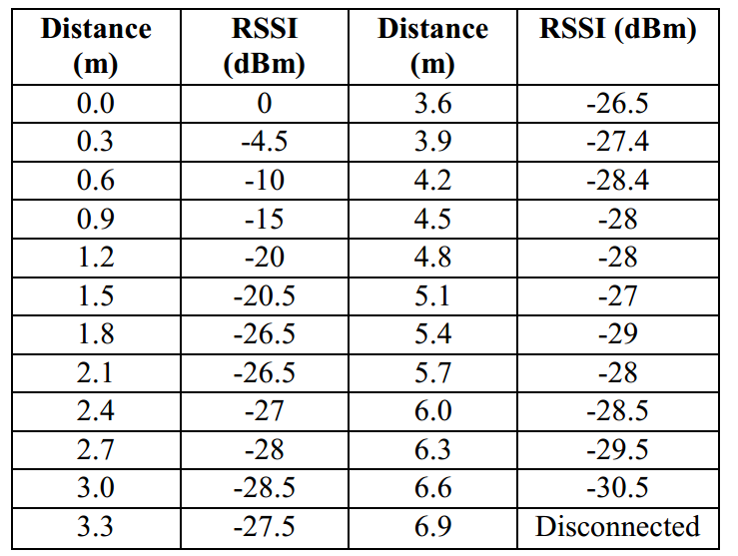
Positioning Methods: Fingerprinting
The RSSI(Received Signal Strength Indication)
&
Distance
Figure 2. A Example of RSSI-Distance Relationship^{[2]}

Slide 4
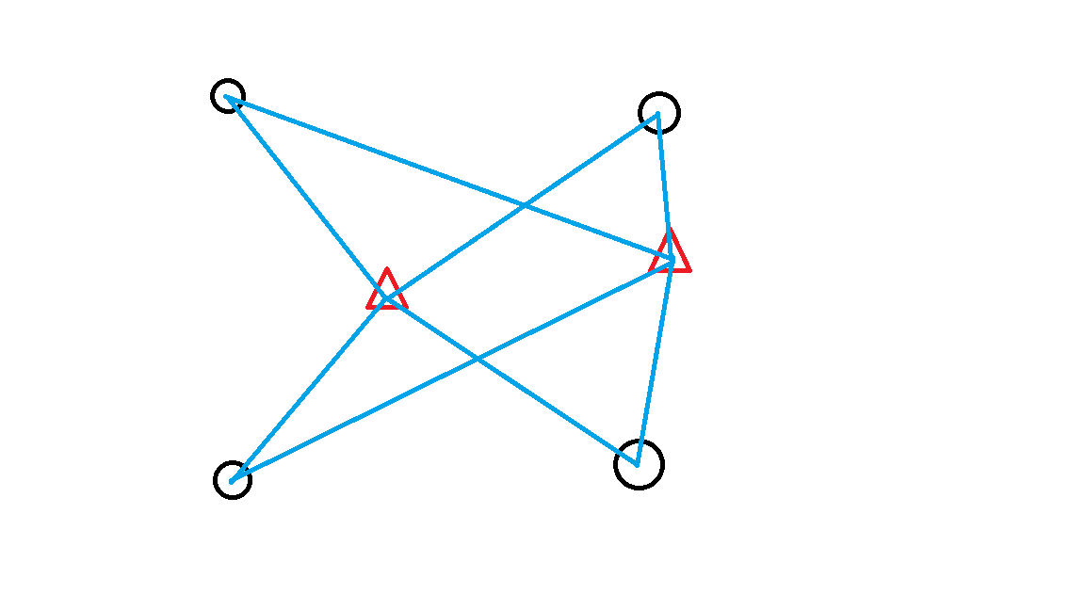
Positioning Methods: Fingerprinting

Slide 5
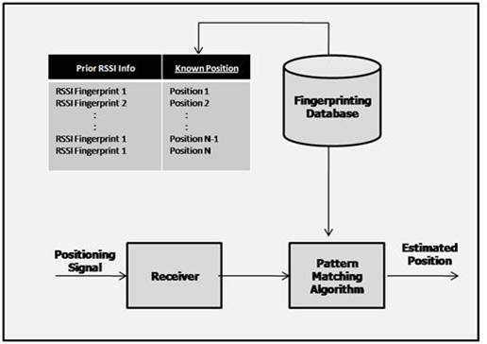
Positioning Methods: Fingerprinting
Figure 1. The Conception of
Fingerprinting
Advantage: Actual distance measurement is not required
Disadvantage: Dependent on the environment

Slide 6
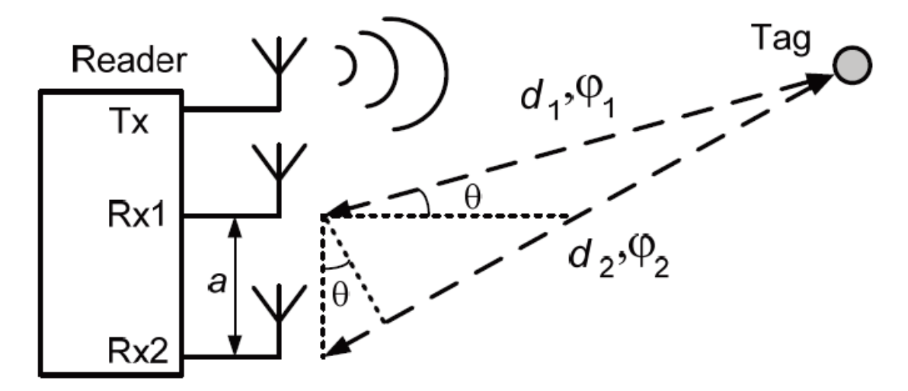
Positioning Methods: AOA
AOA(Angle of Arrival)
Problem: In one wavelength
Solution: LCM^{[3]}

Slide 7
Positioning Methods: TOF
TOF(Time of Flight)^{[3]}
Problem: Time measurement is difficult

Slide 8
Current Work: Whether to use CC2541 for indoor positioning

Slide 9
Current Work: Introduction to CC2541
CC2541: Low Energy and Proprietary System-on-Chip developed by TI
What we are interested in: BLE Radio Module for indoor positioning
Use the above methods to solve the problem

Slide 10
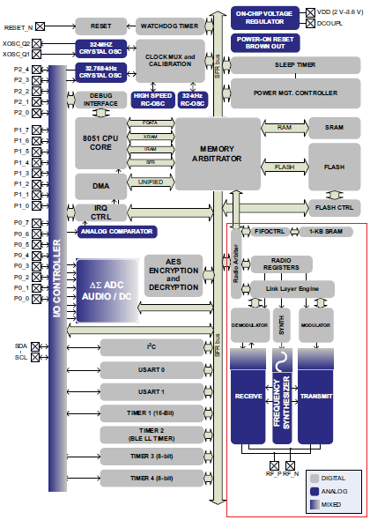
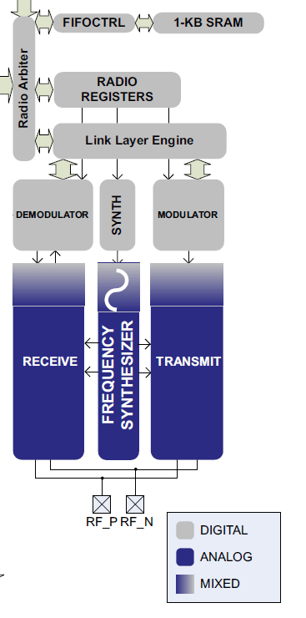
Figure 2. CC2541 and its BLE Radio module

Slide 11
Finding RSSI Interface
The RSSI value is a 8-bit digital value
2s-complement signed number on a logarithmic scale with 1-dB steps
averaging the received power over eight symbol periods (128 μs)

Slide 12
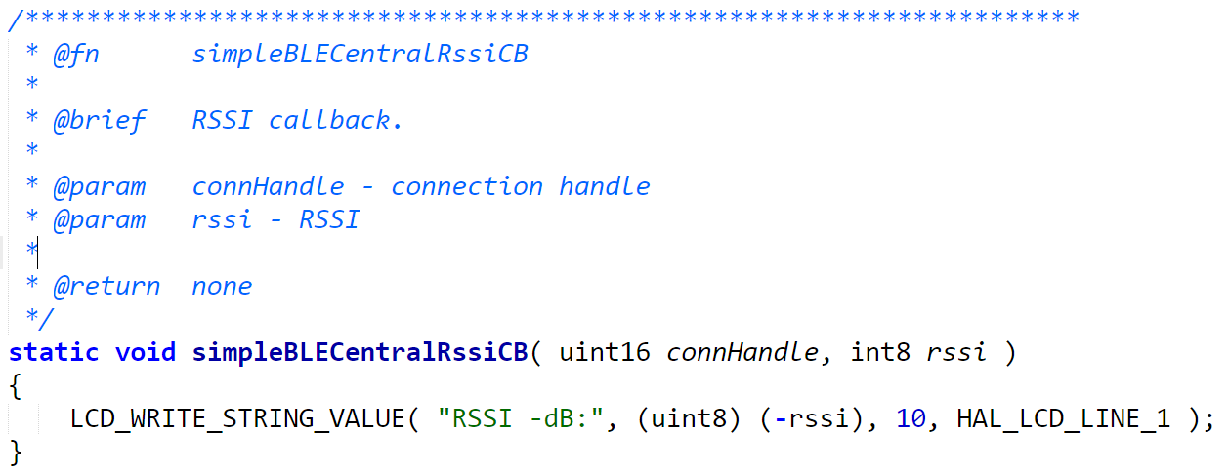
Finding RSSI Interface
RSSI(dBm) Read Function
But this is not enough!

Slide 13
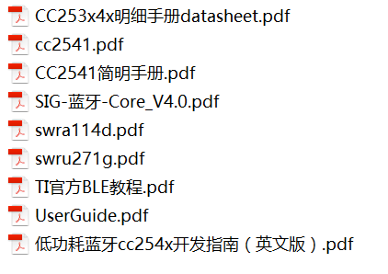
Finding Phase Interface
Search in all the documents that can be found;
Search on the Internet
None!

Slide 14
Future Work
LE Piconet（蓝牙微微网）: The Piconet is an adhoc network which links a wireless user group of devices(10m-100m) using Bluetooth technology protocols
Definition: Build a distribution positioning system

Slide 15
References
[1] Ramsey Faragher and Robert Harle “Location Fingerprinting With Bluetooth Low Energy Beacons,” IEEE JOURNAL ON SELECTED AREAS IN COMMUNICATIONS, VOL. 33, NO. 11, NOVEMBER 2015
[2] Fazli Subhan; Halabi Hasbullah; Azat Rozyyev and Sheikh Tahir Bakhsh “Indoor Positioning in Bluetooth Networks using Fingerprinting and Lateration approach,”
[3] Deepak Vasisht, MIT CSAIL; Swarun Kumar, Carnegie Mellon University; Dina Katabi, MIT CSAIL “Decimeter-Level Localization with a Single WiFi Access Point,” 13th USENIX Symposium on Networked Systems Design and Implementation (NSDI ’16)

Slide 16
Thanks!
Q & A

