Slide 1
Random Graph Connectivity Detection Algorithms & Power-law Random Graph Generation
EE327 Final Representation
Qianyang Peng
F1303025 5130309751

Slide 2
Introduction
This semester I joined in the social network theoretical group of Prof. Wang directed by Ph.D Fu Luoyi and Liu Xiaoyang.
In the group I have mainly involved in some theoretical topics, helped members refine the feasibility of their algorithm and done the implementation work.
This presentation is to introduce what I did and what I learned this semester and to share them with you!

Slide 3
What I have done this semester?
I implemented a NP algorithm for the optimal solution to detect the connectivity of both directed and undirected random graphs.
I implemented an approximation algorithm to calculate the approximate solution to detect the connectivity of a undirected random graph.
I implemented an intuitive linear algorithm to generate a power-law random graph.

Slide 4
Random graphs
A random graph is obtained by starting with a set of n isolated vertices and adding successive edges between them at random.
Representatives
G(n, m)
G(n, p)
G(α, β)
Classic problems
Connectivity, giant component
Dominating set
Connectivity detecting strategy
Our
Concern!

Slide 5
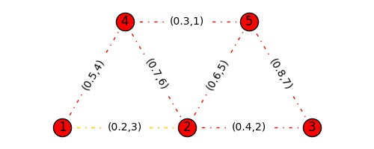
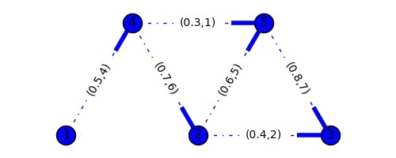
Connectivity between two nodes
Result of such problem have been given in some special cases
What if the graph is both arbitrary in augment and structure?
Fixed structure
Arbitrary augment
Fixed augment
Arbitrary structure

Slide 6
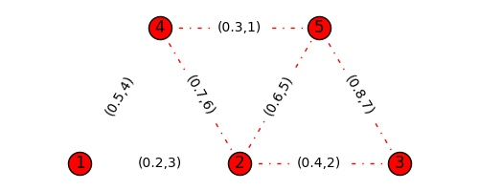
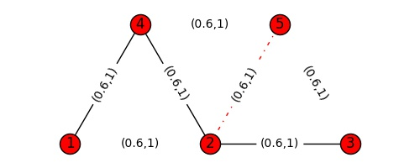
An NP algorithm to calculate the optimal solution
Optimal solution: The detecting strategy that has the minimum expected total cost.
Not the total cost of any one specific test strategy!
Consider this problem recursively:
Let C be the minimum expected total cost.
If the two nodes in the graph has been sure to be connected or unconnected, then C = 0.
Otherwise, C can be calculated by this transformation equation:

Slide 7
An NP algorithm to calculate the optimal solution
Apparently this is having a NP complexity. However:
This is the benchmark algorithm to test other approximated algorithms and helps to testify their approximate ratio.
This is the most intuitive algorithm and gives people direct understanding to this problem.
Recursion:
Much lesser code complexity!
Lots of repeated calculation! Can be solved by hashing graphs into a dictionary.
Cuts can be judged in a graph where every undetected edge considered exist. Paths can be judged in a graph where every undetected edge nothingness.
Can be applied to both directed and undirected graph.
solution
DP
Recursion

Slide 8
The approximation algorithm
The NP algorithm is beautiful, much like the Hanoi recursive algorithm. But it is too time consuming and actually need to look into almost every state of the random graph.
7 edges, 2187 states totally, 2137 states need to be looked into.
Your folder will look like this if you save every snapshots of each state

Slide 9
The approximation algorithm
Luckily we have had a better algorithm. My implementation is based on a feasible approximation algorithm by another group member Fu Xinzhe.
The details of this algorithm is a little complicated and not contained in this PPT, you can ask me afterwards if you are interested.
The time complexity to choose the next edge to test is O(|V||E|(|V|+|E|)), which can be solved in polynomial time.
Main idea of this algorithm is choose the undetected edge whose every unit of cost can achieve the most decrease in the uncertainty of the graph as the next edge to test.

Slide 10
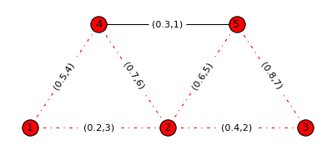
The approximation algorithm
There are some difficulties in this problem that I managed to solve:
How to calculate the number of simple paths between two nodes in a graph?
How to calculate the number of minimal cuts between two nodes in a graph?
How to manage the different property between existing and undetected edges?
npath(1,3)=7
ncut(1,3)=4
npath(1,3)=7
ncut(1,3)=6

Slide 11
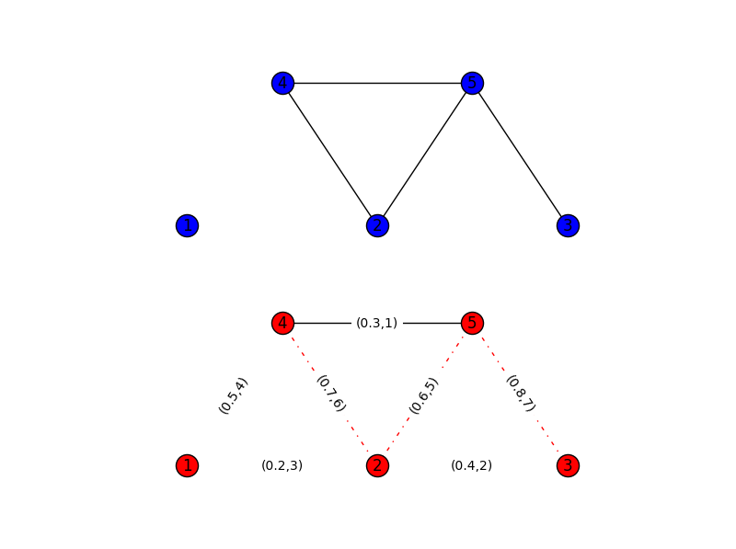
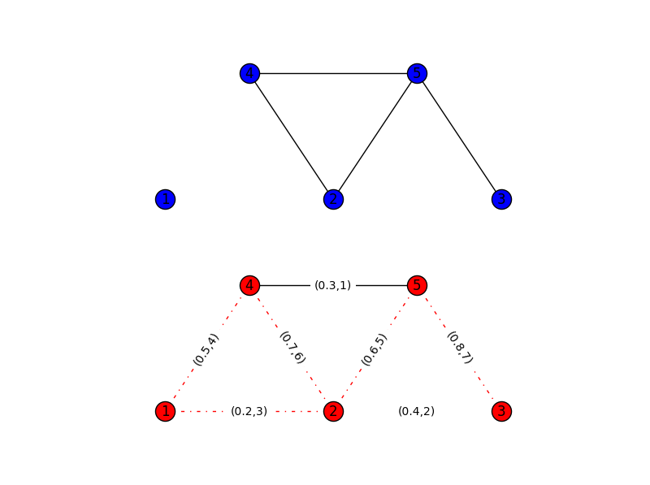
The approximation algorithm
RESULT:
NOT CONNECTED
A cut!

Slide 12
On the generation of a power-law random graph
It is still just a rough idea of mine to find an good algorithm to draw a power-law random graph, and the current algorithms on this problem are either not intuitive or lack randomness. I tried some of my ideas and have had a O(|E|) complexity on generating a graph.
However, it doesn’t fit so well in high degree area. Also finding a neat and clean layout is not a easy work. (i.e. to find a neat and clean distribution of nodes to make it nice in visibility.)
Definitions
Power-law graph: the degree distribution of nodes is within a power-law distribution
G(α,β) is the power law graph whose log(y)=α-βlog(x)
y is the number of nodes whose degree is exactly x

Slide 13
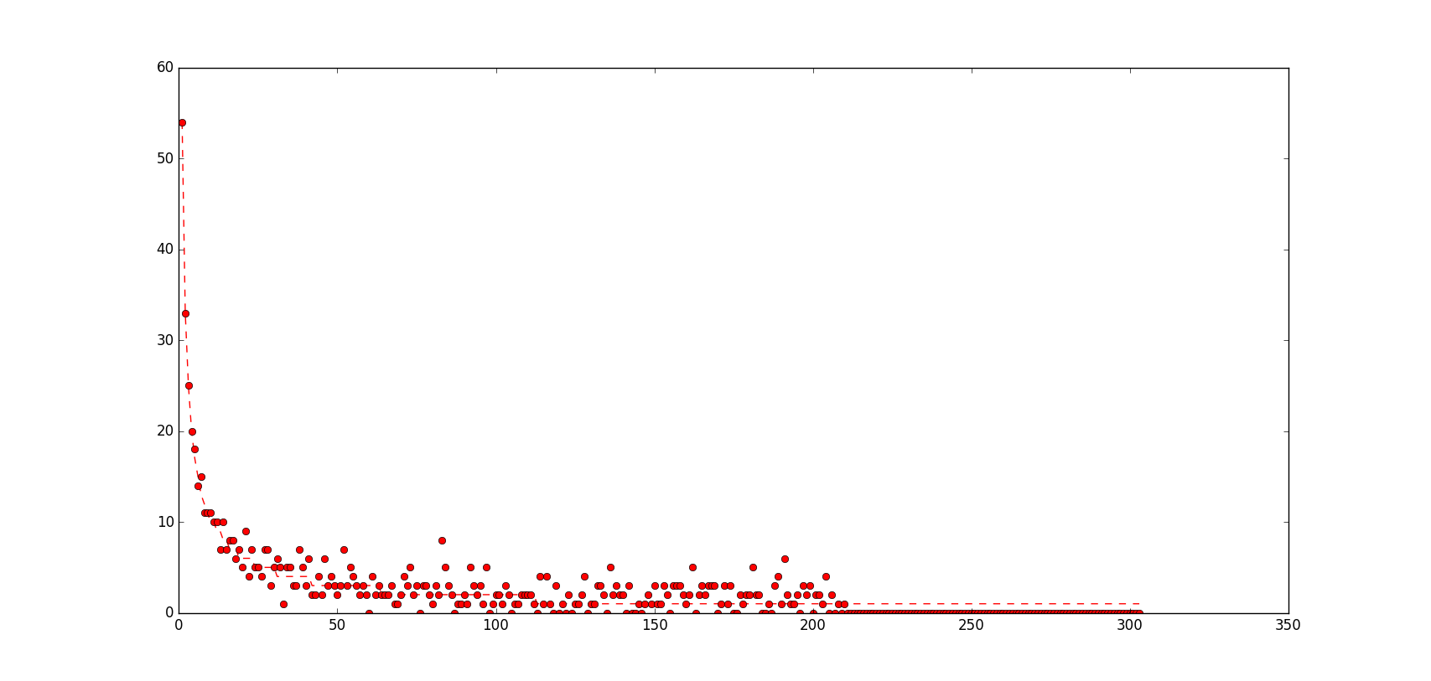
On the generation of a power-law random graph

Slide 14
On the generation of a power-law random graph
Some interesting observations
α=4,β=0.7
Connected
α=4,β=1.5
A giant component
α=4,β=5.5
No giant component

Slide 15
Thank you!
Any question is welcomed!

