Slide 1
Pedometer Placed in the Pocket
Lecturer: Junwei Lu
Notes:
Hello everyone. Today I’ll talk about my work in this semester, which is about pedometer.

Slide 2
Outline
1
Previous Work
3
Pedometer Placed in the Pocket
5
Future Work
Notes:
I’ll introduce my work in three parts, which are:

Slide 3
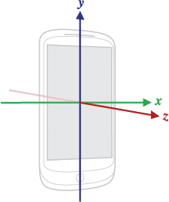
Previous Work
Basic scenario:
The phone is held by hand horizontally.
Basic approach:
Utilize the acceleration on the z-axis.
Detect the peak and valley of the
processed waveform obtained from
the accelerometer.
Notes:
First, let me introduce the previous work that’s done by Zhangjialu et al.

Slide 4
The Preprocess of the Data
The waveform is full of jitter.
Low-pass filter:
y$\left[n\right]=x\left[n\right]×α+y\left[n−1\right]×(1−α)$
Moving average.
$z\left[n\right]=\frac{x\left[n\right]+x\left[n−1\right]+…+x[n−windowSize+1]}{windowSize}$

Slide 5
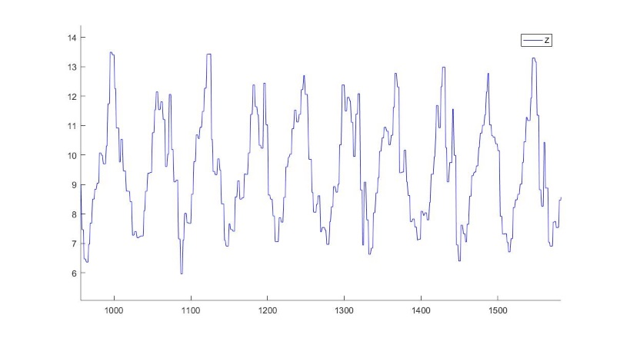
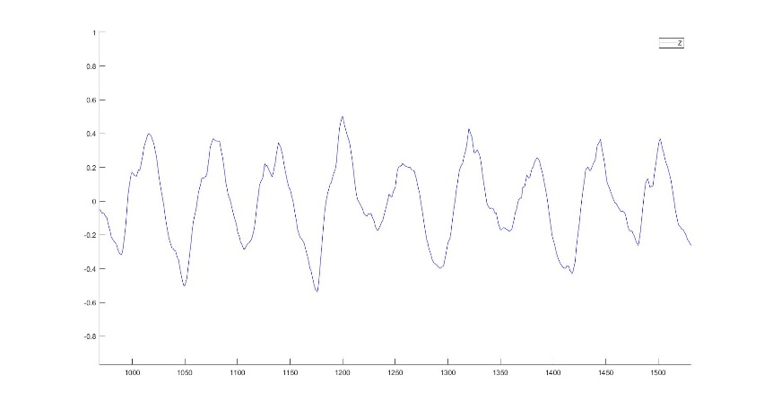
The Preprocess of the Data
Raw data
Processed data

Slide 6
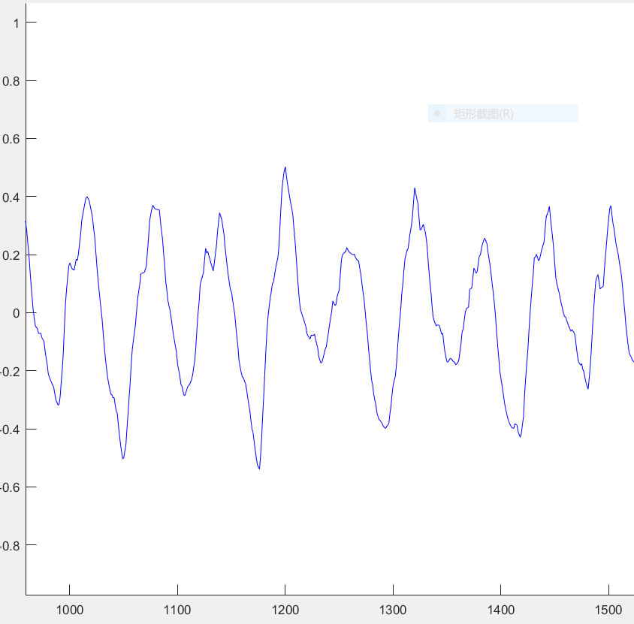
Peak Detection
Temporal threshold
Magnitude threshold

Slide 7
Outline
1
Previous Work
3
Pedometer Placed in the Pocket
5
Future Work

Slide 8
Pedometer Placed in the Pocket
Basic scenario:
The phone or accelerometer is placed in the pocket.
What is the critical indicator of a step?
Rotation of leg!
Utilize gyroscope data.

Slide 9
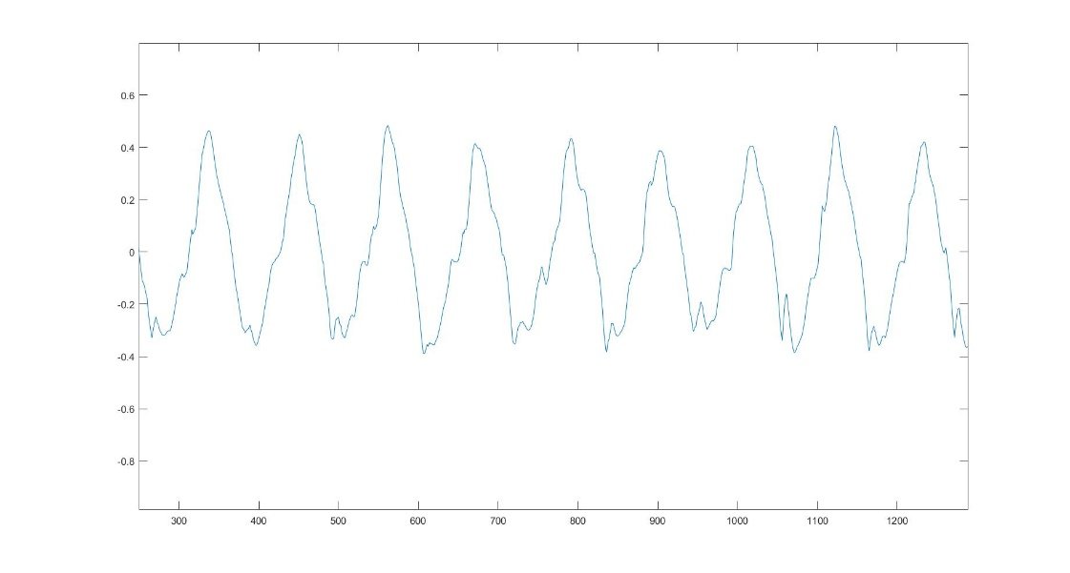
Waveform of Angular Velocity on X-Axis
After walking 50 steps in a constant speed in a straight line, the result returned by the algorithm is 51.

Slide 10
Complex Circumstances
Different people, different rotation magnitude.
Different walking mode.
Temporal threshold and magnitude threshold should be set adaptively!

Slide 11
Adjust Magnitude Thresholds Adaptively
$μ_{a}=\frac{\left|a_{p}\right|+\left|a_{v}\right|}{2}$ , $σ_{a}$ defined as the magnitude standard deviation for the recent K samples.
$t_{a}=$
$\left\{\begin{aligned}peak candidate, \left|a_{n}\right|>max⁡(\left|a_{n−1}\right|,\left|a_{n+1}\right|,μ_{a}+\frac{σ_{a}}{α}) \\ valley candidate, \left|a_{n}\right|<min⁡(\left|a_{n−1}\right|,\left|a_{n+1}\right|,μ_{a}−\frac{σ_{a}}{α}) \\ intermediate sample, otherwise\end{aligned}\right.$

Slide 12
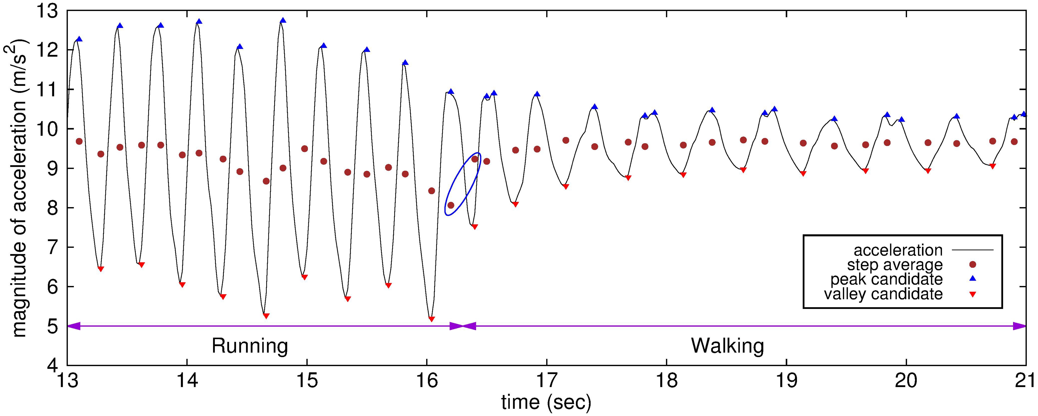
Adjust Magnitude Thresholds Adaptively

Slide 13
Adjust Temporal Thresholds Adaptively
$Th_{p}=μ_{p}−\frac{σ_{p}}{β}$
$Th_{v}=μ_{v}−\frac{σ_{v}}{β}$

Slide 14
Outline
1
Previous Work
3
Pedometer Placed in the Pocket
5
Future Work

Slide 15
Future Work
Finding a good parameter for the adaptive algorithm to achieve high accuracy.
Utilizing the data of other sensors to help judging whether walking and judging the change of device pose.

Slide 16
References
计步器pattern分析, Jialu Zhang, Yucheng Xing.
Step Detection Robust against the Dynamics of Smartphones, Hwan-hee Lee, Suji Choi and Myeong-jin Lee

Slide 17
Thanks！

Slide 18
Q&A

