Slide 1
Software Engineering
Sheng Bin
Shanghai Jiao Tong University
Notes:
Today we will start a new course.

Slide 2
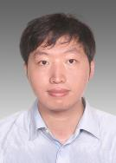
Course Information
Teacher:
Bin Sheng(盛斌)
SEIEE3-511, 15026790946, shengbin@cs.sjtu.edu.cn
Teaching Assistant:
Li XIA(夏立) ziggzagg@sjtu.edu.cn
Project Mentors:
樊增智 谯从彬 夏立 杜皓 殷本俊 裴树炜
Course Website:
http://www.cs.sjtu.edu.cn/~shengbin/course/SE/sesite/home.html

Slide 3
Course Overview
Part A: Software Engineering Concepts
  2. Software Life-Cycle Models
  3. The Software Process
  4. Teams
  5. The Tools of the Trade
  6. Testing
  7. From Modules to Objects
  8. Reusability and Portability
  9. Planning and Estimating

Slide 4
Course Overview
Part B: The Workflows of the Software Life Cycle
  10. Key Material from Part A
  11. Requirements
  12. Classical Analysis
  13. Object-Oriented Analysis
  14. Design
  15. Implementation
  16. Postdelivery Maintenance
  More on UML
  18. Emerging Technologies

Slide 5
Team Projects
Form teams of 3 (± 1?) students
DEADLINE: Sept 28, 2014
After that, teams assigned randomly
Project Ideas:
Pls refer to the project presentation ppt.
No more than two (2) groups working on the same project
One (1) new project allowed
    Email your project idea ASAP, before proposal is due, for feedback.

Slide 6
Project Deliverables
Assignment + Attendance= 30%
Project=70%
Item |  | Due date
Software Engineering | 1. Proposal | Sept 28
 | 2. First report (Specification only) • Part 1 (Statement of Work & Requirements) • Part 2 (Functional Requirements Spec & UI) • Full Report #1 | Oct 31 Oct 31 Oct 31
 | 3. Second report (Design only) • Part 1 (Interaction Diagrams) • Part 2 (Class Diagram and System Architecture) • Full Report #2 | Dec 1 Dec 8 Dec 15
 | 4. First demo | Dec 2 ..
SE Practice | 5. Third report (All reports collated) | Dec 27
 | 6. final demo | Dec 31 ...
 | 7. Electronic Project Archive | Dec 3
Each group will have a mentor to guide the development of the project.

Slide 7
Reference book:
Stephen R Schach, Object Oriented And Classical Software Engineering 8th Edition, McGraw-Hill.
Bruegge & Dutoit: Object-Oriented Software Engineering, Using UML, Patterns and Java, Third Edition, Prentice Hall, 2010.
Sommerville, Ian: Software Engineering,9th Edition, Addison Wesley.
Miles & Hamilton: Learning UML 2.0, O’Reilly Media, 2006. ISBN: 0-596-00982-8
Notes:
Read software written by other peoples
Attention, don’t copy from others
By reading, we should learn how they apply software development to solve the domain problems.
Copying means you steal others intellectual property.
Develop software using the knowledge learned from this course.
We will have some assignments. More importantly, We have another practical course.

Slide 8

Why should we learn SE？
Why should we learn SE?
  Because you are from Computer Science
  SE is the best jobs
    best job of 2011, Career Cast
Best Jobs in America
1. Software engineer
2. College professor
3. Financial advisor
4. Human resources manager
5. Physician assistant
6. Market research analyst
7. Computer/IT analyst
8. Real estate appraiser
9. Pharmacist
10. Psychologist
Money Magazine recently published "Best Jobs in America"
Notes:
1. You should know programming. But it is far from enough. You should know how to develop a complex and relative large software.
2. The strong performance of Software Engineer this year can be attributed to two emerging industries: embedded systems and graphic applications. A proliferation of companies making applications for smartphones and tablets, along with the push to develop "cloud" software hosted entirely online, has made the job market for Software Engineers broader and more diverse.
Analyst [ˈænəlɪst]

Slide 9
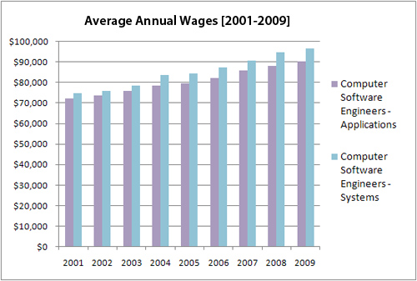
Average Annual Wages
Source: US Department of Labor/Bureau of Labor Statistics (Occupational Employment Surveys)
According to the BLS, software engineering unemployment was 4.6% in 2010, compared to 5.4% for electrical engineers.
Notes:
Wage Reports for Different Careers
Wages of Computer Software Engineer is on the rise during the recent ten years

Slide 10
Software
Q : If you have to write a 10,000 line program in C to solve a problem, how long will it take?
Answers: generally range from 2-4 months
Let us analyze the productivity
  Productivity = output/input resources
  In SW output is considered as LOC
  Input resources is effort - person months; overhead cost modeled in rate for person month
  Though not perfect, some productivity measure is needed, as project has to keep it high

Slide 11
Software …
The productivity is 2.5-5 KLOC/PM
Q: What is the productivity in a typical commercial SW organization ?
A: Between 100 to 2000 LOC/PM
Q: Why is it low, when your productivity is so high? (people like you work in the industry)
A: What the student is building and what the industry builds are two different things

Slide 12
Software…
Students build: student software
Industry builds: industrial strength Systems
What is the difference between
  student software and
  industrial strength software
  for the same problem?

Slide 13
Software…
Student
Developer is the user
  Works for the typical case most of the time
  Bugs are tolerable
  UI not important
  No documentation
Industrial Strength
Others are the users
  Works robustly
  Bugs not tolerated
  UI very important issue
  Documents needed for the user as well as for the organization and the project

Slide 14
Software…
Student
SW not in critical use
Reliability, robustness not important
No investment
Don’t care about portability
Industrial Strength
Supports important functions / business
Reliability , robustness are very important
Heavy investment
Portability is a key issue here

Slide 15
Industrial Strength Software
Student programs != industrial strength software
Key difference is in quality (including usability, reliability, portability, etc.)
  High quality requires heavy testing, which consumes 30-50% of total development effort
  Requires development be broken in stages such that bugs can be detected in each
  Good UI, backup, fault-tolerance, following of stds etc all increase the size for the same functionality

Slide 16
Industrial strength software
If 1/5th productivity, and increase in size by a factor of 2, industrial strength software will take 10 times effort
Brooks thumb-rule: Industrial strength SW costs 10 time more than student SW
In this course, software == industrial strength software

Slide 17
What is software?
Computer programs and associated documentation
Software products may be developed for a particular customer or may be developed for a general market
Software products may be
  Generic - developed to be sold to a range of different customers
  Bespoke (custom) - developed for a single customer according to their specification
Notes:
Software (IEEE) is a collection of
programs,
procedures,
rules, and
associated documentation and data

Slide 18
Software is Expensive
Rough cost estimate…
  Productivity = 500 LOC/PM
  Cost to the company = $10K/PM
  Cost per LOC = $20
  So each line of delivered code costs about $20.
A simple application for a business may have 20KLOC to 50KLOC
  Cost = $100K to $1Million
  Can easily run on $10K-$20K hardware
  So HW costs <<< SW costs.

Slide 19
Software is Expensive…
The HW/SW ratio for a computer system has shown a reversal from the early years.
  In 50s , HW:SW :: 80:20
  In 80s , HW:SW :: 20:80
So, SW is very expensive
  Importance of optimizing HW is not much
  More important to optimize SW

Slide 20
Software is Complex
Complex ≠ complicated
Complex = composed of many simple parts
related to one another
Complicated = not well understood, or explained

Slide 21
Complexity Example:
Scheduling Fence Construction Tasks
Setting posts
[ 3 time units ]
Cutting wood
[ 2 time units ]
Nailing
[ 2 time units for unpainted;
3 time units otherwise ]
Painting
[ 5 time units for uncut wood;
4 time units otherwise ]
Setting posts < Nailing, Painting
Cutting < Nailing
…shortest possible completion time = ?
[ ⇒ “simple” problem, but hard to solve without a pen and paper ]
Notes:
SOURCE: Goodaire & Parmenter, Discrete Mathematics with Graph Theory, Third Edition, Pearson Prentice Hall, 2006. [ Section 11.5, p. 361 ]

Slide 22
More Complexity
Suppose today is Monday, Sept 9, 2013
What day will be on January 3, 2014?
[ To answer, we need to bring the day names and the day numbers into coordination, and for that we may need again a pen and paper ]
Notes:
SOURCE: Hutchins, Cognition in the Wild, The MIT Press, 1995. [ p. 315 ]

Slide 23
Late & Unreliable
20-25% of SW projects never complete
  Because after some time they realize that the final cost will be much higher
Many companies report “runaways”
  Budget & cost out of control
  Consulting companies to help control them
One defense survey found that 70% of the equipment problems are due to SW

Slide 24
Why is SW Unreliable?
SW failures are different from failures of mechanical or electrical systems
  In software, failures are not due to aging related problems
  Failures occur due to bugs or errors that get introduced during development
  The bug that causes a failure typically exists from start, only manifests later

Slide 25
Maintenance
Once SW delivered, it enters maintenance phase
Why is maintenance needed for SW when it does not wear with age?
  Residual errors requiring corrective maintenance
  Upgrades and environment changes – adaptive maintenance
Over SW lifetime, maintenance can cost more than the development cost of SW

Slide 26
What is Software Engineering?
Problem domain discussed before, now we discuss the area of SE
SE (IEEE): systematic approach to development [….] of software
Systematic approach: methodologies and practices that can be used to solve a problem from problem domain

Slide 27

What is SE?
The SWEBOK Knowledge Areas (KAs)
Software requirements
Software design
Software construction
Software testing
Software maintenance
Software configuration management
Software engineering management
Software engineering process
Software engineering tools and methods
Software quality
http://www.computer.org/portal/web/swebok/html/ch1
Notes:
IEEE, is the largest organizations for technical professionals.
They organized a group of experts to summarize the knowledge included in SE.
SWEBOK represents guide to the software engineering Body of Knowledge

Slide 28
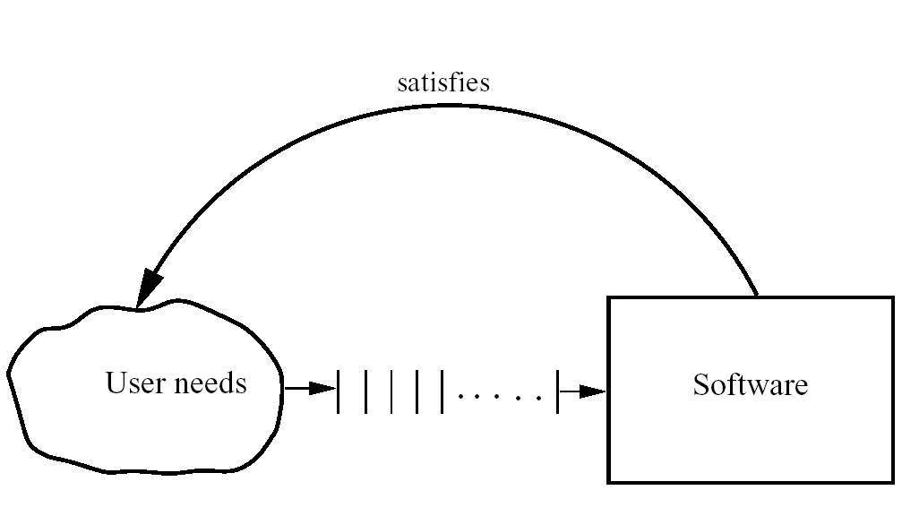
Basic Problem

Slide 29
The Role of Software Engg. (1)
A bridge from customer needs to programming implementation
Customer
Software Engineering
Programmer
First law of software engineering
Software engineer is willing to learn the problem domain
(problem cannot be solved without understanding it first)
Notes:
"You cannot solve it, unless you understand it."

Slide 30
The Role of Software Engg. (2)

Slide 31
Second Law of Software Engineering
Software should be written for people first
  ( Computers run software, but hardware quickly becomes outdated )
  Useful + good software lives log
  To nurture software, people must be able to understand it

Slide 32
Software Engineering Blueprints
Specifying software problems and solutions is like cartoon strip writing
Unfortunately, most of us are not artists, so we will use something less exciting:
UML symbols
However …

Slide 33
What is software engineering?
Software engineering is an engineering discipline which is concerned with all aspects of software production
Software engineers should
  adopt a systematic and organised approach to their work
  use appropriate tools and techniques depending on
    the problem to be solved,
    the development constraints and
    the resources available

Slide 34
What is the difference between software engineering and computer science?
Computer Science
Software Engineering
is concerned with
theory
fundamentals
the practicalities of developing
delivering useful software
Computer science theories are currently insufficient to act as a complete underpinning for software engineering ☹ ☹ ☹
Notes:
Software Engineering vs. Computer Science
Computer science is concerned with theory and fundamentals; software engineering is concerned with the practicalities of developing and delivering useful software
Computer science theories are currently insufficient to act as a complete underpinning for software engineering

Slide 35

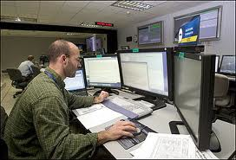
Computer Scientist
  Proves theorems about algorithms, designs languages, defines knowledge representation schemes
  Has infinite time…
Engineer
  Develops a solution for an application-specific problem for a client
  Uses computers & languages, tools, techniques and methods
  Has finite (usually not enough) time…
Software Engineer
  Works in multiple application domains
  Has only 3 months...
  …while changes occurs in requirements and available technology
Notes:
Theorem /ˈθɪərəm/
Finite [ˈfaɪnaɪt]
A computer scientist assumes that techniques, methodologies and tools are to be developed. They investigate in designs for each of these weapons, and prove theorems that specify they do what they are intended to do. They also design languages that allow us to express techniques. To do all this, a computer scientist has available an infinite amount of time.
A software engineering views these issues as solved. The only question for the software engineer is how these tools, techniques and methodologies can be used to solve the problem at hand. What they have to worry about is how to do it under the time pressure of a deadline. In addition they have to worry about a budget that might constrain the solution, and often the use of tools. Good software engineering tools can cost up to a couple of $10,000 Dollars (Galaxy, Oracle 7, StP/OMT)

Slide 36
What is the difference between software engineering and system engineering?
System engineering is concerned with all aspects of computer-based systems development including hardware, software and process engineering
Software engineering is part of this process
System engineers are involved in
system specification, architectural design, integration and deployment

Slide 37
What is a software process?
A set of activities whose goal is the development or evolution of software
Generic activities in all software processes are:
  Specification - what the system should do and its development constraints
  Development - production of the software system
  Validation - checking that the software is what the customer wants
  Evolution - changing the software in response to changing demands

Slide 38
What are the costs of software engineering?
Roughly 60% of costs are development costs, 40% are testing costs. For custom software, evolution costs often exceed development costs
Costs vary depending on the type of system being developed and the requirements of system attributes such as performance and system reliability
Distribution of costs depends on the development model that is used

Slide 39
What are the attributes of good software?
The software should deliver the required functionality and performance to the user and should be maintainable, dependable and usable
Maintainability
  Software must evolve to meet changing needs
Dependability
  Software must be trustworthy
Efficiency
  Software should not make wasteful use of system resources
Usability
  Software must be usable by the users for which it was designed

Slide 40
What are the key challenges facing software engineering?
Software engineering in the 21st century faces three key challenges:
Legacy systems
  Old, valuable systems must be maintained and updated
Heterogeneity
  Systems are distributed and include a mix of hardware and software
Delivery
  There is increasing pressure
  for faster delivery of software

Slide 41
Professional and ethical responsibility
Software engineering involves wider responsibilities than simply the application of technical skills
Software engineers must behave in an honest and ethically responsible way if they are to be respected as professionals
Ethical behaviour is more than simply upholding the law

Slide 42
Thanks shengbin@cs.sjtu.edu.cn
Notes:
Break

